Slide 1


NON-WSQ COURSE • C436
Version 4.0 · 9 Nov 2026 · Claude + Higgsfield edition
Agentic AI for
Video Creation
Tertiary Infotech Academy Pte Ltd
UEN: 201200696W
www.tertiarycourses.com.sg | enquiry@tertiaryinfotech.com | +65 6100 0613
© Tertiary Infotech Academy Pte Ltd

Slide 2





INTRODUCTION
About the Trainer
Qualifications: ____________________________________________
Expertise: _________________________________________________
[ Trainer Name ]
[ Title / Role ]
Experience: ________________________________________________
Contact / Profile: __________________________________________
© Tertiary Infotech Academy Pte Ltd
Agentic AI for Video Creation · C436
2

Slide 3



INTRODUCTION
About the Trainer
PhD-qualified trainer specialising in AI, software engineering and developer tooling.
Builds agentic AI video and content pipelines with Claude, Higgsfield and Codex.
Dr. Alfred Ang
AI Trainer & Engineer
Trains professionals across Singapore on practical, project-based AI skills.
Certifications: PMP, AWS, Microsoft, CompTIA, CKA, CKAD.
linkedin.com/in/angchewhoe
github.com/alfredang
© Tertiary Infotech Academy Pte Ltd
Agentic AI for Video Creation · C436
3

Slide 4




INTRODUCTION
Let's Know Each Other
Take a minute to introduce yourself to the class:
Your name & role
What you do day to day
Your coding experience
What you want from this course
© Tertiary Infotech Academy Pte Ltd
Agentic AI for Video Creation · C436
4

Slide 5






HOUSEKEEPING
Ground Rules
Phones on silent
Participate actively
Mutual respect
Step out quietly for calls or breaks.
No question is stupid — ask freely.
Agree to disagree; one conversation at a time.
Be punctual
Full attendance
Stay hands-on
Return from breaks on time.
Attend every session to get the most from the course.
Follow along with every activity.
© Tertiary Infotech Academy Pte Ltd
Agentic AI for Video Creation · C436
5

Slide 6
THE SCENARIO
Kopi & Coins: One Studio, One Story
A Singapore studio making 60-second money stories for young working adults. You are its new AI video producer.
01
02
03
04
Set up
Plan
Make
Scale
Claude Desktop gets five video skills, the Higgsfield connector and a project; Claude installs LahLah Video. Lab 1.
Claude writes the brief and script, reviews it for edits, and builds a storyboard you approve, standards and a plan. Labs 2-3.
Claude drives Higgsfield to shoot Episode 1, "The Rainy-Day Tin"; you cut and fix it in LahLah Video. Labs 4-5.
Your own compliance skill, then a mini capstone: a short film of your own, from idea to a private upload. Labs 6-7.
© Tertiary Infotech Academy Pte Ltd
Agentic AI for Video Creation · C436
6

Slide 7
THE SCENARIO
Meet the Cast
The same people in every episode — so character consistency is a business requirement.
Priya Nair — founder
Rachel Tan, 29
Ah Ma, 74
Your boss. Sets the studio rules and approves every episode.
Marketing executive, new to money planning. Round glasses, mustard cardigan.
Rachel's grandmother. Kept the family savings in labelled envelopes.
Daniel Lim, 30
The blue tin
You
Rachel's colleague, who spends every bonus the day it lands.
The series symbol: same tin, same dent, same labels every time.
The studio's new AI video producer — you direct the agents.
© Tertiary Infotech Academy Pte Ltd
Agentic AI for Video Creation · C436
7

Slide 8
ROADMAP
Course Outline
Three topics over two days. Each ends in labs that move the studio forward.
01
02
03
T1 · Creative Strategy
T2 · Editing, Storytelling and QA
T3 · Workflow, Compliance, Emerging Tech
AI's impact on video, Higgsfield basics (cast, sets, Cinema Studio, Supercomputer), storytelling, your Claude studio, the Ah Ma demo, standards and work plans. Labs 1-3.
The production run through Claude, camera presets, low-res drafts, a case study, story and technical review in LahLah Video. Labs 4-5.
Claude Skills, industry standards, remedial actions, publishing, emerging tech, adoption and your capstone short film. Labs 6-7.
© Tertiary Infotech Academy Pte Ltd
Agentic AI for Video Creation · C436
8

Slide 9
ROADMAP · HANDS-ON
Lab Materials
Seven labs, each in its own folder: a README (PDF), a prompt page, prompts (PDF), mock assets and an evidence checklist.
DAY
LAB
AGENT
YOU MAKE
1
1 · Set Up Your Claude Video Studio
Claude Desktop
Your Claude studio
1
2 · Plan the Story with Claude and the Storytelling Skill
Claude Desktop
Brief, script, review
1
3 · Storyboard Artifact, Editing Standards and Work Plan
Claude Desktop
Storyboard, standards, plan
1
4 · Create Episode 1 with Claude and Higgsfield
Claude Desktop
Episode 1 clips
2
5 · Edit, Review and Refine in LahLah Video
LahLah Video (or CapCut)
Episode 1 v1 → v2
2
6 · Build a Compliance Skill and Plan Remedial Actions
Claude Desktop
Compliance skill, fixes
2
7 · Mini Capstone: Your Own Short Film, Idea to Upload
Claude Desktop
Your own short film
TIP The labs build on each other: Lab 4 shoots the storyboard you approve in Lab 3; Lab 7 reuses every skill from Labs 1 and 6.
© Tertiary Infotech Academy Pte Ltd
Agentic AI for Video Creation · C436
9

Slide 10
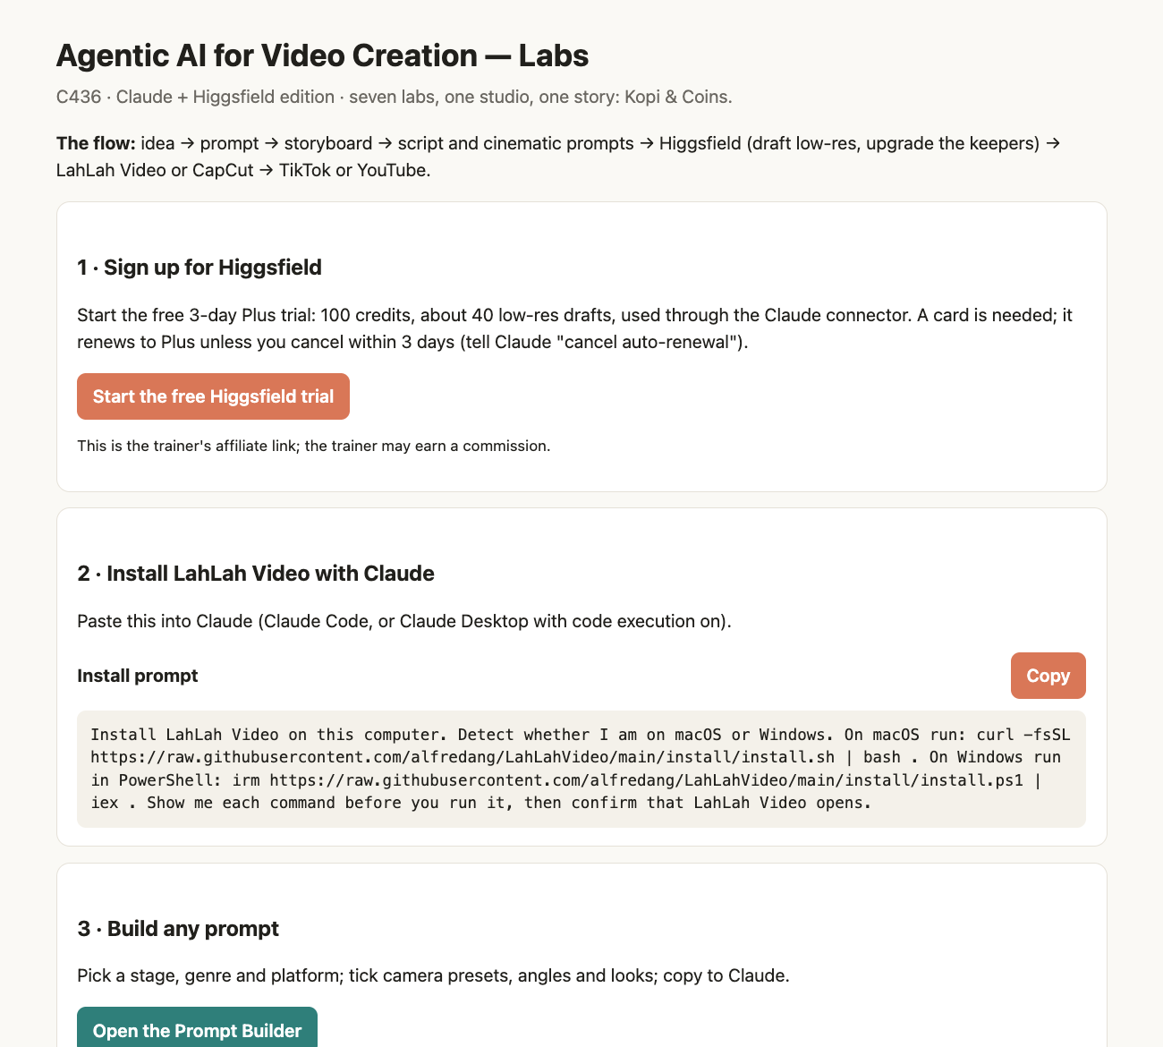
ROADMAP · HANDS-ON
The Labs Home Page: Sign Up, Install, Build a Prompt
labs/index.html — open it first. Everything a lab needs is one click away.
1 · Sign up for Higgsfield
The course link; the free 3-day trial works through Claude.
2 · Install LahLah Video
Copy one prompt into Claude; it installs the editor for Mac or Windows.
3 · Build any prompt
The Prompt Builder: stage, genre, platform, camera presets.
The seven labs
Each row opens that lab's prompt page and its PDF guide.
© Tertiary Infotech Academy Pte Ltd
Agentic AI for Video Creation · C436
10
Notes:
The labs home page is the first file learners open. It links the Higgsfield sign-up, the one-prompt LahLah Video install, the Prompt Builder and each lab's prompt page and guide.

Slide 11
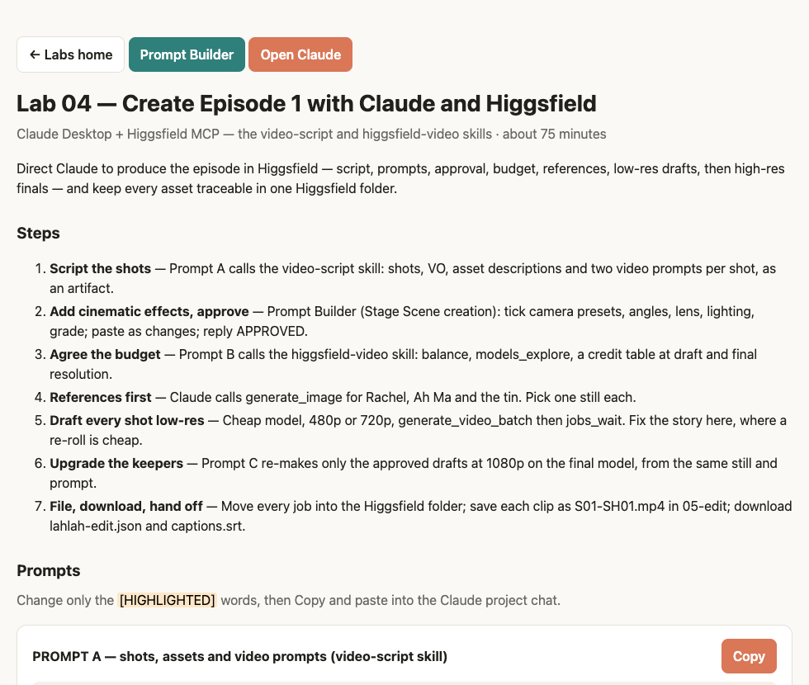
ROADMAP · HANDS-ON
Every Lab Has a Prompt Page with One-Click Copy
lab-NN/prompts.html — the steps, every prompt and the checks, in your browser.
Steps first
The whole lab on one screen, in order.
Copy, then paste into Claude
Each prompt has its own Copy button and a "Copied" confirmation.
Change only the highlights
[HIGHLIGHTED] words are yours to edit; the rest makes the prompt work.
Open Claude
One button starts a new chat; Prompt Builder is one click away.
© Tertiary Infotech Academy Pte Ltd
Agentic AI for Video Creation · C436
11
Notes:
Each lab folder has a prompt page: the steps, every prompt with its own Copy button, the checks, and buttons for Claude and the Prompt Builder. Learners change only the highlighted words.

Slide 12
SCHEDULE
Lesson Plan (9:30 AM – 5:30 PM)
One 30-minute lunch (Day 1 at 12:30, Day 2 at 12:25). Full timings and slide numbers are in the Lesson Plan.
BLOCK
DAY 1 — PLAN AND MAKE
DAY 2 — REFINE AND SCALE
Morning 1
9:30–11:00 Welcome · AI video today · Higgsfield basics
9:30–10:50 Recap · Topic 2 (parameters, editor)
Morning 2
11:00–12:30 Story principles · Lab 1 · Ah Ma demo
10:50–12:25 Lab 5 · Topic 2 recap
Afternoon 1
1:00–3:20 Lab 2 · standards, work plans · Lab 3
12:55–3:35 Topic 3 (skills, standards) · Lab 6
Afternoon 2
3:20–5:30 Topic 2 (production run) · Lab 4 · case study
3:35–5:30 Publishing · Lab 7 capstone · ethics, summary
TIP Refreshments are available through the day; take them during lab time.
© Tertiary Infotech Academy Pte Ltd
Agentic AI for Video Creation · C436
12

Slide 13
TOPIC 1
Creative Strategy and End-to-End Video Production with Agentic AI
1
AI is remaking video: movies, micro-dramas, singers, influencers, ads
2
Higgsfield basics: cast, sets and props, Cinema Studio, Supercomputer
3
Storytelling principles, then Claude directs Higgsfield: the Ah Ma demo
4
Quality issues, script review, standards and work plans
© Tertiary Infotech Academy Pte Ltd
Agentic AI for Video Creation · C436
13

Slide 14
TOPIC 1 · HISTORY OF AI
A Short History of AI (1950–2017)
The Turing test
"Artificial intelligence"
Deep Blue
Deep learning
The Transformer
1950
1956
1997
2012
2017
Alan Turing asks "Can machines think?" and proposes the imitation game.
The Dartmouth workshop names the field. Rules and logic dominate for decades.
IBM's chess computer beats world champion Garry Kasparov — search, not learning.
AlexNet wins ImageNet. Neural networks learn from data and GPUs make them fast.
"Attention Is All You Need" — the architecture behind every modern language model.
Each era changed what a computer could do on its own: follow rules, search, learn, then understand language.
© Tertiary Infotech Academy Pte Ltd
Agentic AI for Video Creation · C436
14
Notes:
Artificial intelligence began as a question — can machines think? — and moved from hand-written rules, to search, to systems that learn from data. Two breakthroughs made today's tools possible: deep learning (2012), which let neural networks learn from millions of examples, and the Transformer (2017), the architecture behind every large language model.

Slide 15
TOPIC 1 · HISTORY OF AI
From Chatbots to Video Agents (2022–2026)
ChatGPT
Multimodal AI
Video models
Agentic AI
AI agents
2022
2023
2024
2025
2026
Generative AI goes mainstream: ask in plain English, get an answer.
Models read and make images; text-to-video tools produce the first short clips.
Realistic text-to-video previews; minutes of consistent motion become possible.
Models plan, call tools and check their own work — coding agents lead the way.
Agents call tools such as Higgsfield through MCP connectors and run whole video workflows.
Years show when each practice took hold. For video, the shift is from a tool you operate to an agent you direct.
© Tertiary Infotech Academy Pte Ltd
Agentic AI for Video Creation · C436
15
Notes:
ChatGPT made generative AI an everyday tool in 2022. Models then learned to see and make images and video. From 2025 models began to plan, use tools and check their own work — agentic AI. By 2026 an agent such as Claude can call a video platform such as Higgsfield through an MCP connector and run a whole production under human direction.

Slide 16
TOPIC 1 · HISTORY OF AI
How AI Changed Video Production
The same job — a 60-second video — done four ways.
STAGE
WHO DOES THE WORK
WHAT YOU CONTROL
Editing software
You shoot, cut, colour and caption every frame by hand.
Everything — and you do everything.
Generative clips
A model makes a 5-10 second clip from a prompt; you assemble the rest.
One prompt per clip; consistency is hard.
Video agent
One agent writes, storyboards, generates and edits in a single project.
The brief and the checkpoints — you direct.
Multi-agent studio
A team of agents researches, writes, makes, reviews and schedules.
The roles, the gates and the final approval.
TIP This course walks the last three rows: one agent (T1), a video agent (T2), a multi-agent studio (T3).
© Tertiary Infotech Academy Pte Ltd
Agentic AI for Video Creation · C436
16

Slide 17
TOPIC 1 · IMPACT OF AI
Two in Three New Micro-Dramas Are Now Made by AI
In nine months AI went from novelty to default for short drama, and it is already selling songs, faces and ads.
2 in 3
$3M
€10k
25M
Micro-dramas, Q3 2026
An AI singer signs
An AI model's best month
People on Higgsfield
Share of vertical dramas released outside China on 20 top apps that were AI-generated. Q1: 3%. Q2: 28%.
Hallwood Media's deal for Xania Monet, an AI R&B voice made with Suno, after her songs reached Billboard charts.
What Aitana López, created by Barcelona agency The Clueless, can earn from brand work.
Creators on one AI video platform, with 850 million generations made.
Owl & Co., via The Hollywood Reporter
Billboard, Sept 2025
Business Insider, Nov 2023
Higgsfield, Nov 2026
TIP The crew shrinks to you and an agent. What stays human: the story, the taste and the sign-off.
© Tertiary Infotech Academy Pte Ltd
Agentic AI for Video Creation · C436
17
Notes:
Open with the numbers. Owl & Co. counted vertical-drama releases on 20 top apps outside China: AI-generated titles went from 3% in the first quarter of 2026 to 28% in the second and two-thirds in the third. Xania Monet, an AI R&B voice whose music is made on Suno, signed with Hallwood Media for a reported $3 million in September 2025. The Clueless says its AI model Aitana López earns up to €10,000 a month. Higgsfield reports 25 million users. The point for learners: the crew has shrunk to one person and an agent, so story, taste and approval are now the scarce skills.

Slide 18
TOPIC 1 · USE CASES
Five Ways People Already Get Paid for AI Video
Every row is a real, named example. Watch one example of each in the next two slides.
USE CASE
WHAT GETS MADE
NAMED EXAMPLE
ON HIGGSFIELD
AI movie
A multi-minute short film with a world and a recurring cast.
PLANET HELL: a 5:15 sci-fi short on Seedance 2.5 (Theoretically Media, 2026).
Cinema Studio, Seedance 2.5
AI micro-drama
1-2 minute vertical episodes, each ending on a hook.
The Great and Powerful Genie on ReelShort, the top AI micro-drama of Q3 2026.
Supercomputer, Cinema Studio
AI singer
A generated voice, face and music video.
Xania Monet: music made on Suno, a $3M record deal, a Billboard airplay chart entry.
Audio models, lip-synced video
AI influencer
One persona who posts daily without a photo shoot.
Aitana López (The Clueless, Barcelona): up to €10,000 a month as a model.
AI Influencer
AI marketing video
UGC-style product ads, in many versions, in minutes.
Ads made in Higgsfield Marketing Studio (the Short on the next slide but one).
Marketing Studio, Supercomputer
TIP Wherever a face, a voice or a song appears, check the rights and label the AI. The law comes later in Topic 1.
© Tertiary Infotech Academy Pte Ltd
Agentic AI for Video Creation · C436
18
Notes:
Five use cases, each with a named example: an AI short film (PLANET HELL), an AI micro-drama (ReelShort's The Great and Powerful Genie), an AI singer (Xania Monet), an AI influencer (Aitana López) and AI marketing videos (Higgsfield Marketing Studio). Ask learners which one their own organisation could use first. Point out the rights question on every row: faces, voices and songs need permission, and AI content needs a label.

Slide 19
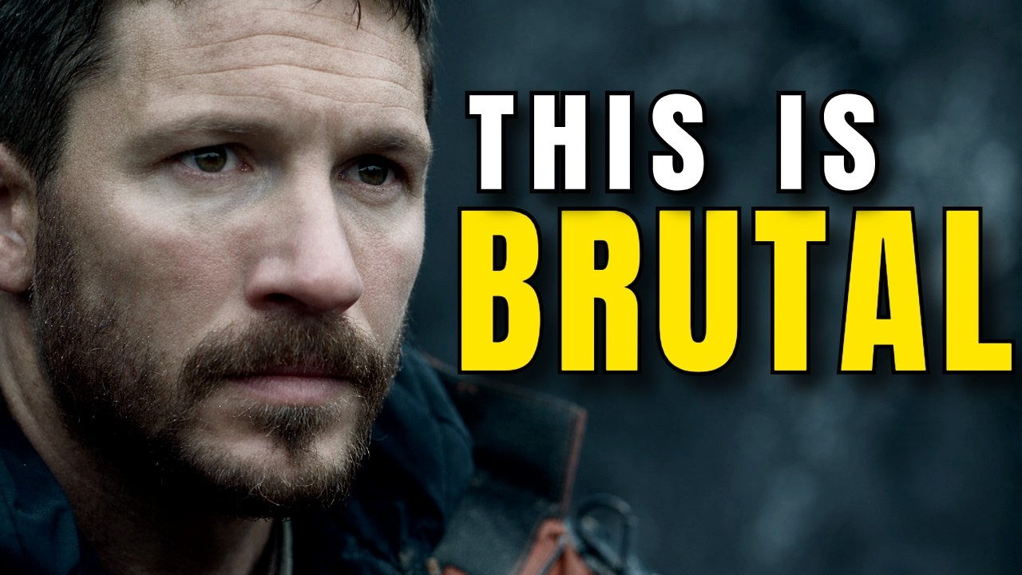
TOPIC 1 · USE CASES
PLANET HELL: Five Minutes of Sci-Fi, No Camera, No Crew
Theoretically Media grew an AI trailer made in Veo 3.1 into a 5:15 short on Seedance 2.5 (YouTube, 2 Nov 2026).
A series, not a clip
The channel calls it an ongoing series about a prison planet. A world you can return to is the business model.
Two models, one look
Trailer in Veo 3.1, film in Seedance 2.5, the model Higgsfield bills as its most advanced.
Watch like an editor
Count the cuts. Spot where a face or costume drifts. Guess what each shot cost.
▶ Open in YouTube
Video: Theoretically Media, 2 Nov 2026 (5:15). Click Enable Content, then click the video in Slide Show.
© Tertiary Infotech Academy Pte Ltd
Agentic AI for Video Creation · C436
19
Notes:
Theoretically Media's PLANET HELL (YouTube, 2 Nov 2026, 5:15) expands an AI trailer first made in Veo 3.1 into a short film made with Seedance 2.5. Play two minutes. Ask learners to watch as editors: count the cuts, spot any drift in faces or costumes, and estimate the credits. This is a long video, shown at the trainer's request as the AI-movie example; learners do not need to watch the rest.

Slide 20




TOPIC 1 · USE CASES
Drama, Influencer, Singer, Ad: Four Shorts Made With AI
Click each one in Slide Show and ask: what would this have cost with a camera crew?
▶ Open in YouTube
▶ Open in YouTube
▶ Open in YouTube
▶ Open in YouTube
AI micro-drama
AI influencer
AI singer
AI marketing video
The Healer's Refusal: a Chinese micro-drama, AI-generated end to end.
A creator builds a persona in Higgsfield AI Influencer Studio.
An AI cover of "Pretty Little Baby". Who owns this song?
UGC-style ads from Higgsfield Marketing Studio.
Shorts: Fast Learning Videos, Shafin Tech, Ai Music Sunny, AI Tech Pro (YouTube). Click Enable Content, then click a video in Slide Show.
© Tertiary Infotech Academy Pte Ltd
Agentic AI for Video Creation · C436
20
Notes:
Four YouTube Shorts, one per use case: a Chinese AI micro-drama (The Healer's Refusal), an influencer built in Higgsfield AI Influencer Studio, an AI cover of "Pretty Little Baby" (use it to ask who owns a song an AI sings) and UGC-style ads from Higgsfield Marketing Studio. Click Enable Content first, then click each Short in Slide Show.

Slide 21
TOPIC 1 · USE CASES
How a Micro-Drama Episode Works
Lessons from a full AI micro-drama workflow (Isa does AI, 2026).
01
02
03
04
05
06
Lock the face
Pick a direction
Cast for the twist
Five quick beats
Fix only what broke
End on a hook
Approve a reference still before any shot.
Ask for three story openings; choose one and steer.
Every character exists to set up the payoff.
A 60-90 second arc with one clear reveal.
Re-roll the bad drafts; keep the good ones.
Micro-drama apps sell the next episode: close on a question.
© Tertiary Infotech Academy Pte Ltd
Agentic AI for Video Creation · C436
21

Slide 22
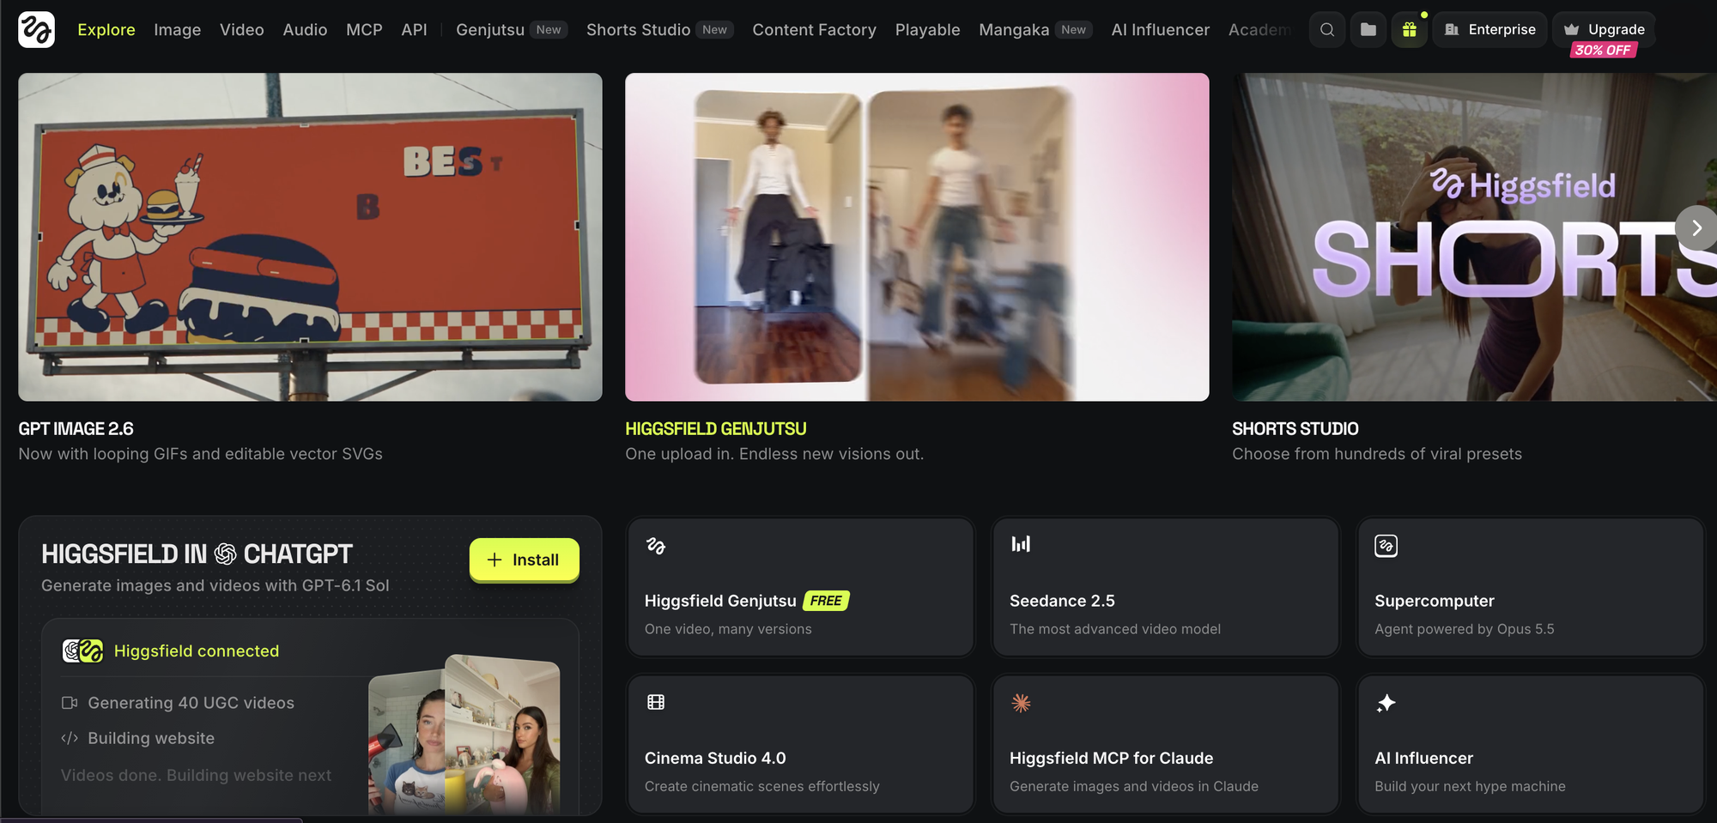
TOPIC 1 · MEET HIGGSFIELD
Higgsfield: Every Top Video Model Behind One Login
higgsfield.ai, 8 Nov 2026: 25 million users and 850 million generations. Your studio for the next two days.
Cinema Studio 4.0
Shoot a scene with a virtual camera, lens, lighting rig and colour palette.
Supercomputer
Higgsfield's own chat agent, "powered by Opus 5.5": it plans a shoot and generates it.
Seedance 2.5 and friends
Kling, Veo, Seedance and Genjutsu (free on the home page) under one credit balance.
MCP for Claude
The connector that lets Claude Desktop drive all of it. You add it in Lab 1.
© Tertiary Infotech Academy Pte Ltd
Agentic AI for Video Creation · C436
22
Notes:
Higgsfield puts many image, video and audio models behind one account and one credit balance. The home page (8 Nov 2026) leads with Cinema Studio 4.0, Supercomputer (an agent "powered by Opus 5.5"), Seedance 2.5, Genjutsu, AI Influencer and the Higgsfield MCP for Claude. Learners try the website first, then drive it from Claude after Lab 1.

Slide 23
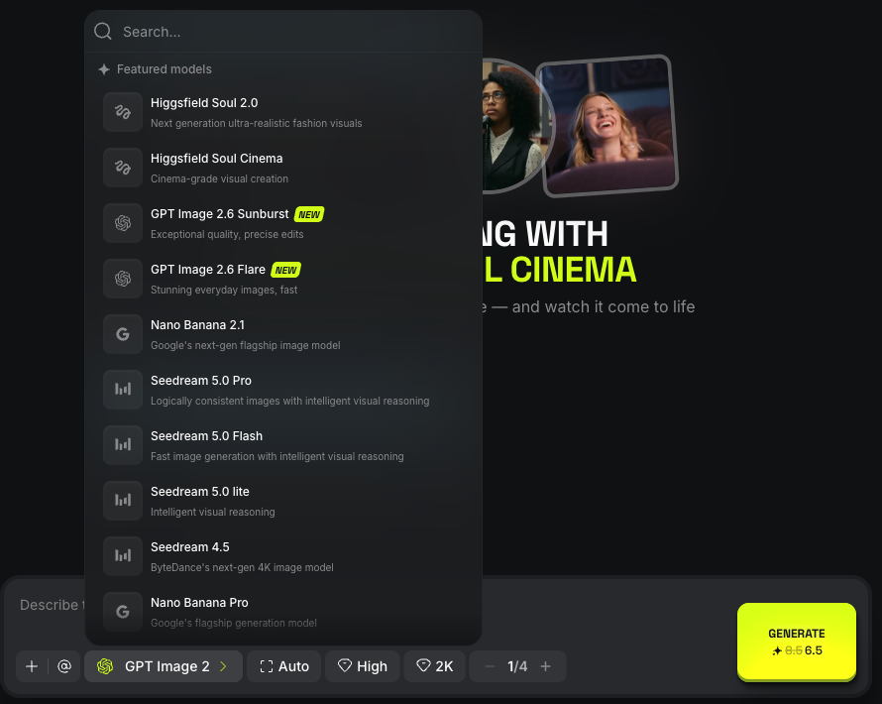
TOPIC 1 · MEET HIGGSFIELD
Pick the Model for the Job
The image model list on higgsfield.ai (8 Nov 2026). Claude reads the same roster with models_explore.
Higgsfield Soul 2.0
Photoreal people for character references — 0.125 credits a still.
Nano Banana, GPT Image, Seedream
Strong all-rounders for props, places and product shots.
Video models
Seedance 2.0 Mini for cheap drafts with sound; Kling 3.0 Turbo or Seedance 2.5 for finals.
Let Claude choose
"Recommend a draft model and a final model for a 9:16, 5-second shot."
© Tertiary Infotech Academy Pte Ltd
Agentic AI for Video Creation · C436
23
Notes:
Higgsfield offers many image and video models. Use a photoreal people model such as Soul 2.0 for character references, an all-rounder for props and places, a cheap model for drafts and a stronger one for finals; Claude can recommend them from models_explore.

Slide 24
TOPIC 1 · MEET HIGGSFIELD
Start Free: 3 Days and 100 Credits on Higgsfield
Sign up through the course link and the 3-day Plus trial gives you 100 credits — about 40 low-res drafts. Connect it to Claude in Lab 1.
1
Sign up Open the course sign-up link and create an account.
YOUR SIGN-UP LINK · FREE 3-DAY TRIAL
Start the free trial →
2
Start the free trial A card is needed and the trial renews to Plus unless you cancel within 3 days: tell Claude "cancel auto-renewal".
higgsfield.ai?fpr=alfred-d0d32b
Free 3-day Plus trial
3
Connect Claude Customize > Connectors > Add custom connector > https://mcp.higgsfield.ai/mcp.
100 credits · works through the Claude connector only
Plus — fits the course
Make a folder Higgsfield Assets > new folder, named after your Claude project.
$49 a month ($39 billed yearly) · 1,000 credits
4
Ultra
$129 a month ($99 billed yearly) · 3,000 credits
5
Set a budget Tell Claude: "Do not spend more than 80 credits. Ask before every batch."
Trainer's affiliate link: the trainer may earn a commission. Prices checked 8 Nov 2026.
© Tertiary Infotech Academy Pte Ltd
Agentic AI for Video Creation · C436
24
Notes:
Sign up at higgsfield.ai?fpr=alfred-d0d32b, the trainer's affiliate link (the trainer may earn a commission; learners pay the normal price). The free 3-day Plus trial gives 100 credits, enough for about 40 Seedance 2.0 Mini drafts at 480p. It needs a card and renews to Plus unless cancelled within 3 days; saying "cancel auto-renewal" to Claude stops the charge. Higgsfield's MCP connector needs a paid plan or the trial, and the trial's credits work only through the Higgsfield MCP — exactly the route this course uses. On 8 November 2026 Plus cost $49 a month ($39 billed yearly) for 1,000 credits and Ultra $129 ($99 yearly) for 3,000. Generations made through Claude always spend credits, so set a budget in words before you start.

Slide 25
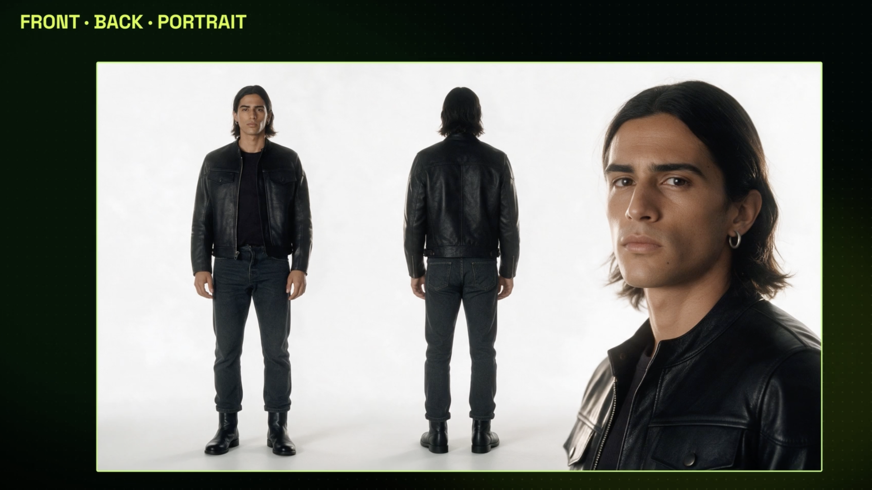
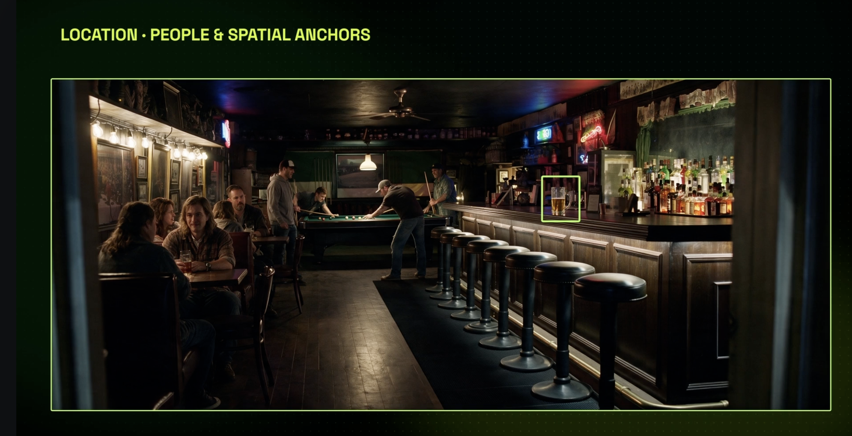
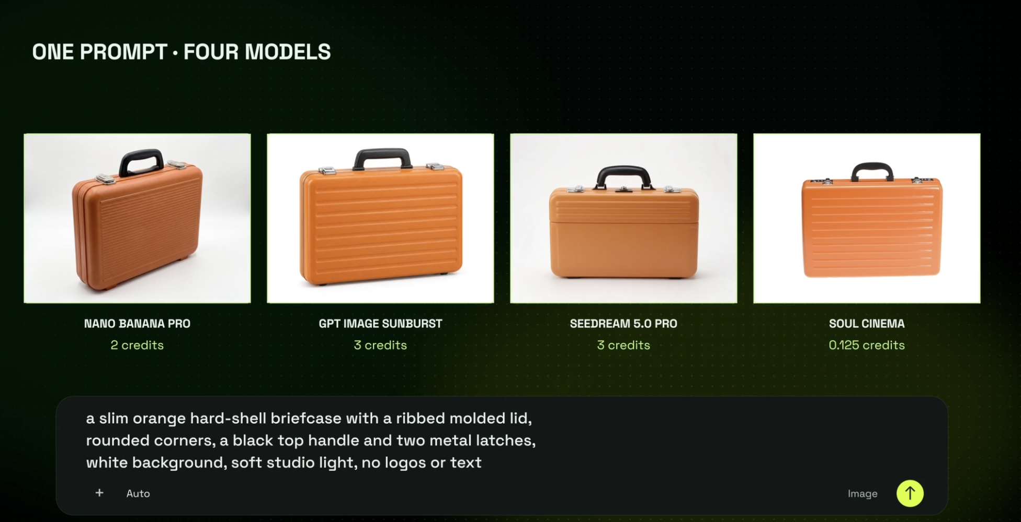
TOPIC 1 · CAST, SET, PROPS
Cast the Actors, Build the Set, Buy the Props: All Generated
Before a frame moves, Higgsfield's image models make your references. Cheap, fast, and reused in every shot.
Character: front, back, portrait
Location: a plate with anchors
Prop: one prompt, four models
One sheet locks face, hair and costume from every side.
The bar, the lamps, the stools: the set every shot returns to.
Soul Cinema 0.125 credits; Nano Banana Pro 2; GPT Image and Seedream 5.0 Pro 3.
TIP Plain background, even light, no text, no logos: the four habits of a reference that works.
© Tertiary Infotech Academy Pte Ltd
Agentic AI for Video Creation · C436
25
Notes:
Every production starts with references: a character sheet (front, back, portrait), a location plate and the key props. They are cheap, from 0.125 credits on Soul Cinema to 2-3 credits on Nano Banana Pro, GPT Image or Seedream 5.0 Pro, and they are reused in every shot, which is what keeps faces and objects from drifting.

Slide 26
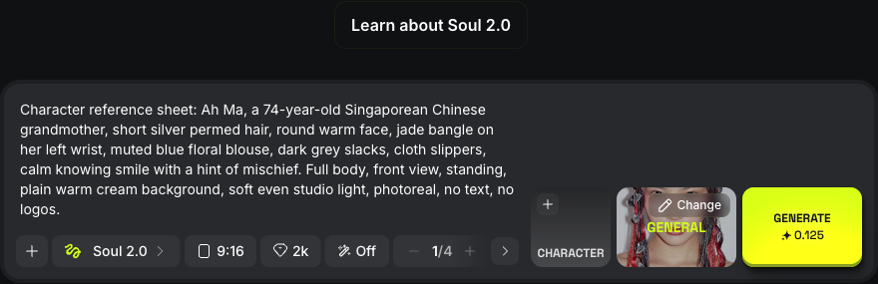
TOPIC 1 · CAST, SET, PROPS
Generate a Reference Still in One Line
The image generator: model, ratio, resolution, count — and the cost on the Generate button.
Paste the asset-bible prompt
Front view, plain background, the five fixed traits.
Set 9:16 and one image
Match the episode; one still is enough to pick from.
Read the cost first
Soul 2.0: 0.125 credits a still. The trial generates through Claude only.
Or ask Claude
The higgsfield-video skill calls generate_image with the same prompt.
© Tertiary Infotech Academy Pte Ltd
Agentic AI for Video Creation · C436
26
Notes:
A reference still is one generation from the asset-bible prompt: front view, plain background, the fixed traits, 9:16. Check the cost on the Generate button first. On the free trial, generate through Claude.

Slide 27
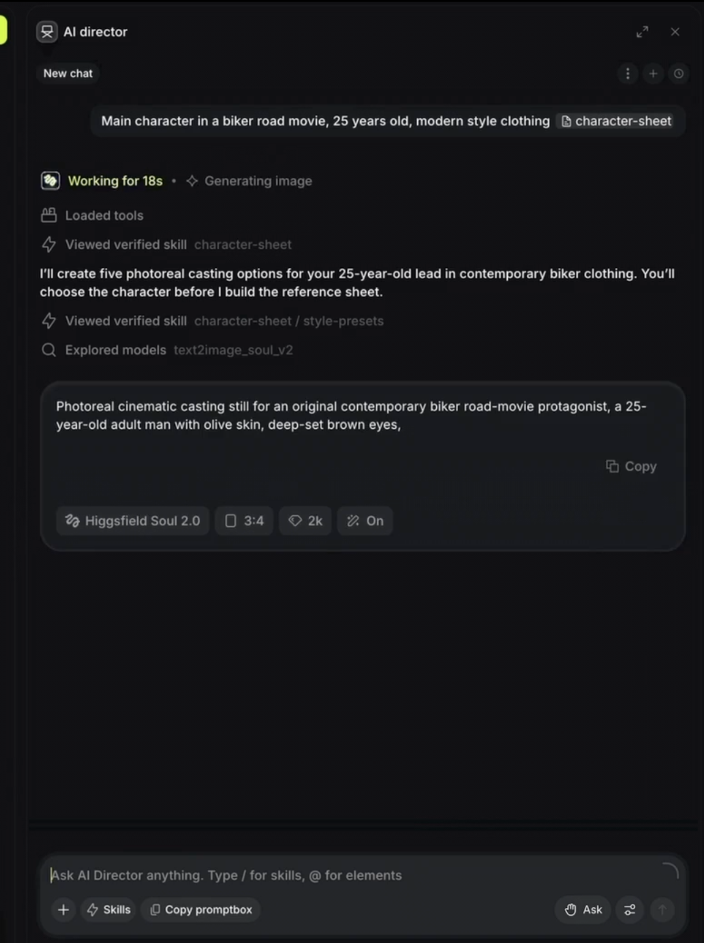
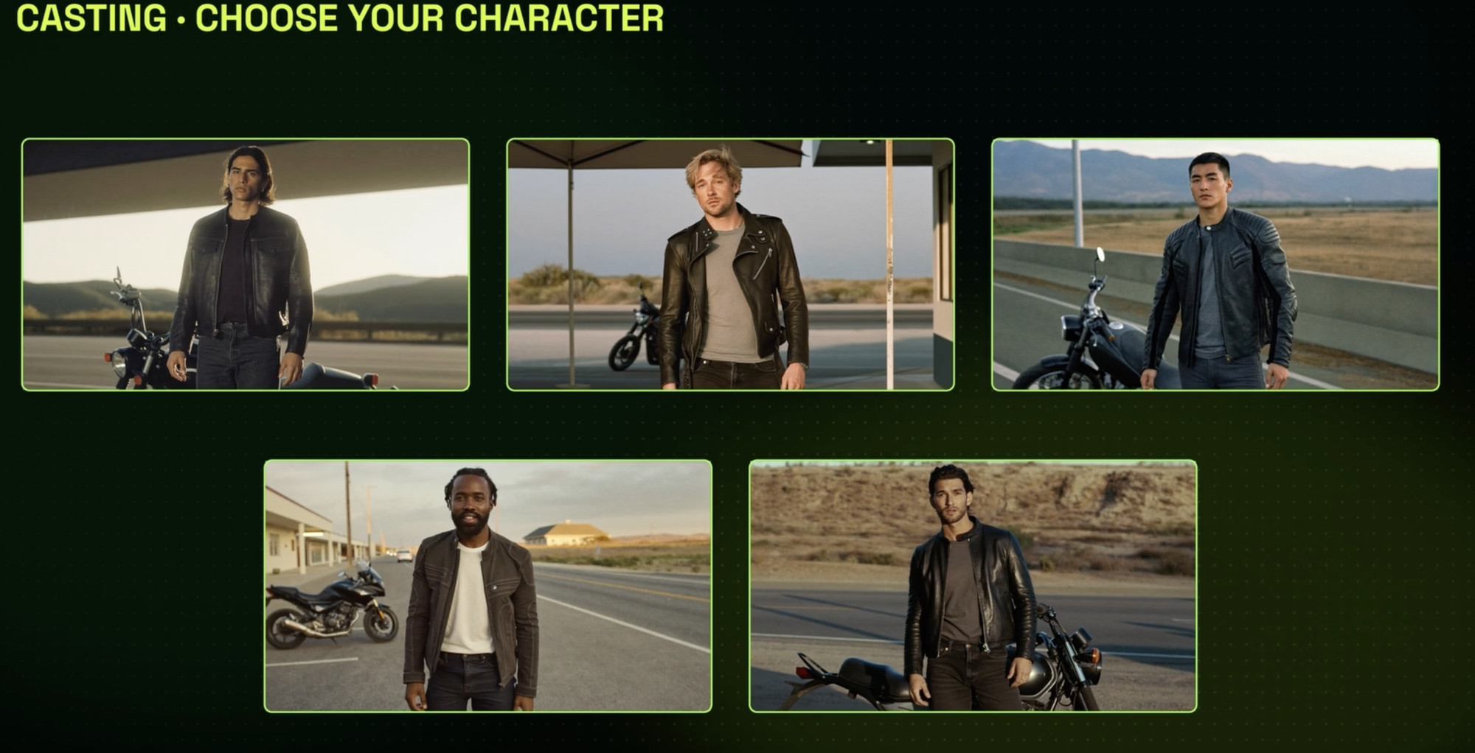
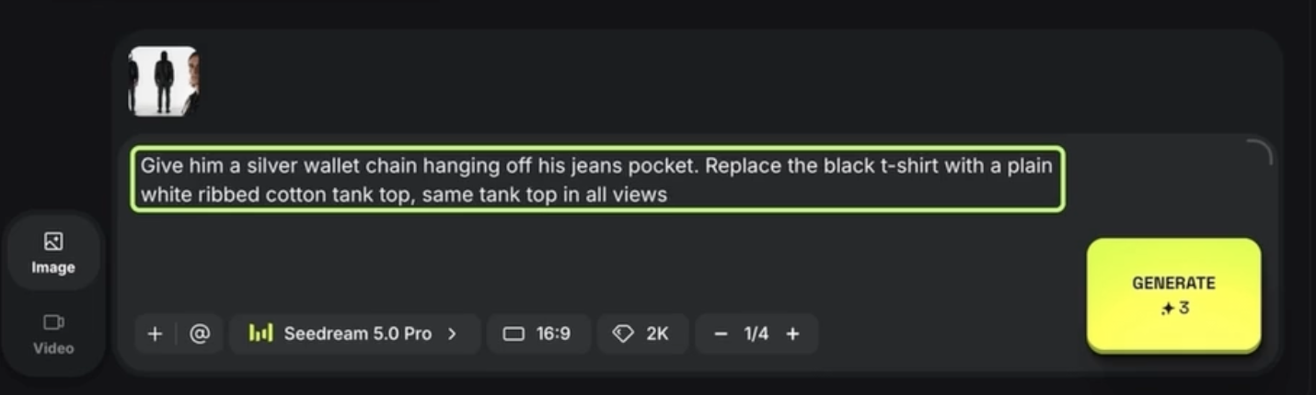
TOPIC 1 · CAST, SET, PROPS
Hold a Casting Call in 18 Seconds
The AI Director writes the casting brief, picks the model and shows you five actors. You choose; then you change one thing.
Ask
Choose
Change one thing
"Main character in a biker road movie, 25 years old, modern style clothing" plus the character-sheet skill.
Five photoreal options on Higgsfield Soul 2.0. The one you pick becomes the sheet.
"Give him a silver wallet chain… same tank top in all views." Seedream 5.0 Pro, 3 credits.
© Tertiary Infotech Academy Pte Ltd
Agentic AI for Video Creation · C436
27
Notes:
Cinema Studio's AI Director takes a casting brief in plain words, loads the character-sheet skill, picks Higgsfield Soul 2.0 and returns five photoreal options in about 18 seconds. The learner chooses one, then makes single, specific edits ("add a silver wallet chain") on an editing model such as Seedream 5.0 Pro for about 3 credits. Fictional people only.

Slide 28
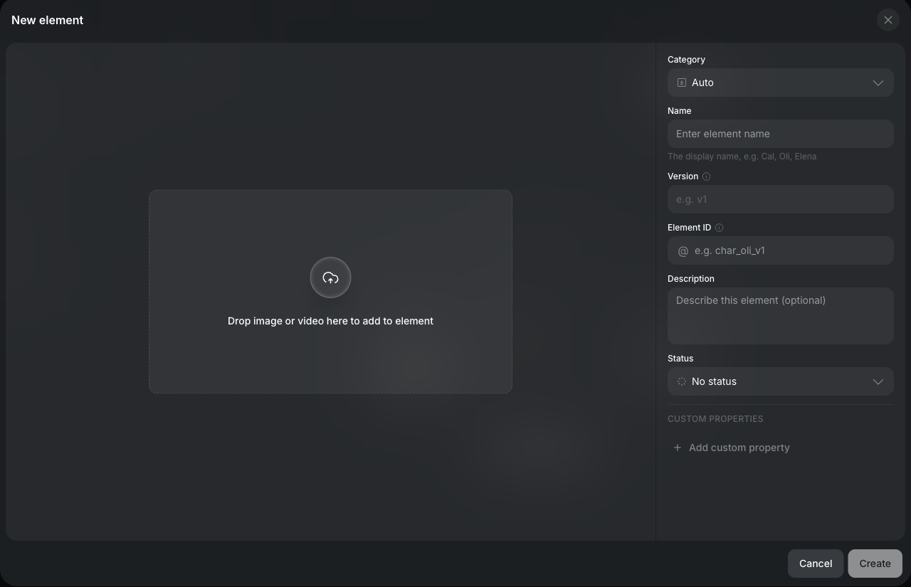
TOPIC 1 · CAST, SET, PROPS
Save It as an Element: the @Name You Prompt With
Assets › Elements › Create element — the reference fields every shot reuses.
Category and Name
Character, Location or Prop; "Ah Ma".
Version and Element ID
v1 and @char_ahma_v1 — the handle you type in prompts.
Description and status
The five fixed traits; mark it Approved.
Custom properties
Age, outfit, accessories, series — the asset bible, stored in Higgsfield.
© Tertiary Infotech Academy Pte Ltd
Agentic AI for Video Creation · C436
28
Notes:
Saving a reference as an Element records its category, name, version, @handle, description, status and custom properties — the asset bible, kept in Higgsfield where every shot can reuse it.

Slide 29
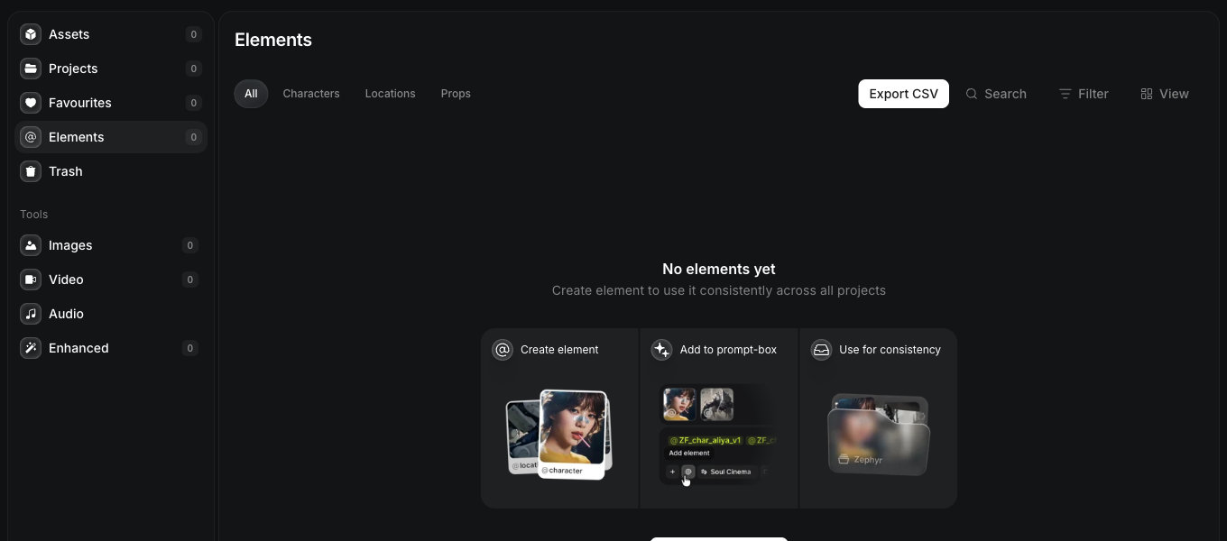
TOPIC 1 · CAST, SET, PROPS
Your Reference Library: Assets › Elements
higgsfield.ai › Assets › Elements — characters, locations and props saved once, used in every project.
Characters, Locations, Props
Three shelves: Ah Ma and Rachel; Ah Ma's HDB kitchen; props as you add them.
Add to the prompt box
Type @ and pick the element — the shot uses that exact reference.
Use for consistency
The same element in every shot keeps faces and props from drifting.
Export CSV
Your asset bible, exported for the project folder.
© Tertiary Infotech Academy Pte Ltd
Agentic AI for Video Creation · C436
29
Notes:
Higgsfield Elements store characters, locations and props once, with a name and an @handle. Mentioning an element in a prompt reuses the same reference, which keeps faces and props consistent across shots and projects.

Slide 30
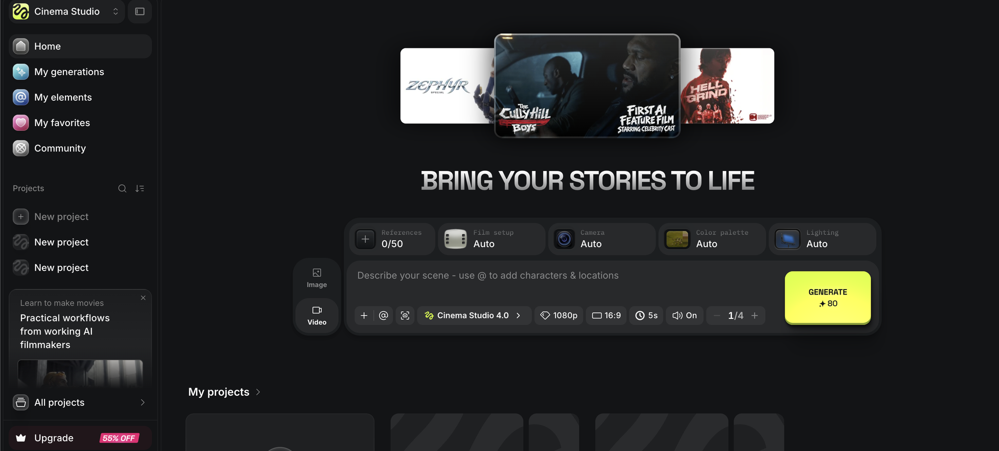
TOPIC 1 · CINEMA STUDIO
Cinema Studio: Direct the Camera, Not Just the Words
higgsfield.ai › Cinema Studio. Describe the scene, drop in your references, set the shot, read the price.
Tag your references
Type @ to add characters and locations: up to 50 references in one scene.
Set the shot
Cinema Studio 4.0, 1080p, 16:9, 5 s, sound on, one take.
Read the price
The Generate button shows the cost before you click: 80 credits for this shot.
Four dials on top
Film setup, camera, colour palette and lighting. Next slide.
© Tertiary Infotech Academy Pte Ltd
Agentic AI for Video Creation · C436
30
Notes:
Cinema Studio is Higgsfield's scene tool (versions 2.5 to 4.0; 3.5 added an AI director and style presets). Describe the scene, type @ to add up to 50 references, then set model, resolution, ratio, length, sound and number of takes. The Generate button shows the price before you click: 80 credits for a 5-second 1080p shot in the example.

Slide 31
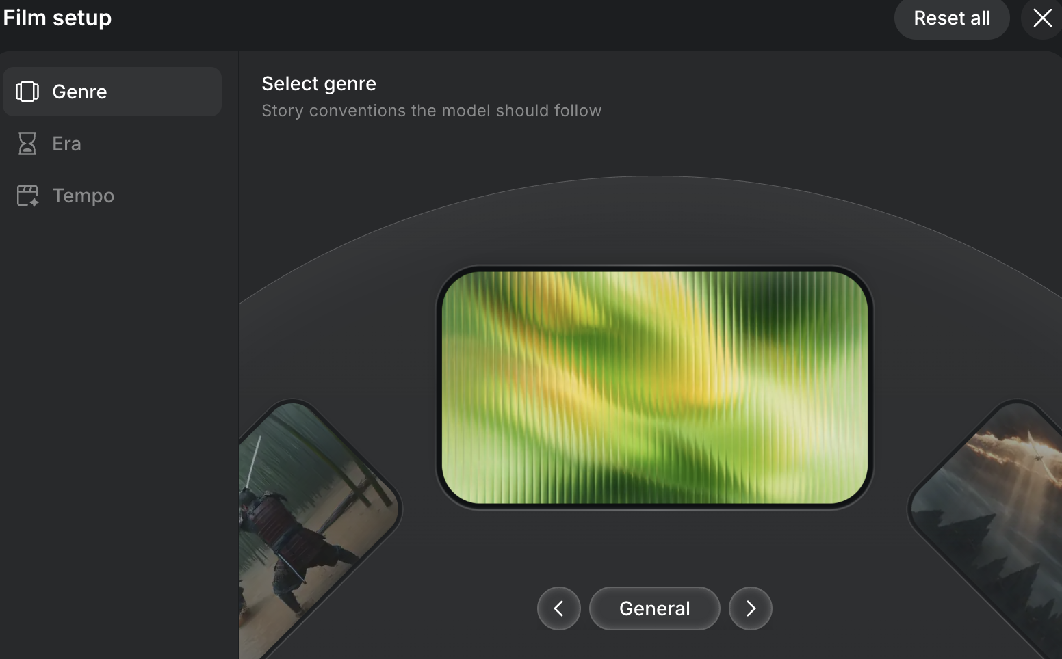
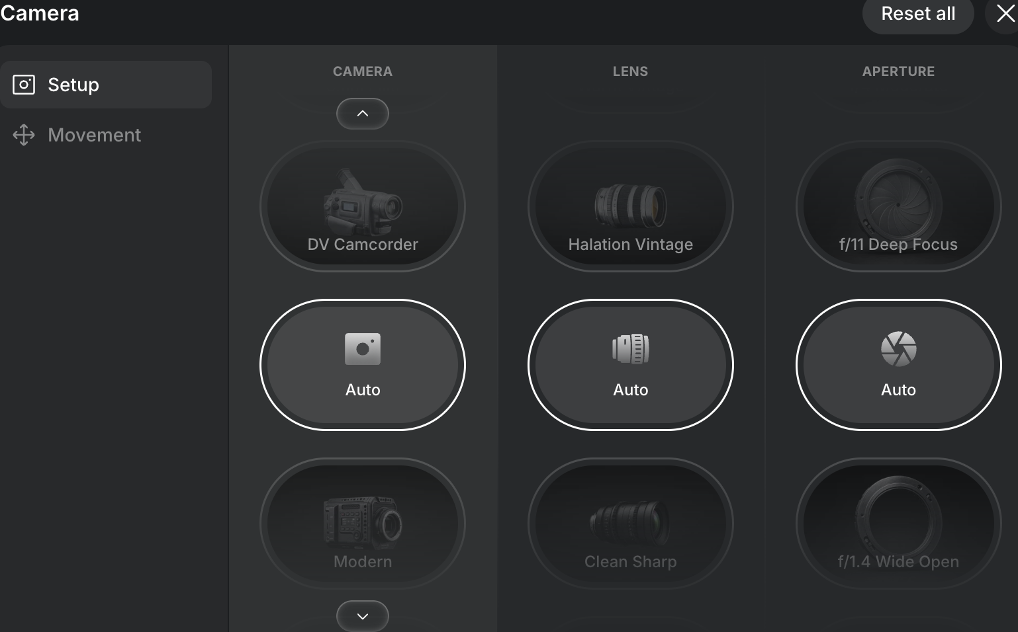
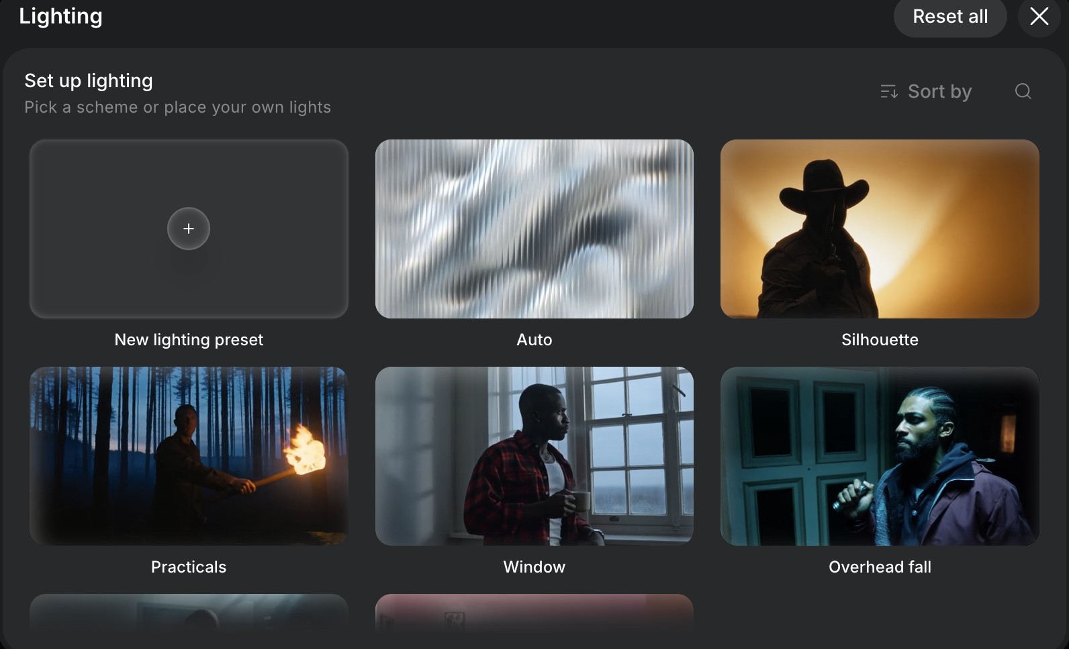
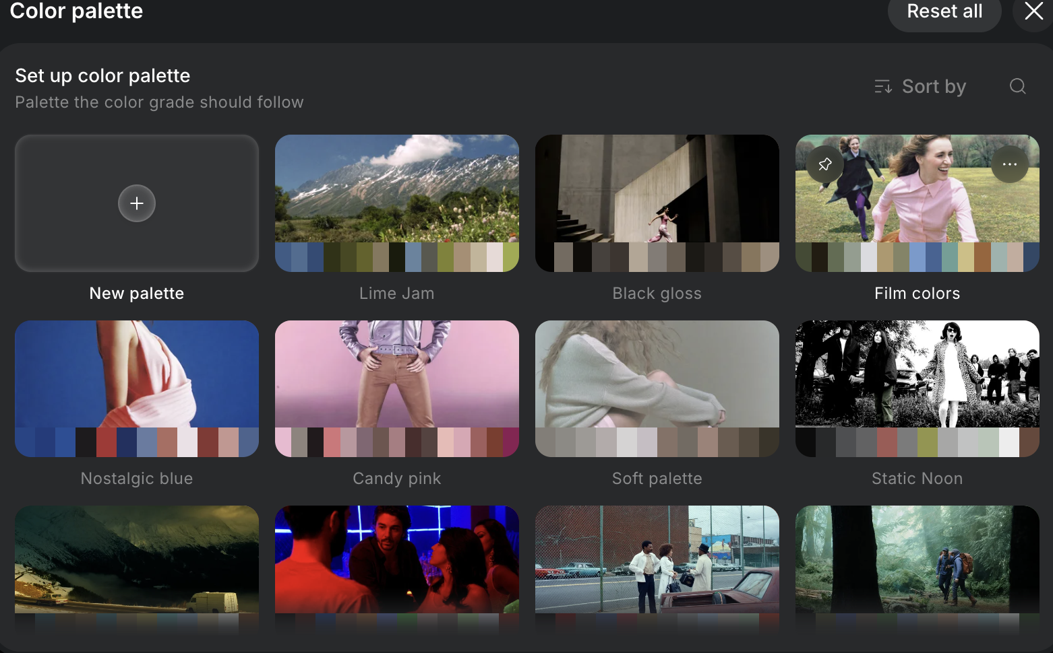
TOPIC 1 · CINEMA STUDIO
Four Dials That Make a Clip Look Like Cinema
Leave them on Auto and the model guesses. Set them and you are the director of photography.
Film setup
Camera
Lighting
Colour palette
Genre, era and tempo: the story conventions the model follows.
Body, lens, aperture: DV Camcorder, Halation Vintage, f/1.4 Wide Open.
Silhouette, window, practicals, overhead fall, or your own rig.
Film colors, Nostalgic blue, Candy pink: the grade the shot follows.
© Tertiary Infotech Academy Pte Ltd
Agentic AI for Video Creation · C436
31
Notes:
Above the prompt sit four panels: Film setup (genre, era, tempo), Camera (body, lens, aperture and movement), Lighting (presets such as Silhouette, Window and Practicals, or your own) and Colour palette (the grade). Left on Auto, the model guesses. Set them to match the storyboard and the look stays consistent from shot to shot.

Slide 32
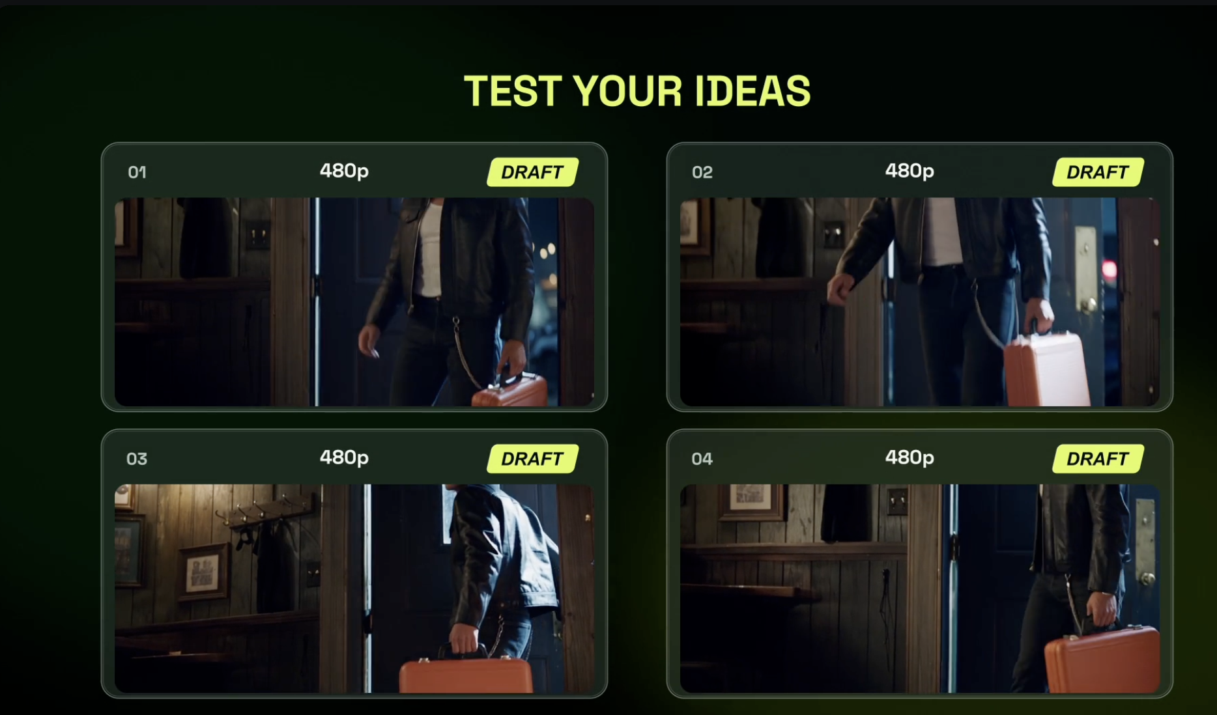
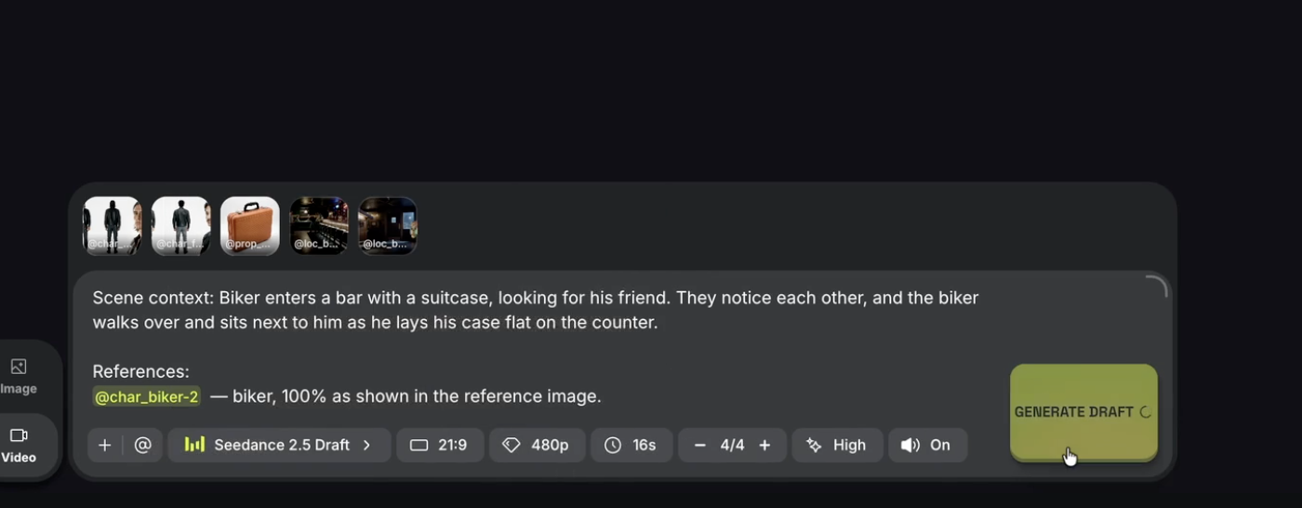
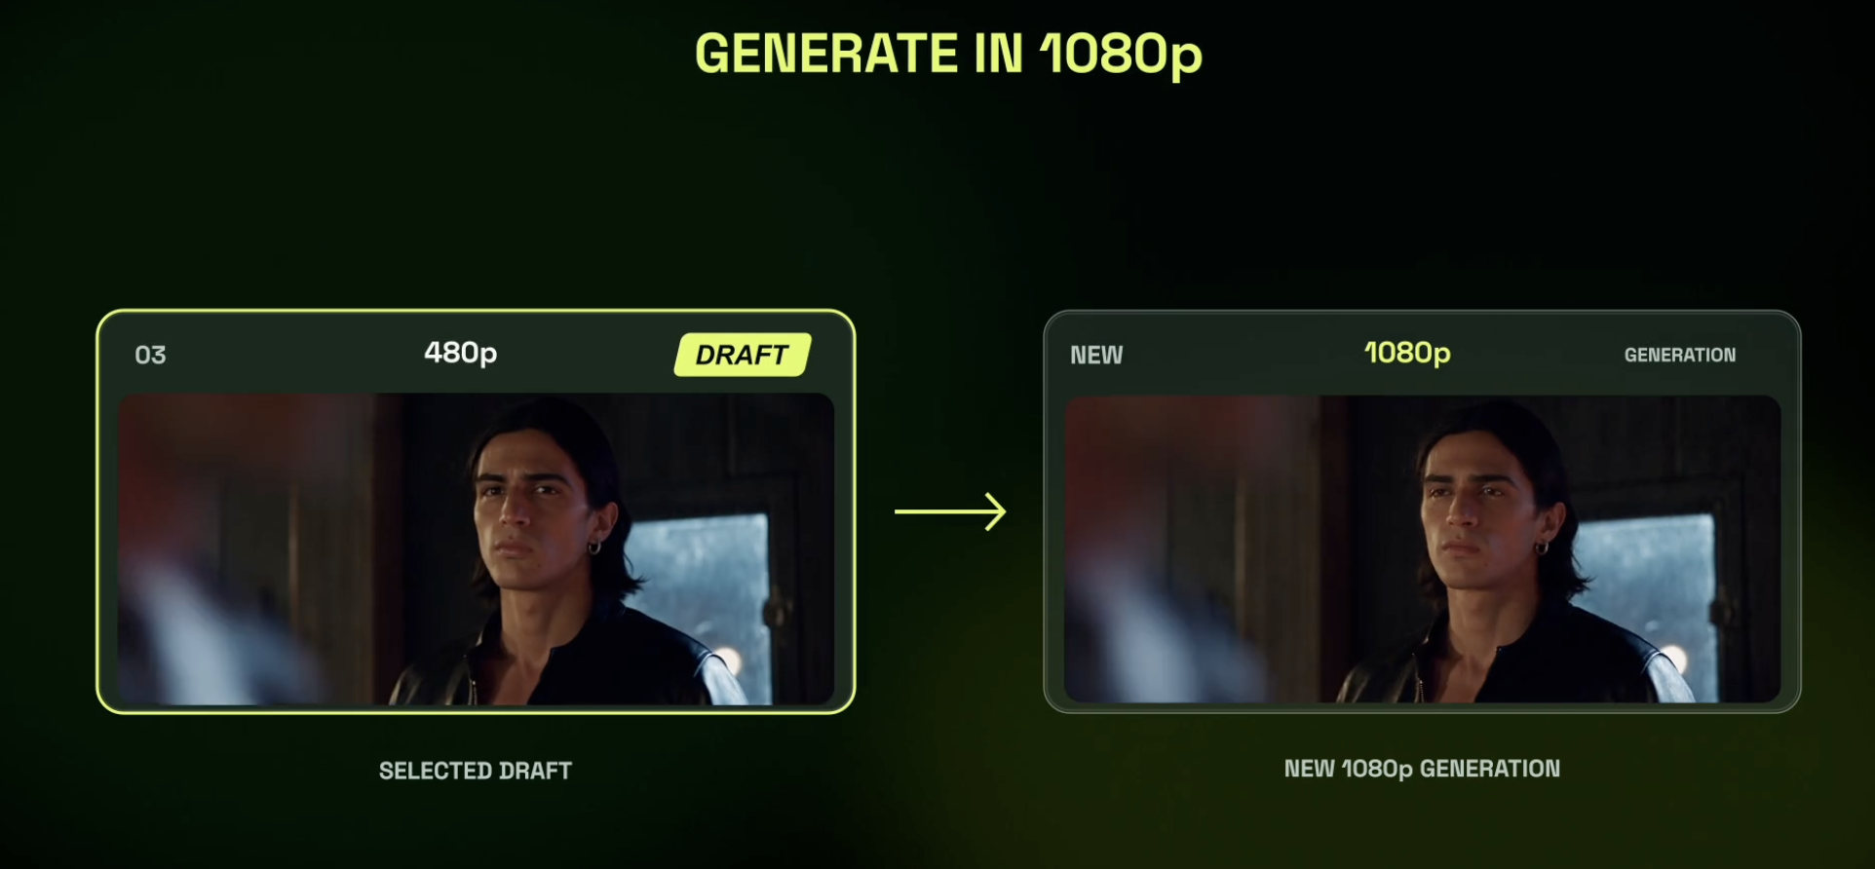
TOPIC 1 · CINEMA STUDIO
Four Drafts at 480p, Then One Keeper at 1080p
Seedance 2.5 Draft makes cheap 480p takes of the same prompt. Re-make only the winner at full resolution.
Prompt once, four takes
Compare the takes
Upgrade the keeper
Scene context plus @references. Seedance 2.5 Draft, 480p, 16 s, 4 takes.
Keep the one where the action, the faces and the suitcase all hold.
Same prompt, same references, now at 1080p.
TIP The course rule from Lab 4 on: no 1080p shot without an approved draft.
© Tertiary Infotech Academy Pte Ltd
Agentic AI for Video Creation · C436
32
Notes:
Seedance 2.5 Draft renders the same prompt at 480p, up to four takes at once. Compare the takes for action, faces and props, keep one, then re-make only that one at 1080p with the same prompt and references. This is the course's low-res-first rule, done by hand.

Slide 33
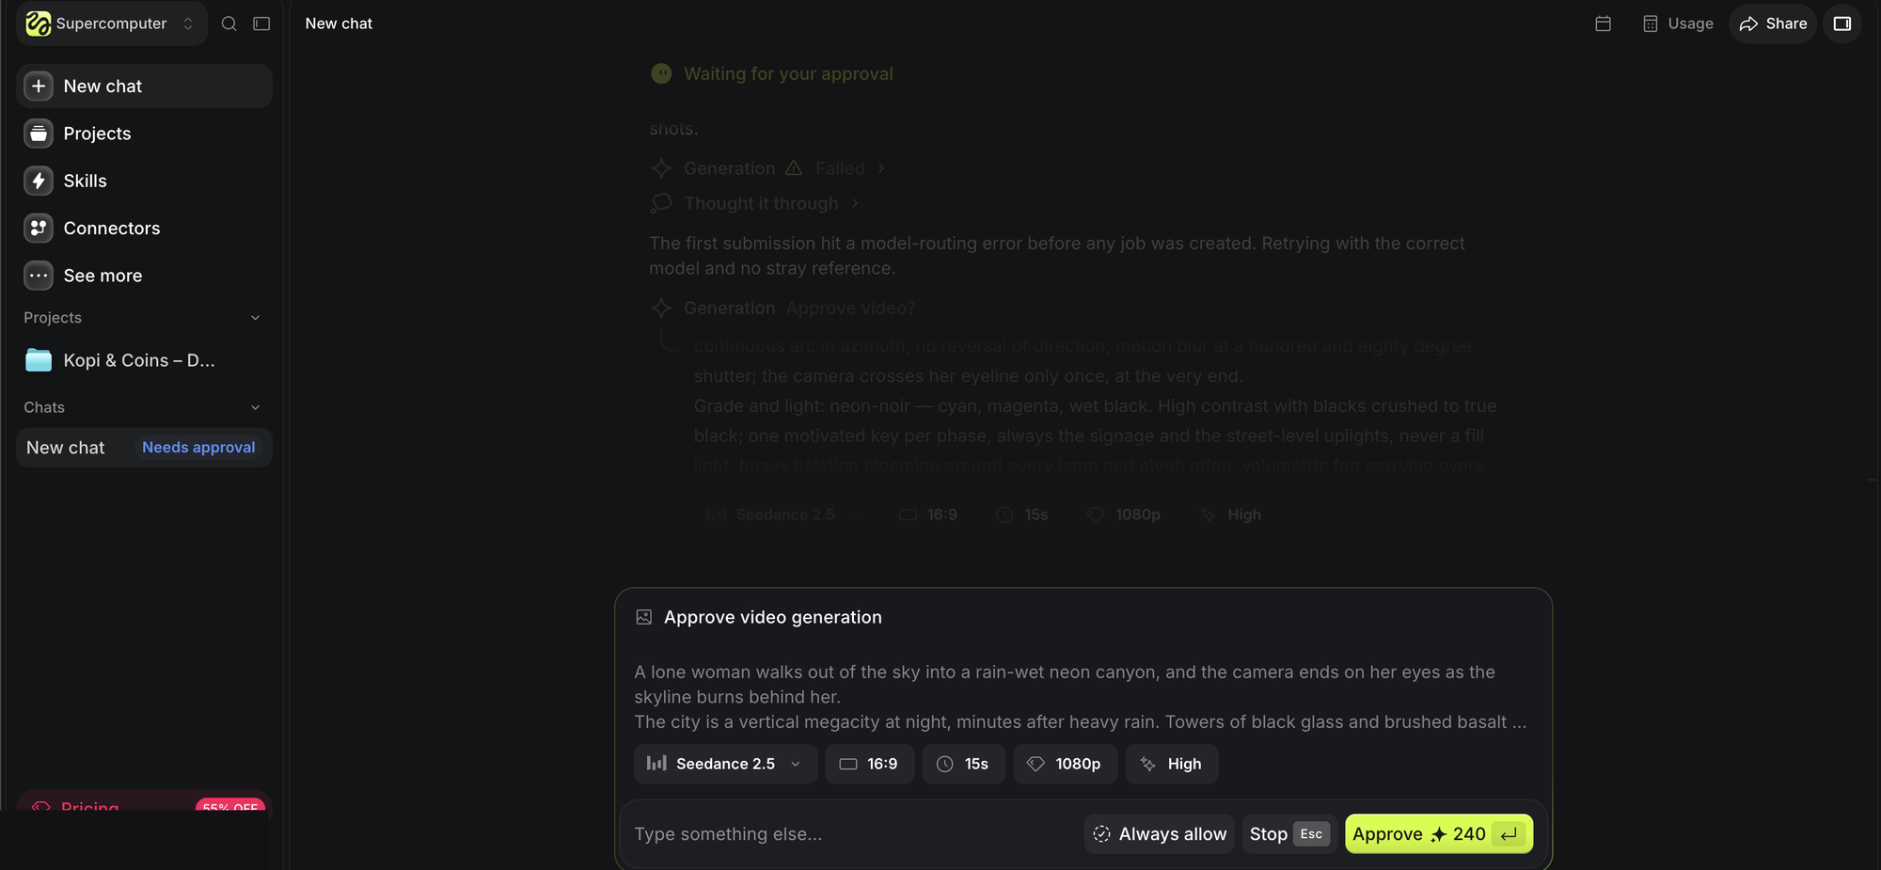
TOPIC 1 · SUPERCOMPUTER
Supercomputer: Higgsfield's Own Agent Asks Before It Spends
A chat agent inside Higgsfield with projects, skills and connectors. It writes the shot, then waits for your yes.
Describe the job
"A lone woman walks out of the sky into a rain-wet neon canyon…"
It writes the settings
Seedance 2.5, 16:9, 15 s, 1080p, high quality.
You approve the spend
The card shows the price: 240 credits for this one shot.
Leave "Always allow" off
Tick it and the agent stops asking. Keep the gate while you learn.
© Tertiary Infotech Academy Pte Ltd
Agentic AI for Video Creation · C436
33
Notes:
Supercomputer is Higgsfield's built-in agent: a chat with projects, skills and connectors. Describe the job and it writes the settings, then shows an approval card with the price (240 credits for one 15-second 1080p Seedance 2.5 shot in the example). Tell learners to leave "Always allow" off: the approval is their budget gate.

Slide 34
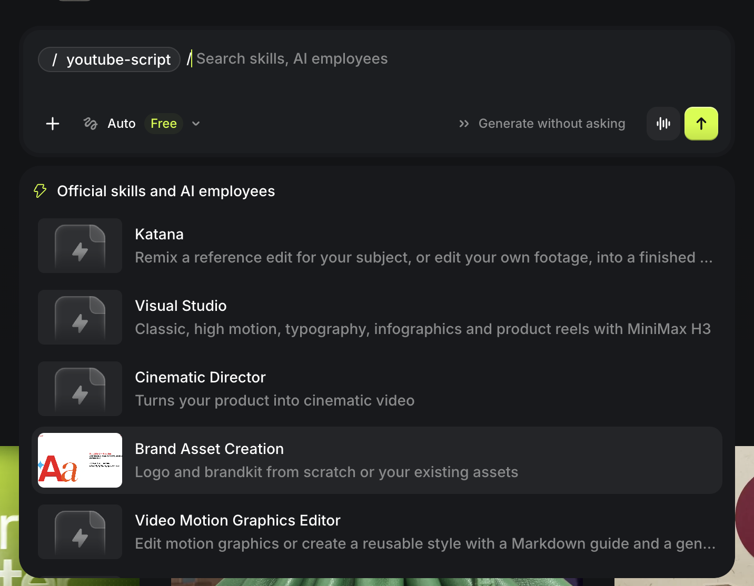
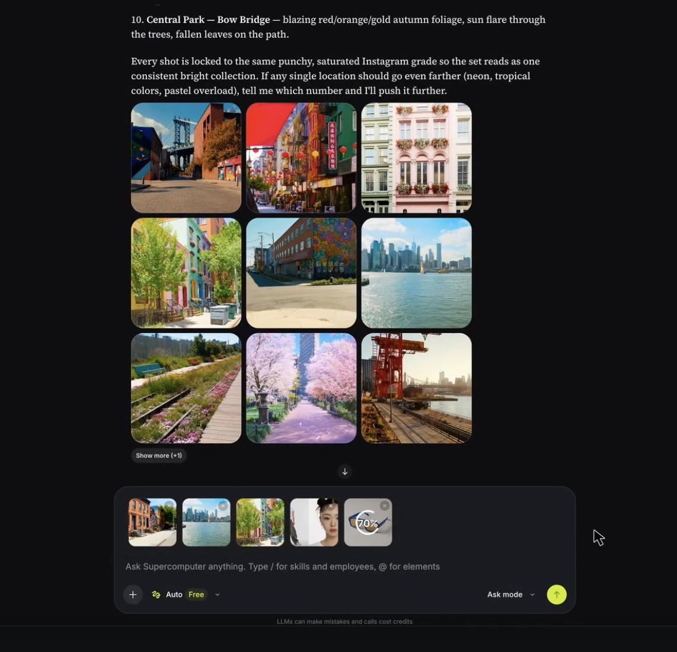
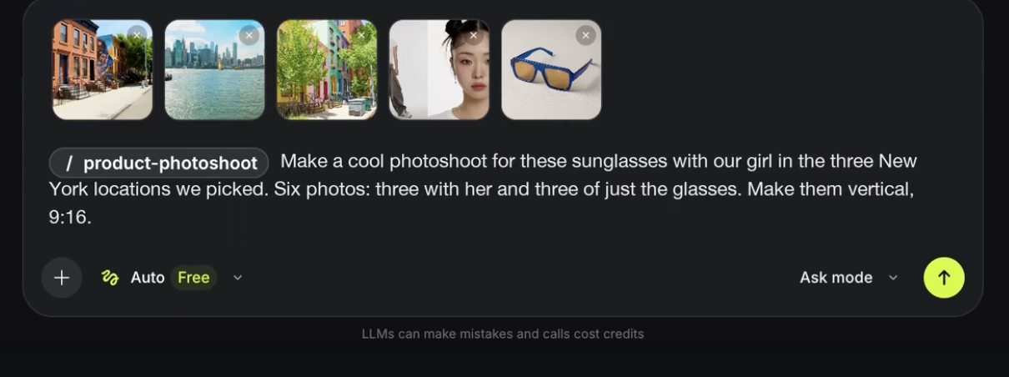
TOPIC 1 · SUPERCOMPUTER
Slash a Skill: One Product Photo Becomes a Campaign
Supercomputer ships official skills. Type / to call one and @ to add your elements.
Pick a skill
Scout locations
Shoot the campaign
Katana, Visual Studio, Cinematic Director, Brand Asset Creation, Video Motion Graphics Editor.
It proposes a grid of New York spots in one punchy grade. You pick three.
/product-photoshoot: "Six photos: three with her and three of just the glasses. 9:16."
TIP One more line, "Generate a video in Cinema Studio using these images", and the stills become a commercial.
© Tertiary Infotech Academy Pte Ltd
Agentic AI for Video Creation · C436
34
Notes:
Supercomputer ships official skills (Katana, Visual Studio, Cinematic Director, Brand Asset Creation, Video Motion Graphics Editor and more). Type / to call one and @ to attach elements. The example scouts New York locations, runs /product-photoshoot for six vertical photos, then asks for a Cinema Studio commercial from the same images.

Slide 35
TOPIC 1 · SUPERCOMPUTER
Go Deeper After Class: The Docs and a 25-Minute Walkthrough
Two references for the evening you want to explore Higgsfield on your own.
Higgsfield API docs · docs.higgsfield.ai/docs
Metics Media · Higgsfield AI Tutorial for Beginners (2026)
How to use them here
Today you drive Higgsfield through Claude. The docs and the tutorial show what each button does when you work by hand.
The official reference for models, parameters and endpoints. Open it when Claude reports a tool error or a model name you do not know.
A 24:36 walkthrough on YouTube (30 Oct 2026): choosing a plan, the interface, images, image to video, consistent characters and products, multi-shot videos, 4K upscaling.
© Tertiary Infotech Academy Pte Ltd
Agentic AI for Video Creation · C436
35
Notes:
Two references for self-study. The Higgsfield API docs (docs.higgsfield.ai/docs) list the models, parameters and endpoints, which helps when Claude reports a tool error. Metics Media's "Higgsfield AI Tutorial for Beginners (2026)" (YouTube, 30 Oct 2026, 24:36) walks through plans, the interface, images, image to video, consistency, multi-shot videos and 4K upscaling.

Slide 36
TOPIC 1 · VIDEO PRINCIPLES
The Video Production Lifecycle
AI changes who does each stage — not the stages themselves.
01
02
03
04
05
Development
Pre-production
Production
Post-production
Distribution
Idea, audience, message, creative brief.
Script, storyboard, characters, references, standards, plan.
Shoot — or generate — the shots, voice and music.
Assemble, edit, sound, captions, colour, QC.
Compliance check, approval, export, publish, measure.
TIP Most AI-video failures are pre-production failures: no brief, no storyboard, no character references.
© Tertiary Infotech Academy Pte Ltd
Agentic AI for Video Creation · C436
36
Notes:
AI does not remove the classic stages of production; it changes who does them and how fast. Skipping pre-production is the most common reason AI video looks random — there is no brief, no storyboard and no character reference for the model to follow.

Slide 37
TOPIC 1 · VIDEO PRINCIPLES
Four Decisions Before Anyone Writes a Line
Four decisions to make before anyone writes a line.
Logline
Audience
The story in one sentence. "A young professional learns from her grandmother's biscuit tin why every payday starts with a rainy-day fund."
Who exactly, on which platform, watching how. Young working adults, on a phone, sound often off.
One message
Tone and look
What the viewer should remember. Pay your rainy-day fund first.
Warm, hopeful, slice-of-life; soft natural light; a Singapore HDB home.
© Tertiary Infotech Academy Pte Ltd
Agentic AI for Video Creation · C436
37

Slide 38
TOPIC 1 · VIDEO PRINCIPLES
Story Structure for 60 Seconds
Short-form still needs a beginning, middle and end — compressed.
01
02
03
04
05
06
Hook 0-5 s
Set-up 5-15 s
Turn 15-30 s
Choice 30-45 s
Payoff 45-55 s
End card 55-60 s
A problem the viewer feels at once: the laptop dies, the bank balance is $312.
Who and where: Rachel calls Ah Ma.
The surprise: the tin is full of labelled envelopes.
The character acts: three savings buckets on payday.
Six months later, the next shock is calm.
The call to action and the disclaimer.
© Tertiary Infotech Academy Pte Ltd
Agentic AI for Video Creation · C436
38
Notes:
Short-form video compresses the three-act structure into about six beats. The hook must make the viewer feel the problem within five seconds; the payoff should mirror the hook so the change is obvious.

Slide 39
TOPIC 1 · VIDEO PRINCIPLES
Writing a Short-Form Script
A script for the eye and the thumb, not the page.
Hook in 3 seconds
Show, then tell
Short lines
Open on the problem, not the logo. If the first frame does not ask a question, viewers swipe.
Let the picture carry the story; voice-over adds only what the picture cannot.
About 2.5 spoken words a second — under 140 words for 60 seconds.
On-screen text
Sound cues
One call to action
The rule the viewer must remember appears as text: "Rule 1: rainy day first."
Mark music changes and effects in the script; they carry emotion.
End with one thing to do, plus the disclaimer.
© Tertiary Infotech Academy Pte Ltd
Agentic AI for Video Creation · C436
39

Slide 40
TOPIC 1 · VIDEO PRINCIPLES
The Storyboard Is What the Model Actually Shoots
A storyboard turns the script into shots — the units an AI model actually generates.
One shot, one action
Shot details
Each frame shows a single action. Two actions in one prompt is where AI video falls apart.
Size, angle, movement, duration, characters, sound and on-screen text for every shot.
Continuity line
Cheap to change
What must stay the same as the previous shot: clothes, props, light, direction.
Moving a sketch costs nothing; regenerating a shot costs credits and time.
© Tertiary Infotech Academy Pte Ltd
Agentic AI for Video Creation · C436
40
Notes:
A storyboard breaks the script into shots. Each shot has one size, one angle, one movement and one action, plus a continuity line that says what must stay the same. This is also the right unit for an AI video model: one prompt per shot.

Slide 41
TOPIC 1 · VIDEO PRINCIPLES
Pick the Shot Size by What the Viewer Must Feel
Choose the size by what the viewer needs to see — and feel.
SHOT
WHAT IT SHOWS
USE IT FOR
ECU — extreme close-up
An eye, a hand, a phone screen.
Detail and tension: the $1,400 repair quote.
CU — close-up
A face fills the frame.
Emotion: Rachel's reaction.
MCU — medium close-up
Head and shoulders.
Dialogue and video calls.
MS — medium shot
Waist up, some setting.
Action with context: setting up the savings buckets.
WS — wide shot
The whole person and the room.
Place and time: six months later.
EWS — extreme wide
A building, a city skyline.
Establishing shots and transitions.
© Tertiary Infotech Academy Pte Ltd
Agentic AI for Video Creation · C436
41

Slide 42
TOPIC 1 · VIDEO PRINCIPLES
Camera Angles and Movement
Name them in every shot prompt — AI models follow camera language.
TERM
WHAT IT DOES
EXAMPLE IN EPISODE 1
Eye level
Neutral; the viewer is an equal.
Most dialogue.
High / low angle
Makes a subject smaller / stronger.
Low angle on Ah Ma holding the tin.
Over-the-shoulder
Puts us in the conversation.
Rachel's phone screen during the call.
Static
Calm, observational.
The end card.
Push-in (dolly in)
Builds focus or tension.
Slowly onto the dead laptop.
Pan / tracking
Follows action or reveals space.
Following Rachel to the window.
© Tertiary Infotech Academy Pte Ltd
Agentic AI for Video Creation · C436
42

Slide 43
TOPIC 1 · VIDEO PRINCIPLES
Characters and Consistency
Viewers forgive a cheap set; they do not forgive a face that changes.
Character bible
Five fixed traits
Identity, age, role in the story, how they move and speak — written once, reused for every episode.
Face, hair, glasses, clothes, colours. Repeat them in every shot prompt.
Reference images
Props are characters too
A front-view still per character. In Higgsfield every shot animates from it.
The blue tin needs the same colour, dent and labels every time.
© Tertiary Infotech Academy Pte Ltd
Agentic AI for Video Creation · C436
43
Notes:
Consistency comes from repeating concrete traits, not names. An asset bible lists five visible traits that never change; an approved reference still for each character lets Higgsfield animate every shot from the same face.

Slide 44
TOPIC 1 · VIDEO PRINCIPLES
Composition for 9:16
Vertical video has its own rules — and the platform's buttons sit on top of your frame.
Rule of thirds
Safe zones
Eyes on the upper third line; the subject on a third, not dead centre.
Keep text out of the bottom ~20% and the right edge, where captions, likes and the caption bar sit.
Eyeline and 180-degree rule
Screen direction
In a two-person scene, keep both on their side of an imaginary line so they face each other.
If Rachel walks left to right in one shot, she keeps going left to right in the next.
© Tertiary Infotech Academy Pte Ltd
Agentic AI for Video Creation · C436
44

Slide 45
TOPIC 1 · VIDEO PRINCIPLES
Sound and Captions
Half the emotion is in the sound; most viewers start with it off.
Voice-over and dialogue
Music
Clear, close, never buried under music.
Sets the feeling; ducks under the voice; must be licensed or generated with rights.
Sound effects
Captions
The laptop click, the tin lid — small sounds sell the moment.
Always on for short-form; accurate, in sync, two lines at most, inside the safe zone.
© Tertiary Infotech Academy Pte Ltd
Agentic AI for Video Creation · C436
45

Slide 46
TOPIC 1 · CLAUDE + HIGGSFIELD
Typing Prompts vs Directing a Production
Higgsfield on its own, even with Supercomputer, makes great clips. Claude plus Higgsfield runs your whole production by your rules.
Higgsfield on its own
Claude + Higgsfield over MCP
You write or chat every shot in the web app.
The video-script skill writes every prompt from the approved board.
Your story, rules and approvals live in your head.
Claude calls Higgsfield's tools and keeps a status table.
Keeping Rachel's face the same is your problem.
References first: every shot animates from an approved still.
Nothing checks your budget or your storyboard.
A credit plan before, a hand-off file for the editor after.
© Tertiary Infotech Academy Pte Ltd
Agentic AI for Video Creation · C436
46
Notes:
You can type prompts into Higgsfield yourself, one clip at a time. With the connector, Claude turns an approved storyboard into every prompt, calls Higgsfield's tools, keeps a status table, holds the budget and writes the hand-off file for the editor — you direct and approve.

Slide 47
TOPIC 1 · AGENTIC AI VS AI AGENTS
Agentic AI vs AI Agents
Both use the same building blocks. The difference is how long they live and what starts them.
Agentic AI — task-oriented
AI agents — always on
Uses tool calling and skills to complete a task.
Also use tool calling and skills.
Uses memory within the task (and often across sessions).
Also use memory — long-term, about you and your work.
Starts when you give it a task; stops when the task is done.
Run 24/7 on a computer or server; wake on schedules and messages.
Need not be on 24/7. Example: Claude making Episode 1 in Higgsfield.
Example: an always-on agent such as Hermes Agent running a weekly pipeline.
© Tertiary Infotech Academy Pte Ltd
Agentic AI for Video Creation · C436
47
Notes:
The two terms are often used loosely. In this course: both use tool calling and skills, and both use memory. Agentic AI is task-oriented — it is given a task, works through it and stops, so it need not run 24/7. An AI agent is always on: it lives on a computer or server, keeps long-term memory and can be woken by a schedule, a message or another agent.

Slide 48
TOPIC 1 · AGENTIC AI VS AI AGENTS
Agentic AI or an AI Agent? Pick by the Job
Use this table to decide what you need for a video job.
FEATURE
AGENTIC AI
AI AGENTS
Tool calling
Yes — generates images, video, voice, music.
Yes — plus files, browser, terminal, other apps.
Skills
Yes — Claude Skills: SKILL.md folders loaded on demand.
Yes — SKILL.md folders it can create and improve.
Memory
Yes — project history, references, elements.
Yes — long-term memory across every session.
Availability
Task-oriented; may not be on 24/7.
Always on, 24/7; reachable by chat apps.
Started by
You, with a task.
You, a schedule (cron), a message or another agent.
In this course
Labs 1-7 — Claude Desktop with skills and the Higgsfield connector.
Topic 3 — as the next step: schedules and always-on pipelines.
© Tertiary Infotech Academy Pte Ltd
Agentic AI for Video Creation · C436
48

Slide 49
TOPIC 1 · ONE AI AGENT
Anatomy of a Single AI Agent
Start with one agent. A model on its own only answers; the parts around it let it act.
ONE AI AGENT · MODEL + PARTS
Instructions
Memory
Who the agent is and the rules it follows — the studio brief, the project instructions.
What it keeps: your preferences, past episodes, the character bible.
THE BRAIN
Tools
The model
Context
Actions it can take through connectors: Higgsfield's generate_image, generate_video_batch.
the brain
What it can see right now: attached files, the chat, the project state.
Reads the goal, plans the next step and decides which part to use.
Skills
Guardrails
Saved procedures it loads when the task matches — the storyboard skill.
Approvals, permissions and limits — what it must ask before doing.
One agent is enough when the work is one line of thought. Add agents only when the work splits into different jobs.
© Tertiary Infotech Academy Pte Ltd
Agentic AI for Video Creation · C436
49
Notes:
A language model on its own can only answer. An agent wraps the model with instructions, tools, skills, memory, context and guardrails so it can take actions and check them. Start every project with one agent; add more only when the work clearly splits into different jobs.

Slide 50
TOPIC 1 · ONE AI AGENT
The Agentic Loop
Every agent — chat, video or multi-agent — runs the same loop until the goal is met.
01
02
03
04
05
Goal
Plan
Act
Observe
Reflect
You state the outcome: "a 60-second episode on emergency funds".
The agent breaks it into steps: brief, script, storyboard, shots.
It calls a tool or skill: write, generate, edit.
It reads the result: a script, a frame, a cut.
It checks against the goal and your rules, then loops or stops for approval.
TIP Give the goal and the rules, not micro-steps. Review at the points where a mistake is expensive.
© Tertiary Infotech Academy Pte Ltd
Agentic AI for Video Creation · C436
50
Notes:
The loop is goal, plan, act, observe, reflect — repeated until the goal is met or the agent needs approval. Your job is to give a clear goal and rules, and to review at the points where a mistake is expensive.

Slide 51
TOPIC 1 · ONE AI AGENT
Tools, Skills and Memory in a Video Agent
The three things that turn a chatbot into a production assistant.
Tools — what it can do
Skills — how you want it done
Memory — what it remembers
Image models for characters and scenes, video models for motion, voice and music generation, captioning, the timeline editor, export.
A saved workflow: "Kopi & Coins episode: 9:16, 60 s, warm light, captions on, disclaimer end card".
The character bible, the brand, the last episode's fixes, your feedback style. Next episode starts ahead.
© Tertiary Infotech Academy Pte Ltd
Agentic AI for Video Creation · C436
51

Slide 52
TOPIC 1 · ONE AI AGENT
Which Agent for Which Job
Match the agent to the work. Bigger is not better.
AGENT
BEST FOR
IN THIS COURSE
Claude + skills
Thinking work: briefs, scripts, storyboards, standards, plans.
Labs 1-3 (Claude Desktop project)
Claude + Higgsfield connector
Making the shots: stills, video, status, hand-off.
Lab 4 (Higgsfield over MCP)
An editor
Assembling, captioning, fixing and exporting the cut.
Lab 5 (LahLah Video or CapCut)
A skill chain with human gates
A repeatable, compliant pipeline from idea to upload.
Labs 6-7 (all skills + publish)
TIP Rule of thumb: one agent, many skills — add a tool only when the work needs it.
© Tertiary Infotech Academy Pte Ltd
Agentic AI for Video Creation · C436
52

Slide 53
TOPIC 1 · YOUR CLAUDE STUDIO
Skills, Connectors and Projects
Three things you set up once in Claude Desktop — then every lab is one prompt.
Skills — the studio's know-how
Connector — Higgsfield over MCP
Project — one per video
Instructions, the studio brief and every approved file, named 01-idea__ to 06-publish__. Its twin is a Higgsfield folder with the same name.
Five ZIPs you upload once: storytelling, storyboard, video-script, higgsfield-video, platform-publish. Claude loads one when the task matches, or when you name it.
Customize > Connectors > Add custom connector, URL https://mcp.higgsfield.ai/mcp. Claude gets balance, models_explore, presets_show, generate_image, generate_video_batch, jobs_wait.
© Tertiary Infotech Academy Pte Ltd
Agentic AI for Video Creation · C436
53
Notes:
Claude Desktop needs three things set up once. Skills are folders with a SKILL.md file that hold the studio's way of doing a job; Claude loads one when the task matches or when you name it. A connector is an MCP server Claude can call — Higgsfield's gives Claude tools to check credits, list models and presets, generate stills and video and wait for results. A project keeps one video's instructions, files and chats together; its twin is a Higgsfield folder with the same name.

Slide 54
TOPIC 1 · YOUR CLAUDE STUDIO
Idea to Upload: the Pipeline You Build
Seven stages, one skill or tool each — and you approve before any credit is spent.
01
02
03
04
05
06
07
Idea
Story
Storyboard
Script
Generate
Edit
Publish
You, plus a Prompt Builder template.
storytelling skill: brief, script, review.
storyboard skill: an artifact you approve.
video-script skill: shots, assets, cinematic prompts.
higgsfield-video + Higgsfield: draft low-res, upgrade the keepers.
LahLah Video (default) or CapCut.
platform-publish: TikTok or YouTube, AI label on.
© Tertiary Infotech Academy Pte Ltd
Agentic AI for Video Creation · C436
54
Notes:
The course pipeline has seven stages: idea, story, storyboard, script, generation, edit and publish. Each has one skill or tool, and the gates — storyboard, script and budget approval, then upload approval — keep a person in charge of every credit spent and every post published.

Slide 55
TOPIC 1 · CLAUDE + HIGGSFIELD
The Higgsfield Tools Claude Calls
One custom connector — https://mcp.higgsfield.ai/mcp — gives Claude these tools. You never type a tool name; the skills do.
TOOL
WHAT IT DOES
USED IN
balance
Credits left and the current plan.
Labs 1, 4
models_explore
Today's video and image models, with what each costs.
Labs 1, 4, 7
presets_show
Camera presets by name, for each shot's move.
Labs 1, 4
generate_image
Reference stills for characters, places and props.
Lab 4
generate_video_batch
Up to 12 shots in parallel; returns job IDs.
Labs 4, 7
jobs_wait
Status and result links for up to 12 jobs.
Labs 4, 5, 7
TIP Names from the hosted server's catalogue, 8 Nov 2026. Before each class ask Claude: "List every Higgsfield tool you can call."
© Tertiary Infotech Academy Pte Ltd
Agentic AI for Video Creation · C436
55
Notes:
The Higgsfield connector exposes tools Claude calls on your behalf: balance for credits, models_explore for today's models and costs, presets_show for camera presets, generate_image for reference stills, generate_video_batch for up to 12 shots at once, and jobs_wait for status and result links. Tool names come from the hosted server's catalogue; check the live list before each class.

Slide 56
TOPIC 1 · YOUR CLAUDE STUDIO
Install LahLah Video in One Line: Mac or Windows
Free, open source and CapCut-style. One command fetches the newest release, installs it and opens it.
Mac
Windows 10 or 11
Apple silicon or Intel. Open Terminal (Cmd+Space, type Terminal) and paste:
Open PowerShell (Start menu, type PowerShell) and paste:
curl -fsSL https://raw.githubusercontent.com/alfredang/LahLahVideo/main/install/install.sh | bash
irm https://raw.githubusercontent.com/alfredang/LahLahVideo/main/install/install.ps1 | iex
1
Installs into Applications and opens the app.
1
No admin password needed. The app opens when it finishes.
2
By hand: the .dmg from github.com/alfredang/LahLahVideo/releases, dragged into Applications.
2
By hand: run the …_x64-setup.exe from the same releases page.
3
"Apple could not verify LahLah Video"? System Settings › Privacy & Security › Open Anyway.
3
"Windows protected your PC"? Click More info › Run anyway.
TIP Rather not type? Lab 1 has a prompt: Claude detects your system, shows you the one command, runs it and checks the window opens.
© Tertiary Infotech Academy Pte Ltd
Agentic AI for Video Creation · C436
56
Notes:
LahLah Video is a free, open-source, CapCut-style editor. On a Mac, paste the curl command into Terminal; on Windows 10 or 11, paste the irm command into PowerShell. Each script downloads the newest release, installs it, clears the unknown-developer block and opens the app. To install by hand, download the .dmg (Mac) or -setup.exe (Windows) from the GitHub releases page; on first launch use Privacy & Security › Open Anyway (Mac) or More info › Run anyway (Windows). Lab 1 also has a prompt that asks Claude to run the right command for you.

Slide 57
LAB 01 · HANDS-ON
Set Up Your Claude Video Studio
LAB 01
DAY 1 · ~30 MIN
THE STORY SO FAR
Priya has bought the studio a Claude plan and a Higgsfield plan. Before anyone writes a line, you set up the studio once: the skills that hold the studio's know-how, the connector that lets Claude drive Higgsfield, a project for Episode 1, and an editor on your laptop.
YOU'LL BUILD
A Claude project "Kopi & Coins – Ep1 micro-drama (TikTok)" with five skills on, Higgsfield connected, the studio brief in its knowledge, and LahLah Video open on your computer
Surface: Claude Desktop — skills, the Higgsfield connector and a project
Features: Higgsfield sign-up · five video skills · Higgsfield MCP connector · a Claude project with instructions and knowledge · LahLah Video installed by Claude
© Tertiary Infotech Academy Pte Ltd
Agentic AI for Video Creation · C436
57
Notes:
Lab 1 (30 min). Install the tools once so every later lab is one prompt away: Claude calls the right skill and the right Higgsfield tool by name. A skill is a folder with a SKILL.md file: the studio's way of doing one job, written once. Claude loads it only when the task matches, or when you name it — "use the storyboard skill". Five skills cover the whole pipeline: storytelling, storyboard, video-script, higgsfield-video and platform-publish. A connector is an MCP server Claude can call. Higgsfield's connector gives Claude tools such as balance (credits left), models_explore (which video models exist today), presets_show (camera presets), generate_image, generate_video_batch and jobs_wait (status and result links). Every MCP generation spends Higgsfield credits, even on "unlimited" plans. A project keeps one video's instructions, files and chats together. Project knowledge has no folders, so the studio uses filename prefixes instead: 01-idea__, 02-storyboard__, 03-script__, 04-assets__, 05-edit__, 06-publish__. The Higgsfield side mirrors the project: a folder in Higgsfield Assets with the same name. Every reference still and every clip for Episode 1 is moved into it, so nothing lives outside Higgsfield and anyone can trace a shot to its job. Claude is already on your laptop, so let Claude install the editor. The install script picks the right .dmg or .exe, copies it and clears the macOS download warning — no hunting through download pages.

Slide 58
LAB 01 · STEPS
Set Up Your Claude Video Studio
Claude Desktop — skills, the Higgsfield connector and a project · the full step-by-step, with the reasoning, is in your Learner Guide.
1
Sign up for Higgsfield Open the sign-up link on the labs page and start the free 3-day trial (100 credits, usable through the Claude connector), or a paid plan.
5
Create the project + New Project "Kopi & Coins – Ep1 micro-drama (TikTok)". Paste the instructions from project-ep01-setup.pdf; add studio-brief.pdf to its knowledge.
2
Turn on code and files Claude Desktop: Settings > Capabilities > Code execution and file creation.
6
Test tools and skills Prompt A calls balance, models_explore and presets_show (no generation). Prompt B lists the skills in pipeline order.
3
Upload five skills Customize > Skills > + > Upload a skill. Upload each ZIP in assets/skills and switch it on.
7
Install LahLah Video Prompt C: Claude detects Mac or Windows, runs the one-line installer and opens the editor.
4
Connect Higgsfield Customize > Connectors > + > Add custom connector. Name Higgsfield, URL https://mcp.higgsfield.ai/mcp, Connect, sign in.
© Tertiary Infotech Academy Pte Ltd
Agentic AI for Video Creation · C436
58

Slide 59
LAB 01 · THE PROMPT
Set Up Your Claude Video Studio
PROMPT A — test the Higgsfield tools (no generation)
Check the Higgsfield connector without generating anything.
1. Call balance and tell me my credits and plan.
2. Call models_explore and recommend two video models for a 9:16, 5-second image-to-video shot: one cheap low-res draft model and one final-quality model, with the credit cost of each at 480p or 720p and at 1080p.
3. Call presets_show and list ten camera presets by name.
List every Higgsfield tool you can call, one line each. Do not call any generate_ tool.
© Tertiary Infotech Academy Pte Ltd
Agentic AI for Video Creation · C436
59

Slide 60
LAB 01 · THE PROMPT
Set Up Your Claude Video Studio (cont.)
PROMPT B — test the skills
List the skills you can use in this project. For each one give:
its name, the job it does, the words in my request that would make you load it, and what it hands to the next skill.
Then tell me the order the five video skills run in for one episode, from idea to publish.
© Tertiary Infotech Academy Pte Ltd
Agentic AI for Video Creation · C436
60

Slide 61
LAB 01 · THE PROMPT
Set Up Your Claude Video Studio (cont.)
PROMPT C — install LahLah Video with Claude
Install LahLah Video on this computer. Detect whether I am on macOS or Windows. On macOS run: curl -fsSL https://raw.githubusercontent.com/alfredang/LahLahVideo/main/install/install.sh | bash . On Windows run in PowerShell: irm https://raw.githubusercontent.com/alfredang/LahLahVideo/main/install/install.ps1 | iex . Show me each command before you run it, then confirm that LahLah Video opens.
NOTE Set up once, then speak in jobs, not steps: "use the storyboard skill on the approved script" beats twenty lines of instructions.
© Tertiary Infotech Academy Pte Ltd
Agentic AI for Video Creation · C436
61

Slide 62
LAB 01 · VERIFY
Set Up Your Claude Video Studio
Studio ready? Every line below should be a screenshot you could show.
CHECK YOUR WORK
✓
Five skills appear under Customize > Skills and are switched on.
✓
Higgsfield shows as connected, and Prompt A returned a real credit balance from the balance tool.
✓
Claude named a low-res draft model and a final model from models_explore, with costs, and ten presets from presets_show.
✓
The project exists with its instructions saved and studio-brief.pdf in its knowledge.
✓
Claude listed the five skills in pipeline order.
✓
LahLah Video opens on your computer.
© Tertiary Infotech Academy Pte Ltd
Agentic AI for Video Creation · C436
62

Slide 63
TOPIC 1 · CLAUDE DIRECTS HIGGSFIELD
One Prompt, and Claude Casts the Actors and Builds the Set
The prompt behind the Ah Ma demo's references. Claude prices it, calls Higgsfield and files every still.
PROMPT — references through the Higgsfield connector
Use the higgsfield-video skill. From the approved asset bible,
make three 9:16 reference stills on Soul 2.0, one image each:
1. Ah Ma, 74: silver perm, jade bangle on her left wrist, muted
blue floral blouse, knowing smile. Front view, plain cream
background, photoreal, no text, no logos.
2. Rachel Tan, 29: shoulder-length black hair, round tortoiseshell
glasses, mustard cardigan over a white tee. Same set-up.
3. Ah Ma's HDB kitchen: round marble table, two kopi cups, a money
plant on the sill, afternoon sun, no people.
Quote the credits first. Save each still I approve as an Element:
@char_ahma_v1, @char_rachel_v1, @loc_hdb_kitchen_v1.
© Tertiary Infotech Academy Pte Ltd
Agentic AI for Video Creation · C436
63
Notes:
With the connector on, one prompt makes the references. Claude uses the higgsfield-video skill, quotes the credits, calls generate_image on Soul 2.0 for each still, waits for your approval and saves the keepers as Elements with @handles. The same handles then go into every shot prompt.

Slide 64
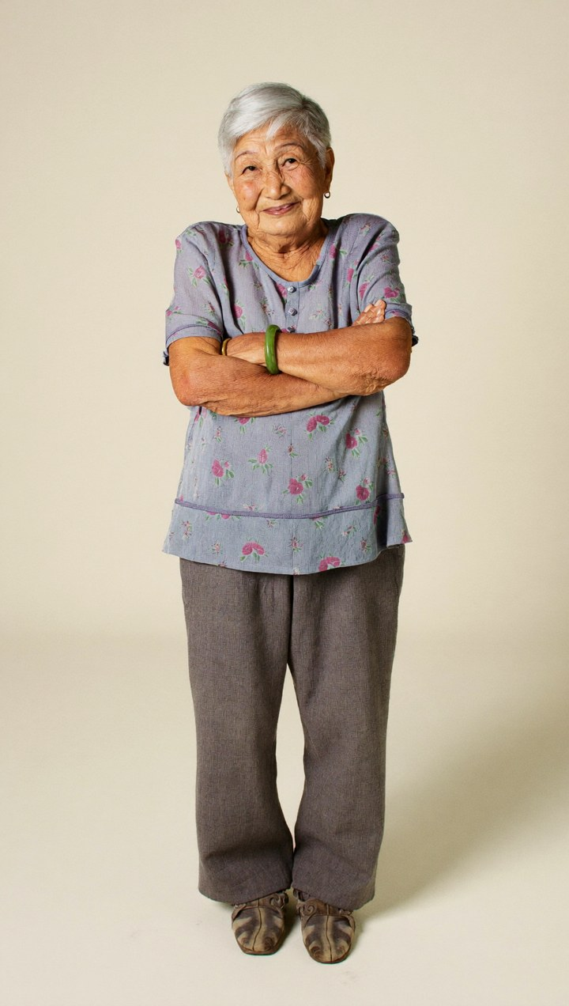

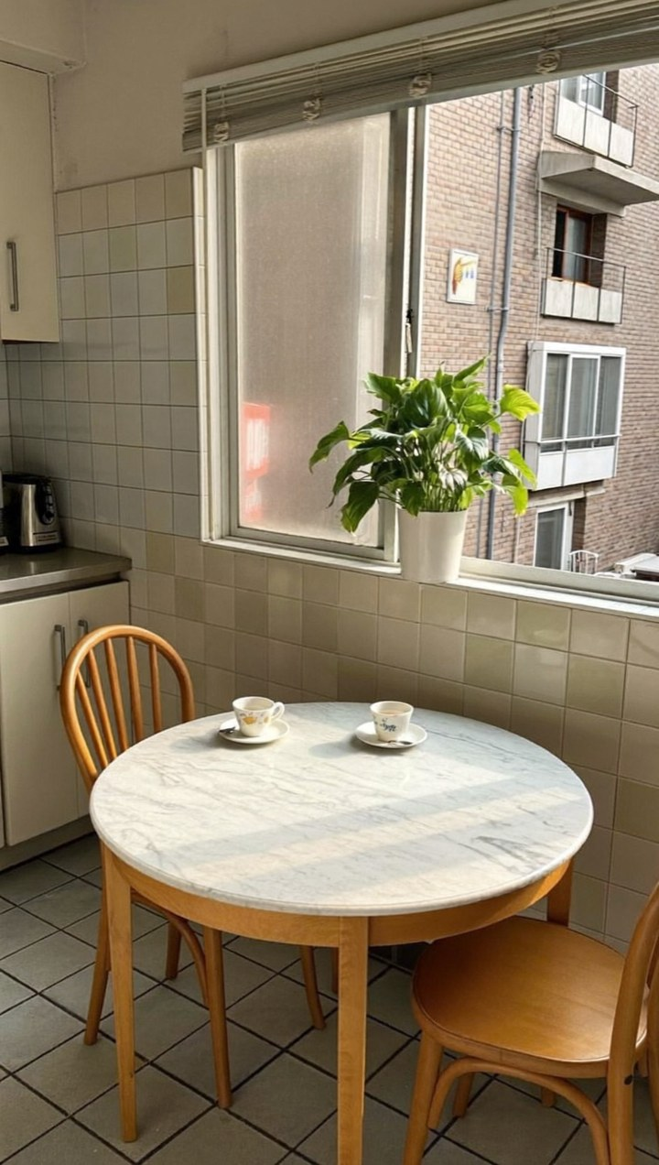
TOPIC 1 · CLAUDE DIRECTS HIGGSFIELD
Three Keepers for Under Half a Credit
What came back: Soul 2.0 stills at 0.125 credits each, saved as Elements and reused in all four shots of the demo.
@char_ahma_v1
@char_rachel_v1
@loc_hdb_kitchen_v1
Jade bangle, blue floral blouse, and a smile that knows more than it says.
Round glasses, mustard cardigan: the fixed traits every shot repeats.
Take two. Take one had garbled text on a tin, so Claude re-rolled it without the tin.
© Tertiary Infotech Academy Pte Ltd
Agentic AI for Video Creation · C436
64
Notes:
The demo's references: Ah Ma, Rachel and Ah Ma's HDB kitchen, each a Soul 2.0 still at about 0.125 credits. The first kitchen showed garbled text on a tin (a typical AI quality issue), so Claude re-rolled it without the tin. All three were saved as Elements and used in every shot.

Slide 65
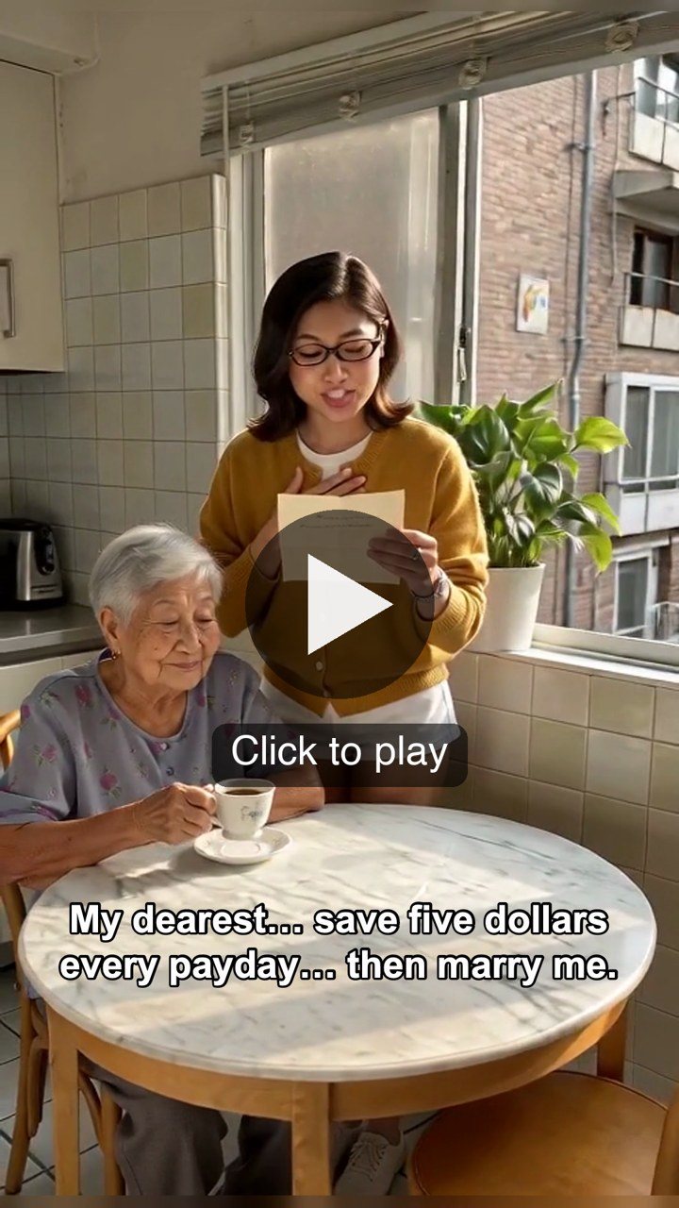
TOPIC 1 · DEMO
Ah Ma's Love Letter: 23 Seconds of Film for 14 Credits
The whole course in one short film. Claude wrote and boarded it, Higgsfield shot it, LahLah Video cut it.
The story
Rachel finds a 1972 letter in Ah Ma's blue tin and reads it aloud, expecting romance. It is a proposal with a savings plan.
Four shots, lip-synced
Seedance 2.0 Mini at 480p: 2.5 credits a shot, dialogue and sound generated with the picture.
Music and the cut
A 22-second ElevenLabs music bed (3.2 credits), cut at 24 fps with captions, an end card and the AI label.
The punchline
Ah Ma: "That's why got this tin lah." Love is… saving first.
AI-generated video, fictional characters. Made 8 Nov 2026. Click the video to play.
© Tertiary Infotech Academy Pte Ltd
Agentic AI for Video Creation · C436
65
Notes:
The course demo, made on 8 Nov 2026 with the course prompts. Four shots on Seedance 2.0 Mini at 480p (2.5 credits each; one 6-second shot) with lip-synced dialogue, three stills and a 22-second ElevenLabs music bed: about 14 credits in all. Cut in LahLah Video at 24 fps with captions, an end card and the AI label. The video is embedded, so it plays offline.

Slide 66
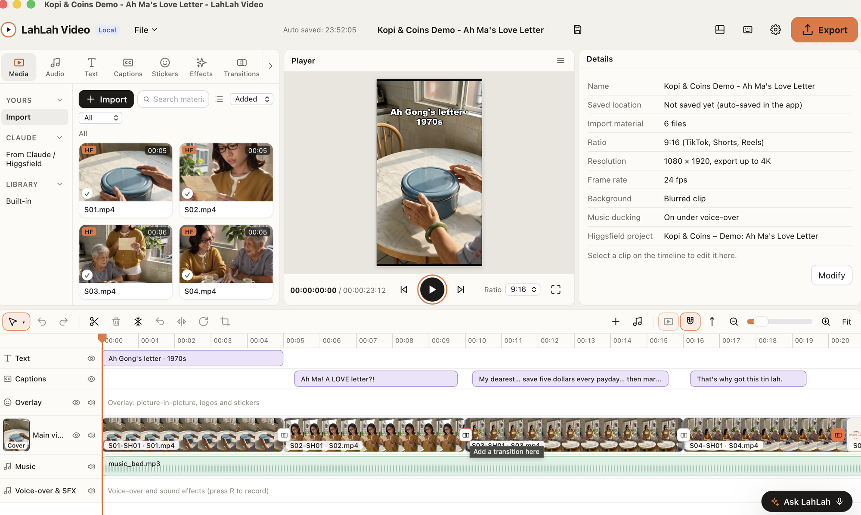
TOPIC 1 · DEMO
How the Demo Was Cut: Four Clips, Three Captions, One Music Bed
The same film open in LahLah Video. Claude built this timeline from one hand-off file; you only press Play and Export.
From Claude / Higgsfield
S01-S04 arrive in the media bin tagged HF, straight from the Higgsfield project.
Read the tracks
Text, captions, overlay, main video, music, voice-over: top to bottom, like CapCut.
Details that matter
9:16, 1080 x 1920, 24 fps to match the clips, music ducking on under the voices.
Ask LahLah
Bottom right: say or type the next edit. Export sits top right.
© Tertiary Infotech Academy Pte Ltd
Agentic AI for Video Creation · C436
66
Notes:
The demo open in LahLah Video. Claude's hand-off file (lahlah-edit.json) placed the four Higgsfield clips on the main track, the title and three captions above them and the music bed below, with ducking under the voices. The project runs at 24 fps to match the clips: a 30 fps project repeats frames and the motion judders. Ask LahLah (bottom right) takes the next edit by voice or text.

Slide 67
TOPIC 1 · QUALITY ISSUES
Types of Quality Issues in Video Content
Know what can go wrong so you can design it out — and spot it in review.
TYPE
EXAMPLES
HOW YOU NOTICE
Technical — picture
Low resolution, blur, flicker, compression blocks, wrong aspect ratio, black frames.
Full-screen playback on the target device; check export settings.
Technical — sound
Clipping, noise, music over voice, uneven loudness, out-of-sync audio.
Headphones; a loudness meter.
AI generation
Face drift, extra fingers, warped objects, garbled text, impossible physics, uncanny lip-sync.
Frame-by-frame checks against references.
Story and continuity
Weak hook, unclear message, slow pacing, props or clothes that change, jump cuts.
Watch as a viewer; compare adjacent shots.
Compliance
Unlicensed music, missing disclaimer, misleading claims, personal data, unlabelled AI content.
Check against standards and a checklist.
© Tertiary Infotech Academy Pte Ltd
Agentic AI for Video Creation · C436
67
Notes:
Quality issues fall into five types: technical picture problems, technical sound problems, issues typical of AI generation, story and continuity problems, and compliance problems. Knowing the type tells you how to spot the issue and which kind of solution will fix it.

Slide 68
TOPIC 1 · QUALITY ISSUES
Quality Issues Typical of AI Video
Generative video fails in recognisable ways. Name them so you can prompt against them.
Identity drift
Anatomy and objects
Garbled text
The face, hair or glasses change between shots.
Extra fingers, melting hands, a phone that bends.
Signs, screens and labels become nonsense letters.
Physics and motion
Lip-sync and voice
Style drift
Objects pass through each other; walking slides; flicker between frames.
Mouths out of time; voice that does not fit the character.
Lighting, colour or art style changes mid-episode.
© Tertiary Infotech Academy Pte Ltd
Agentic AI for Video Creation · C436
68

Slide 69
TOPIC 1 · SCRIPT REVIEW
Edit Types and When to Use Them
Reviewing a script means deciding which edits will deliver the creative vision.
EDIT
WHAT IT DOES
EPISODE 1 EXAMPLE
Cut / jump cut
Moves on instantly; a jump cut compresses time.
Laptop dies → bank balance.
Cutaway / B-roll
Shows detail that supports the voice.
The labelled envelopes inside the tin.
Match cut
Links two shots by shape or action.
The tin lid closing → the banking app opening.
Montage
Compresses time in a rhythm of short shots.
Three paydays in three seconds.
J-cut / L-cut
Sound leads or trails the picture.
Ah Ma's voice starts before we see her.
Text overlay
Puts the key idea on screen.
"Rule 1: rainy day first."
© Tertiary Infotech Academy Pte Ltd
Agentic AI for Video Creation · C436
69
Notes:
Reviewing a script means deciding, scene by scene, which edits will create the intended feeling. A match cut links two ideas, a montage compresses time, a J-cut or L-cut lets sound lead or trail the picture, and a text overlay fixes the key idea in the viewer's memory.

Slide 70
TOPIC 1 · SCRIPT REVIEW
Reviewing a Script for Edits
A procedure you can run on any script — with or without an agent.
1
Find the vision Re-read the brief: audience, one message, tone.
2
Mark the beats Split the script into hook, set-up, turn, choice, payoff, end card.
3
Name the feeling For each beat, what should the viewer feel?
4
Choose the edits Pick the edit types that create that feeling (cut, match cut, montage, J/L-cut, text).
5
Flag the risks Note the quality issues each scene invites.
6
Decide Accept, change or reject — and record why.
TIP The agent can draft the review; the producer owns the decisions.
© Tertiary Infotech Academy Pte Ltd
Agentic AI for Video Creation · C436
70

Slide 71
LAB 02 · HANDS-ON
Plan the Story with Claude and the Storytelling Skill
LAB 02
DAY 1 · ~50 MIN
THE STORY SO FAR
Priya wants Episode 1, The Rainy-Day Tin, live in two weeks. Before anyone spends a Higgsfield credit, the story has to work on paper — and you need to know which edits and which quality risks each scene will bring.
YOU'LL BUILD
01-idea__brief, 01-idea__script-v1 and 01-idea__script-review saved to the project knowledge
Surface: Claude Desktop — the storytelling skill
Features: Prompt Builder · creative brief · 60-second script · script review for edits · quality-issue forecast
© Tertiary Infotech Academy Pte Ltd
Agentic AI for Video Creation · C436
71
Notes:
Lab 2 (50 min). Use one AI agent and one skill to turn an idea into a brief and a timed script, then review the script to decide the edits each scene needs. One agent is enough here. Planning is a single line of thought — brief, script, review — and the storytelling skill gives Claude the studio's structure for a micro-drama: hook in three seconds, set-up, turn, choice, payoff, end card. The Prompt Builder holds a template for every stage, genre and platform. You change the words in [BRACKETS]; the structure that makes the prompt work stays put. The brief comes before the script because it fixes the audience, the one message and the rules. A script written without a brief drifts into generic money tips. The script review is the skill at work here: reading a script and deciding which edits will deliver the creative vision — a match cut between the tin and the banking app, a montage for "six months later", a text overlay for the rule. Your decision step matters. Claude proposes; the producer decides. Record why you rejected a suggestion — that note is evidence of judgement.

Slide 72
LAB 02 · STEPS
Plan the Story with Claude and the Storytelling Skill
Claude Desktop — the storytelling skill · the full step-by-step, with the reasoning, is in your Learner Guide.
1
Open the project Start a new chat inside the Ep1 project. Attach episode-01-idea.pdf.
5
Review for edits Prompt C: for every scene Claude names the edit types it needs and why.
2
Build the prompt Open prompt-builder.html: Stage Story, Genre Micro-drama, Platform TikTok. Fill the brackets, Copy, paste — or use Prompt A.
6
Forecast quality issues Prompt D: the quality issues most likely in each scene and how to prevent them.
3
Brief first Prompt A calls the storytelling skill for the creative brief. Correct anything that breaks the studio rules.
7
Decide as the producer Accept or reject at least two suggestions. Save the three files to project knowledge with the 01-idea__ prefix.
4
Write the script Prompt B: six timed scenes, voice-over, on-screen text and sound for 60 seconds.
© Tertiary Infotech Academy Pte Ltd
Agentic AI for Video Creation · C436
72

Slide 73
LAB 02 · THE PROMPT
Plan the Story with Claude and the Storytelling Skill
PROMPT A — creative brief (storytelling skill)
Use the storytelling skill. Read the studio brief in this project and the attached episode idea.
Write a one-page creative brief for Episode 1, "The Rainy-Day Tin": audience, the one message, platform and format (TikTok, 9:16, 60 seconds), tone, logline, characters, call to action, must include, must avoid.
Rules: general money education only. No product names, no promised returns, no numbers we cannot source. Ask me up to three questions before you write if anything is unclear.
© Tertiary Infotech Academy Pte Ltd
Agentic AI for Video Creation · C436
73

Slide 74
LAB 02 · THE PROMPT
Plan the Story with Claude and the Storytelling Skill (cont.)
PROMPT B — the 60-second script
Using the approved brief, write the script for Episode 1.
Six scenes, timed to exactly 60 seconds:
hook (0-5s), set-up, turn, choice, payoff, end card (55-60s).
For each scene give: time range, what we SEE, voice-over or dialogue, on-screen text, and sound (music cue or effect). Keep spoken lines short — under 140 words in total. End card: "Start your rainy-day tin this payday." plus the disclaimer from the studio brief.
© Tertiary Infotech Academy Pte Ltd
Agentic AI for Video Creation · C436
74

Slide 75
LAB 02 · THE PROMPT
Plan the Story with Claude and the Storytelling Skill (cont.)
PROMPT C — script review for edits
Review script-v1 as a video editor before production.
Make a table, one row per scene: scene, what the scene must make the viewer feel, the edit types it needs (for example cut, cutaway or B-roll, match cut, montage, J or L cut, text overlay, speed ramp, transition, music cue), and why each edit serves the story.
Then list two scenes where a different edit would be stronger, and say what you would change.
© Tertiary Infotech Academy Pte Ltd
Agentic AI for Video Creation · C436
75

Slide 76
LAB 02 · THE PROMPT
Plan the Story with Claude and the Storytelling Skill (cont.)
PROMPT D — quality-issue forecast
For the same six scenes, forecast the quality issues we are most likely to meet when Higgsfield generates this episode.
Group them as: technical (picture and sound), AI generation (for example face drift, extra fingers, garbled text), story and continuity, and compliance (music rights, disclaimer, misleading money claims).
For each issue give the scene, how we would notice it, and one way to prevent it in the prompt or the edit.
NOTE The cheapest place to fix a video is the script. Every edit you decide now is a Higgsfield credit you will not spend later.
© Tertiary Infotech Academy Pte Ltd
Agentic AI for Video Creation · C436
76

Slide 77
LAB 02 · VERIFY
Plan the Story with Claude and the Storytelling Skill
Your story should survive these six questions before it meets a storyboard.
CHECK YOUR WORK
✓
The brief names one audience, one message and the must-avoid rules.
✓
The script has six scenes that add up to exactly 60 seconds.
✓
The end card carries the call to action and the disclaimer.
✓
The script review lists the edit types for every scene, with a reason for each.
✓
The quality forecast covers all four groups of issues.
✓
You accepted or rejected at least two suggestions and wrote why.
© Tertiary Infotech Academy Pte Ltd
Agentic AI for Video Creation · C436
77

Slide 78
TOPIC 1 · STANDARDS
Editing Standards and Guidelines
The written rules every episode — and every agent — must meet before publishing.
Brand
Story
Captions
Colours, fonts, logo position, the end card.
Hook in 3 seconds, one message, pacing limits.
Always on, accurate, two lines max, in the safe zone.
Audio
Legal
Platform
Voice clarity, music under voice, loudness target.
Rights, personal data, money messaging, AI labelling.
9:16, 1080x1920, frame rate, duration limits.
© Tertiary Infotech Academy Pte Ltd
Agentic AI for Video Creation · C436
78
Notes:
Editing standards are the written rules every episode must meet. Writing them down makes them checkable by a reviewer — and usable by an AI agent as a skill. Each rule should have a number or a yes/no test.

Slide 79
TOPIC 1 · STANDARDS
Legal Requirements for Video in Singapore
What the studio's guidelines must protect against. General guidance — not legal advice.
AREA
REQUIREMENT
GUIDELINE FOR KOPI & COINS
Copyright
Copyright Act 2021: music, images and footage need permission or a licence.
Use licensed or rights-cleared generated music; record the licence.
Personal data
PDPA: do not collect, use or show personal data without consent.
Fictional characters only; no real bank screens or names.
Money messaging
Financial Advisers Act: recommending specific products is regulated advice.
General education only; no products, no promised returns; disclaimer.
Advertising
Singapore Code of Advertising Practice (ASAS): truthful, not misleading; disclose sponsorship.
No exaggerated claims; label any sponsored episode.
AI content
Platforms require labels for realistic altered or synthetic content.
Turn on the AI-content disclosure when uploading.
© Tertiary Infotech Academy Pte Ltd
Agentic AI for Video Creation · C436
79
Notes:
A studio publishing money education in Singapore must respect copyright, personal data protection, the line between general education and regulated financial advice, advertising standards, and platform rules on AI-generated content. This table is general guidance for the course scenario, not legal advice.

Slide 80
TOPIC 1 · STANDARDS
Broadcasting and Platform Standards
Technical rules your guidelines should quote with numbers.
STANDARD
REQUIREMENT
FOR A 60 S SHORT
Loudness — broadcast
EBU R128: -23 LUFS integrated, true peak ≤ -1 dBTP.
Reference for TV versions.
Loudness — streaming
Platforms normalise near -14 LUFS.
Mix to about -14 LUFS, true peak ≤ -1 dBTP.
Picture
Rec. 709 colour, constant frame rate, no black or frozen frames.
1080x1920, 24-30 fps, H.264 MP4.
Captions
WCAG 2.2 — captions for all prerecorded audio.
Burned-in or uploaded; checked for accuracy.
Framing
Title- and action-safe areas.
Text clear of the bottom ~20% and the right edge.
TIP Platform limits change. Check the platform's help pages before each campaign.
© Tertiary Infotech Academy Pte Ltd
Agentic AI for Video Creation · C436
80
Notes:
Broadcast loudness is set by EBU R128 (-23 LUFS) in Europe and ATSC A/85 (-24 LKFS) in the US; streaming platforms normalise playback to roughly -14 LUFS. Picture, captions and framing have their own standards. Quote them with numbers in your guidelines.

Slide 81
TOPIC 1 · WORK PLANS
The Post-Production Workflow
Post-production in order. Every stage has an input, an output and an owner.
01
02
03
04
05
06
References
Assembly
Fine cut
Sound and captions
QC and compliance
Approve and deliver
Reference stills, style frames, voice — locked before generation.
Shots placed in story order: the rough cut.
Timing, pacing and story review; picture lock.
Voice, music, effects, loudness, captions.
Technical parameters and standards checked.
Human approval, export, publish.
© Tertiary Infotech Academy Pte Ltd
Agentic AI for Video Creation · C436
81

Slide 82
TOPIC 1 · WORK PLANS
A Post-Production Work Plan
The plan your Lab 3 CSV follows — 10 working days for Episode 1.
STAGE
OWNER
DAYS
DEPENDS ON
REVIEW GATE
Reference stills
Producer
1
Approved script
Asset bible signed off
Drafts, then 1080p
Claude + Higgsfield
2
References
Storyboard, script and budget approved
Rough cut and story review
Editor
2
Generation
Story review: every scene lands
Sound, captions, fine cut
Editor
2
Story review
Picture lock
QC and compliance
Reviewer
1
Fine cut
All parameters PASS
Approval and export
Founder
1 + 1 buffer
QC
Signed approval
© Tertiary Infotech Academy Pte Ltd
Agentic AI for Video Creation · C436
82
Notes:
A work plan lists each post-production stage with its owner, duration, dependency and review gate. The dependencies define the critical path; the gates define where work stops until someone approves.

Slide 83
TOPIC 1 · WORK PLANS
Timelines and Review Gates
A plan that hits its date has three features.
A critical path
Review gates
A buffer for AI
The chain of stages that cannot overlap. Its length is the shortest possible schedule.
Points where work stops until someone approves: storyboard, picture lock, QC, final approval.
Allow a day to regenerate failed shots. AI production is fast, but not always right first time.
© Tertiary Infotech Academy Pte Ltd
Agentic AI for Video Creation · C436
83

Slide 84
LAB 03 · HANDS-ON
Storyboard Artifact, Editing Standards and Work Plan
LAB 03
DAY 1 · ~60 MIN
THE STORY SO FAR
The script is approved. Before Claude may send a single shot to Higgsfield, the studio needs an asset bible so Rachel looks the same in every shot, a storyboard you have approved, the editing rules every episode must follow, and a plan with dates.
YOU'LL BUILD
02-storyboard__ep01-approved.html, the asset bible, editing standards and work-plan.csv in the project
Surface: Claude Desktop — the storyboard skill and artifacts
Features: Character and asset bible · storyboard as an HTML artifact · review and approve · editing standards · work plan CSV
© Tertiary Infotech Academy Pte Ltd
Agentic AI for Video Creation · C436
84
Notes:
Lab 3 (60 min). Turn the approved script into the documents a production team — human or AI — works from, and approve the storyboard before any credit is spent. An asset bible lists the traits that must never change — face, hair, glasses, clothes, the prop. Video models forget; repeating the same five traits in every shot prompt, and animating from an approved reference still, is how you keep Rachel recognisable. The storyboard skill writes a self-contained HTML artifact: one card per shot with size, angle, camera move, action, dialogue, on-screen text, sound, asset references and the Higgsfield prompt. Artifacts block outside images and video, so the board stays text and colour — and loads anywhere. The approval gate is the point of the artifact. The skill stops and waits; the higgsfield-video skill will refuse to generate until it finds an approved storyboard and script. Editing standards are the skill at work here: guidelines every editor (and every agent) follows, written against legal requirements — copyright, personal data, fair money messaging, AI labelling — and platform standards such as loudness, safe areas and captions. The work plan is the skill at work here: the post-production stages in order, each with an owner, a duration and a review gate, so the episode can hit its date.

Slide 85
LAB 03 · STEPS
Storyboard Artifact, Editing Standards and Work Plan
Claude Desktop — the storyboard skill and artifacts · the full step-by-step, with the reasoning, is in your Learner Guide.
1
Lock the characters Prompt A: the asset bible — five fixed traits each for Rachel, Ah Ma and the blue tin, plus a reference prompt for each.
5
Write the standards Prompt D: the studio's editing standards and guidelines, legal and platform rules included.
2
Storyboard as an artifact Prompt B calls the storyboard skill. Claude opens a shot-card storyboard marked DRAFT beside the chat.
6
Plan the post-production Prompt E gives a work plan; save it as work-plan.csv and set real dates.
3
Pick the camera language In the Prompt Builder (Stage Storyboard), tick shot sizes, angles and camera moves for each shot and paste them in as changes.
7
Peer review Swap storyboards with a partner. Each names one continuity risk in the other's board.
4
Review, then approve Prompt C requests changes. Only when every shot is right, reply APPROVED; the banner turns green.
© Tertiary Infotech Academy Pte Ltd
Agentic AI for Video Creation · C436
85

Slide 86
LAB 03 · THE PROMPT
Storyboard Artifact, Editing Standards and Work Plan
PROMPT A — character and asset bible
Create the asset bible for Kopi & Coins.
For Rachel Tan (29), Ah Ma (74) and the blue butter-cookie tin, give: role in the story, five visible traits that must never change (face, hair, clothing, accessories, colours), how they move and speak, and one reference-image prompt each (front view, neutral light, plain background, 9:16).
Rachel: shoulder-length black hair, round tortoiseshell glasses, mustard-yellow cardigan over a white T-shirt. Ah Ma: short silver permed hair, jade bangle, floral blouse. Save it to project knowledge as 02-storyboard__asset-bible.
© Tertiary Infotech Academy Pte Ltd
Agentic AI for Video Creation · C436
86

Slide 87
LAB 03 · THE PROMPT
Storyboard Artifact, Editing Standards and Work Plan (cont.)
PROMPT B — storyboard artifact (storyboard skill)
Use the storyboard skill on the approved Episode 1 script.
Make the storyboard as an HTML artifact: six to eight shot cards for TikTok, 9:16, 60 seconds. Each card: shot ID (S01-SH01), time, shot size, camera angle, camera move (a Higgsfield preset name where one fits), the one action, characters, dialogue or VO, on-screen text, sound, continuity line and asset references.
Faces in the upper third; text clear of the bottom 20% of the frame (35% if you also post to Reels). Respect the 180-degree rule in the video-call scene. Mark it DRAFT and stop for my review.
© Tertiary Infotech Academy Pte Ltd
Agentic AI for Video Creation · C436
87

Slide 88
LAB 03 · THE PROMPT
Storyboard Artifact, Editing Standards and Work Plan (cont.)
PROMPT C — request changes, then approve
Changes to the storyboard:
- S01-SH01: start on the $1,400 repair quote, ECU, camera [CAMERA_MOVE, e.g. Dolly In].
- S03-SH01: high angle on the tin, camera Static.
- Payoff shot: mirror the framing of the hook. Keep every other shot unchanged. Show me the new version.
(When every shot is right, reply only: APPROVED)
© Tertiary Infotech Academy Pte Ltd
Agentic AI for Video Creation · C436
88

Slide 89
LAB 03 · THE PROMPT
Storyboard Artifact, Editing Standards and Work Plan (cont.)
PROMPT D — editing standards and guidelines
Write the editing standards: the rules every Kopi & Coins episode must meet before it is published.
Sections:
1. Brand: colours, fonts, logo position, end card.
2. Story: hook in the first 3 seconds, one message, pacing.
3. Captions: always on, accuracy, line length, safe area.
4. Audio: dialogue clarity, music under voice, loudness target.
5. Legal: music and image rights, no personal data, money messaging (general education only, no promised returns, disclaimer), labelling AI-generated content.
6. Platform: 9:16, 1080x1920, frame rate, duration limits, TikTok and YouTube AI-content labels.
Make every rule checkable, with a number or a yes/no test.
© Tertiary Infotech Academy Pte Ltd
Agentic AI for Video Creation · C436
89

Slide 90
LAB 03 · THE PROMPT
Storyboard Artifact, Editing Standards and Work Plan (cont.)
PROMPT E — post-production work plan
Create a post-production work plan for Episode 1 as CSV with columns: stage, task, owner, start day, duration (hours), depends on, review gate, done when.
Stages in order: reference stills in Higgsfield, low-res draft shots, upgrade approved shots to 1080p, assembly in LahLah Video, story review, fine cut, sound mix, captions, technical QC, compliance review, approval, export, publish.
We have 10 working days. Put a human approval gate before publish, and allow one day for regenerating failed shots.
NOTE Standards written down are standards Claude can follow. Standards in your head are surprises at review time.
© Tertiary Infotech Academy Pte Ltd
Agentic AI for Video Creation · C436
90

Slide 91
LAB 03 · VERIFY
Storyboard Artifact, Editing Standards and Work Plan
Nothing goes to Higgsfield until this board passes.
CHECK YOUR WORK
✓
The asset bible fixes five visible traits each for Rachel, Ah Ma and the tin, with a reference prompt each.
✓
The storyboard artifact has six to eight shot cards, each with one size, one angle, one camera move and one action.
✓
Every card has a continuity line and asset references.
✓
The storyboard banner reads APPROVED, and the approved file is saved as 02-storyboard__ep01-approved.
✓
The standards cover brand, story, captions, audio, legal and platform — each rule checkable.
✓
work-plan.csv lists every stage with an owner, a duration and a review gate, and fits 10 working days.
© Tertiary Infotech Academy Pte Ltd
Agentic AI for Video Creation · C436
91

Slide 92
TOPIC 1 · RECAP
Episode 1 Exists on Paper — and Your Studio Is Ready
Episode 1 exists on paper — fully planned.
Set up — Lab 1
Planned — Lab 2
Specified — Lab 3
Five skills, the Higgsfield connector, a project and LahLah Video.
A creative brief, a 60-second script and a review of the edits each scene needs.
An asset bible, an approved storyboard artifact, editing standards and a 10-day work plan.
© Tertiary Infotech Academy Pte Ltd
Agentic AI for Video Creation · C436
92

Slide 93
TOPIC 2
AI-Assisted Video Editing, Storytelling and Quality Assurance
1
The production run: Claude shoots Episode 1 in Higgsfield
2
References, camera presets and the scene prompt formula
3
Draft low-res, upgrade the keepers; platforms
4
Reviewing footage, parameters and fixes in LahLah Video
© Tertiary Infotech Academy Pte Ltd
Agentic AI for Video Creation · C436
93

Slide 94
TOPIC 2 · THE PRODUCTION RUN
How Claude Produces Episode 1 in Higgsfield
The higgsfield-video skill, step by step — it refuses to start without two approvals and a budget.
01
02
03
04
05
06
07
Approvals
Credit plan
References
Low-res drafts
Upgrade the keepers
File
Hand-off
Storyboard and script both APPROVED.
balance + models_explore: cost at draft and at 1080p, plus 30%.
generate_image: one approved still per character and prop.
Batch drafts at 480p or 720p; jobs_wait.
Only approved drafts re-made at 1080p.
Every job moved into the project's Higgsfield folder.
Download links, lahlah-edit.json, captions.srt.
© Tertiary Infotech Academy Pte Ltd
Agentic AI for Video Creation · C436
94
Notes:
The higgsfield-video skill checks two approvals and a budget, generates one reference still per character and prop, drafts every shot at low resolution, upgrades only the approved drafts to 1080p, asks you to file every job in the project's Higgsfield folder, and hands over download links, lahlah-edit.json and captions.srt.

Slide 95
TOPIC 2 · CONSISTENCY
References: Locking Characters and Props
The single biggest lever for consistency in AI video.
Still first
Animate from the still
generate_image makes a front-view still of Rachel from the asset bible. You pick one; it becomes @Rachel.
Every shot is image-to-video from that still, so the face is never re-invented.
Soul ID for a long series
Props are characters too
Train an identity from 5-20 photos in about 10 minutes — fictional or consenting people only.
The blue tin gets its own still: same colour, same dent, labels added in the editor.
© Tertiary Infotech Academy Pte Ltd
Agentic AI for Video Creation · C436
95
Notes:
Approve one reference still per character and important prop, then animate every shot from it (image-to-video). For a long series, Higgsfield's Soul ID trains an identity from 5-20 photos — use it only for fictional or consenting people.

Slide 96
TOPIC 2 · CINEMATIC EFFECTS
Camera Presets That Change the Feeling
Name the preset in the prompt; Claude matches it with presets_show. Seven of Higgsfield's 64:
PRESET
WHAT THE CAMERA DOES
EPISODE 1 SHOT
Dolly In
Glides toward the subject; builds focus.
Slowly onto the phone with the repair quote.
Crash Zoom In
A fast punch-in; shock.
The bank balance lands.
Handheld
A slight, human shake; realism.
Rachel's late-night video call.
Crane Up
Rises above the scene; release.
Six months later, the calm desk.
Whip Pan
A fast swipe; energy and a transition.
Payday montage, one bucket after another.
360 Orbit
Circles the subject; a reveal.
Ah Ma lifts the tin lid.
Static
No movement; calm, readable.
The end card.
TIP Preset names from higgsfield.ai/camera-controls; the meanings are this course's plain-English glosses.
© Tertiary Infotech Academy Pte Ltd
Agentic AI for Video Creation · C436
96
Notes:
Higgsfield names 64 camera presets. Naming one in a shot prompt — Dolly In to build focus, Crash Zoom In for shock, Crane Up for release — changes how the viewer feels about the moment. Where no preset fits, describe the move in plain words.

Slide 97
TOPIC 2 · SCENE CREATION
The Scene Prompt Formula
Every shot prompt has the same nine slots. Fill them from the asset bible and the Prompt Builder chips.
SCENE PROMPT — the formula, then Episode 1, shot 1
[SHOT_SIZE] [ANGLE] of [SUBJECT], [ACTION],
in [LOCATION_TIME], [LIGHTING], [MOOD], [COLOUR_GRADE],
camera: [CAMERA_MOVE], [LENS], 9:16,
no on-screen text, no logos
Extreme close-up, eye level, of a phone glowing in a young
woman's hand, small silver watch on her wrist, her thumb
freezes, at a home desk at night, warm desk-lamp light,
tense mood, muted teal-and-amber grade,
camera: Dolly In, slow, 50mm, 9:16,
no on-screen text, no logos
© Tertiary Infotech Academy Pte Ltd
Agentic AI for Video Creation · C436
97
Notes:
Every shot prompt fills the same slots: shot size, angle, subject, one action, place and time, lighting, mood, colour grade, camera move, lens and aspect ratio, ending with "no on-screen text, no logos" because text is added in the editor.

Slide 98
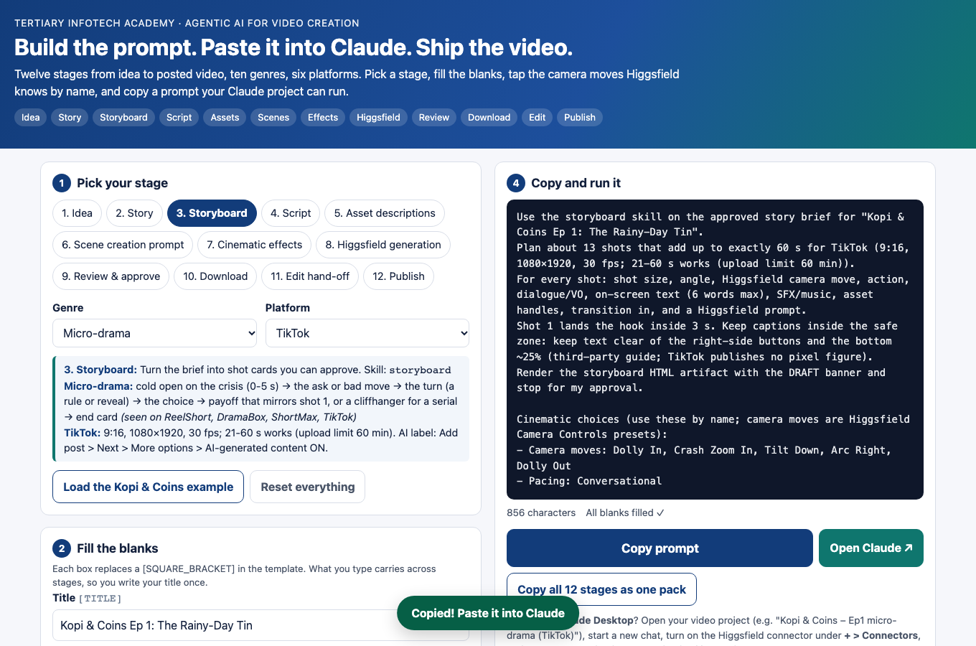
TOPIC 2 · PROMPT BUILDER
The Prompt Builder: Tick, Fill, Copy
labs/prompt-builder.html — a template for every stage, genre and platform, ready to paste into Claude.
Pick three things
Stage, genre (micro-drama, product ad, explainer…) and platform (TikTok, YouTube, Shorts, Reels, micro-drama apps).
Tick the camera language
Any number of the 64 presets, plus angles, shot sizes, lens, lighting, mood, grade and transitions.
Fill the brackets
Change only the [BRACKETED] words; the structure that works stays put.
Copy to Claude
One click copies the prompt; Open Claude starts a new chat.
© Tertiary Infotech Academy Pte Ltd
Agentic AI for Video Creation · C436
98
Notes:
The Prompt Builder page holds a template for every stage, genre and platform. Learners pick a stage, genre and platform, tick any number of camera presets, angles and looks, fill the bracketed words and copy the result into Claude.

Slide 99
TOPIC 2 · CREDITS
Five Seconds of Video Costs 2.5 to 60 Credits
Same 9:16 shot, twelve Higgsfield models. Draft on the cheap rows, finish on the dear ones.
MODEL
SETTING
CREDITS
SOUND
USE IT FOR
Seedance 2.0 Mini
480p · 5 s
2.5
Yes
Drafts: the course default
Seedance 2.0 Mini
720p · 5 s
5
Yes
Sharper drafts
Wan 3.0 · Grok 1.5 Lite
480p · 5 s
5
Wan only
Second-opinion drafts
Hailuo 2.3
768p · 6 s
6
No
Motion from a start frame
Veo 3.1 Lite
4 s, audio on
6
Yes
Short spoken lines
Kling 3.0 Turbo
720p / 1080p · 5 s
7.5 / 10
No
Cheapest 1080p finals
Kling 3.0 · Kling 2.6
5 s, sound on
10
Yes
Finals with sound
Kling 4.0 Flash · 4.0
720p / 1080p · 5 s
15 / 16.25
No
Complex motion, many references
Seedance 2.5 · 2.0
5 s · 2.0 at 1080p
35 / 60
Yes
Hero shots only
TIP Live quotes from higgsfield generate cost, 8 Nov 2026. Prices move: ask Claude to price every batch before it spends.
© Tertiary Infotech Academy Pte Ltd
Agentic AI for Video Creation · C436
99
Notes:
Prices are live quotes from the Higgsfield CLI (generate cost) for a 9:16 shot on 8 November 2026. Seedance 2.0 Mini at 480p is the cheapest model that also makes sound and dialogue, at 0.5 credits a second. Hailuo has no sound option and is priced for 6 seconds at 768p. Kling 3.0 drops to 7.5 credits with sound off. Prices change, so the higgsfield-video skill prices every batch before it spends.

Slide 100
TOPIC 2 · CREDITS
Draft Low-Res, Then Upgrade the Keepers
Higgsfield prices by model, seconds and resolution. Make your mistakes where they are cheap.
Draft at 480p or 720p
Upgrade only what you approve
Seedance 2.0 Mini at 480p, sound included.
Same still, same prompt, same preset — final model.
A 5-second draft: 2.5 credits.
Kling 3.0 Turbo, 5 s at 1080p: 10 credits.
Fix framing, action and continuity here.
One 1080p shot costs four drafts; Seedance 2.5 costs 14.
Re-roll freely — a draft is disposable.
Course rule: no 1080p shot without an approved draft.
© Tertiary Infotech Academy Pte Ltd
Agentic AI for Video Creation · C436
100
Notes:
Higgsfield prices by model, length and resolution: 2.5 credits for a 5-second Seedance 2.0 Mini draft at 480p against 10 for a 5-second Kling 3.0 Turbo shot at 1080p and 35 for Seedance 2.5. Draft every shot at 480p, fix it there, then re-generate only the approved shots at 1080p.

Slide 101
TOPIC 2 · CREDITS
Plans, Budgets and Limits
MCP has no credit cap of its own. You set it, in words.
The plans
The connector spends credits
Plus $49 a month for 1,000 credits; Ultra $129 for 3,000; a 3-day Plus trial works through Claude only (higgsfield.ai/pricing, 8 Nov 2026).
The free trial works only through the connector; on paid plans MCP generations spend credits even where the website offers unlimited ones.
Say the budget
Check the live page
"Do not spend more than 150 credits. Ask before every batch." The skill pauses at 80%.
Plans, bonuses and model prices change monthly — confirm before you subscribe.
© Tertiary Infotech Academy Pte Ltd
Agentic AI for Video Creation · C436
101
Notes:
The MCP connector has no credit cap of its own and always spends credits. State the budget in words, ask Claude to price every batch first, and check the live plans page before subscribing.

Slide 102
TOPIC 2 · PLATFORMS
Where Your Episode Lives
Frame, length and the AI label for each platform (checked 8 Nov 2026). Micro-drama apps: ReelShort, DramaBox, ShortMax.
PLATFORM
FRAME
LENGTH
AI LABEL
TikTok
9:16 · 1080x1920
Uploads to 60 min; land the hook in 3 s
More options > AI-generated content
YouTube
16:9 · 1920x1080
15 min until the account is verified
Studio > Attributes > AI use
YouTube Shorts
9:16 · 1080x1920
Up to 3 min
Same AI use setting
Instagram Reels
9:16 · 1080x1920
Up to 20 min; keep 14% top and 35% bottom clear
AI label toggle (wording awaiting verification)
Micro-drama apps
9:16
1-2 min episodes; ReelShort seasons run 70-80
No public spec
TIP Platforms change their limits often. Check the help page before each campaign.
© Tertiary Infotech Academy Pte Ltd
Agentic AI for Video Creation · C436
102
Notes:
Each platform sets its own frame, length and AI-label rules: TikTok and Shorts are 9:16, YouTube 16:9; Shorts run up to 3 minutes; micro-drama apps such as ReelShort use 1-2 minute episodes in long seasons. TikTok and YouTube both ask you to label realistic AI content.

Slide 103
TOPIC 2 · DIRECTING
Directing Claude and Higgsfield
Six habits that turn credits into a usable cut.
1
Approve before you spend Storyboard, script and budget — in that order.
2
Name the skill "Use the video-script skill on the approved board" beats twenty lines of instructions.
3
References first A still for every character and important prop.
4
One shot, one action Split any shot that does two things.
5
Draft low, upgrade the keepers 480p or 720p first; 1080p only for approved drafts.
6
Say what to keep "Re-roll S03-SH01 only; keep everything else."
© Tertiary Infotech Academy Pte Ltd
Agentic AI for Video Creation · C436
103
Notes:
Six habits keep a production on budget: approve before you spend, name the skill, make references first, keep one action per shot, draft low and upgrade the keepers, and say exactly what to keep when you ask for a change.

Slide 104
LAB 04 · HANDS-ON
Create Episode 1 with Claude and Higgsfield
LAB 04
DAY 1 · ~75 MIN
THE STORY SO FAR
The storyboard is approved and Priya has set a credit budget. Your job today: get every shot of Episode 1 made in Higgsfield, with Rachel, Ah Ma and the tin the same in every shot, filed in one Higgsfield folder, and downloaded ready to edit — without spending full-resolution credits on shots you will throw away.
YOU'LL BUILD
Higgsfield folder "Kopi & Coins – Ep1 micro-drama (TikTok)" with reference stills, drafts and finals; clips saved as S01-SH01.mp4 …; lahlah-edit.json and captions.srt
Surface: Claude Desktop + Higgsfield MCP — the video-script and higgsfield-video skills
Features: Shot list · asset descriptions · scene and cinematic prompts · approval · credit plan · reference stills · low-res drafts · upgrade the keepers · jobs_wait · Higgsfield folder · download · lahlah-edit.json
© Tertiary Infotech Academy Pte Ltd
Agentic AI for Video Creation · C436
104
Notes:
Lab 4 (75 min). Direct Claude to produce the episode in Higgsfield — script, prompts, approval, budget, references, low-res drafts, then high-res finals — and keep every asset traceable in one Higgsfield folder. The video-script skill turns each storyboard card into a shot that a model can make: one action, the asset's five traits, one camera move, the lighting and grade, and the aspect ratio. It writes an image-to-video prompt (animate from a reference still) and a text-to-video fallback. Cinematic effects are Higgsfield's named camera presets — Dolly In, Crash Zoom In, Whip Pan, 360 Orbit, Crane Up, FPV Drone, Bullet Time and 57 more. Claude matches each shot to a preset from presets_show; where no preset fits, it writes the move into the prompt in plain words. Draft low, finish high. Higgsfield prices by model, length and resolution: an 8-second Kling 3.0 shot at 720p costs about 16 credits; an 8-second Seedance 2.5 shot at 1080p about 72. Test framing, action and continuity on cheap low-res drafts, then spend high-res credits only on the shots you keep. References first is the consistency rule: approve one still per character and prop, then animate every shot from that still. A face that never has to be re-invented cannot drift. Higgsfield files MCP generations in Assets. Make a folder with the project's name and Move every job into it — the skill lists the job IDs. Claude cannot fetch the MP4s itself; you click each result link and save the clip.

Slide 105
LAB 04 · STEPS
Create Episode 1 with Claude and Higgsfield
Claude Desktop + Higgsfield MCP — the video-script and higgsfield-video skills · the full step-by-step, with the reasoning, is in your Learner Guide.
1
Script the shots Prompt A calls the video-script skill: shots, VO, asset descriptions and two video prompts per shot, as an artifact.
5
Draft every shot low-res Cheap model, 480p or 720p, generate_video_batch then jobs_wait. Fix the story here, where a re-roll is cheap.
2
Add cinematic effects, approve Prompt Builder (Stage Scene creation): tick camera presets, angles, lens, lighting, grade; paste as changes; reply APPROVED.
6
Upgrade the keepers Prompt C re-makes only the approved drafts at 1080p on the final model, from the same still and prompt.
3
Agree the budget Prompt B calls the higgsfield-video skill: balance, models_explore, a credit table at draft and final resolution.
7
File, download, hand off Move every job into the Higgsfield folder; save each clip as S01-SH01.mp4 in 05-edit; download lahlah-edit.json and captions.srt.
4
References first Claude calls generate_image for Rachel, Ah Ma and the tin. Pick one still each.
© Tertiary Infotech Academy Pte Ltd
Agentic AI for Video Creation · C436
105

Slide 106
LAB 04 · THE PROMPT
Create Episode 1 with Claude and Higgsfield
PROMPT A — shots, assets and video prompts (video-script skill)
Use the video-script skill on the approved storyboard.
For every shot give: shot ID, timeline seconds, the one action, dialogue or VO, on-screen text (added in the editor, never generated), the assets in shot with their five fixed traits, and two prompts:
- i2v: animate from the approved reference still;
- t2v: fallback with no still.
Scene prompt formula:
[SHOT_SIZE] [ANGLE] of [SUBJECT], [ACTION], in [LOCATION_TIME], [LIGHTING], [MOOD], [COLOUR_GRADE], camera: [CAMERA_MOVE], [LENS], 9:16, no on-screen text, no logos.
Show it as an HTML artifact marked DRAFT and stop.
© Tertiary Infotech Academy Pte Ltd
Agentic AI for Video Creation · C436
106

Slide 107
LAB 04 · THE PROMPT
Create Episode 1 with Claude and Higgsfield (cont.)
PROMPT B — budget, references, low-res drafts (higgsfield-video skill)
Use the higgsfield-video skill to produce Episode 1.
1. Check the storyboard and script are APPROVED.
2. Call balance and models_explore: a cheap draft model (480p or 720p) and a final model (1080p).
3. Credit table: stills, low-res drafts, 1080p upgrades, +30%. Budget [BUDGET] credits. Ask before every batch.
4. On Go: generate_image for Rachel, Ah Ma and the tin; wait for my picks.
5. Draft every shot LOW-RES with generate_video_batch; poll jobs_wait; keep the status table. No 1080p yet.
6. Folder: "Kopi & Coins – Ep1 micro-drama (TikTok)". List the job IDs to Move into it.
© Tertiary Infotech Academy Pte Ltd
Agentic AI for Video Creation · C436
107

Slide 108
LAB 04 · THE PROMPT
Create Episode 1 with Claude and Higgsfield (cont.)
PROMPT C — upgrade the keepers to high resolution
These drafts are approved: [SHOT_IDS]. Re-generate ONLY these at 1080p on the final model, from the same reference still, the same prompt and the same camera preset. Show the cost first. Leave rejected drafts alone. Add the new job IDs to the status table and the folder list.
© Tertiary Infotech Academy Pte Ltd
Agentic AI for Video Creation · C436
108

Slide 109
LAB 04 · THE PROMPT
Create Episode 1 with Claude and Higgsfield (cont.)
PROMPT D — re-roll one draft, then hand off
S03-SH01 drifted: the tin has no dent and the labels are garbled. Re-roll this LOW-RES draft only, from the approved tin still, camera Static, no text in the prompt — we add the labels in LahLah Video.
When every shot is final, write lahlah-edit.json (schema lahlah-edit/1, platform tiktok, 9:16, 30 fps, clips in timeline order with trim_in and trim_out, transitions from the storyboard, captions in timeline seconds) and captions.srt. Give me the 1080p download links in order, named S01-SH01.mp4 and so on, and the total credits spent.
NOTE Draft low, finish high. A re-roll at 480p costs a fraction of one at 1080p — make your mistakes where they are cheap.
© Tertiary Infotech Academy Pte Ltd
Agentic AI for Video Creation · C436
109

Slide 110
LAB 04 · VERIFY
Create Episode 1 with Claude and Higgsfield
Count the credits, then count the clips in the folder.
CHECK YOUR WORK
✓
The script artifact is APPROVED, with an i2v and a t2v prompt and one camera move for every shot.
✓
A credit table at draft and final resolution was approved before any generation.
✓
One approved reference still each for Rachel, Ah Ma and the tin.
✓
Every shot was drafted low-res first; only approved drafts were upgraded to 1080p.
✓
Every still, draft and final sits in the Higgsfield folder named after the project, with its job ID in the status table.
✓
The 1080p clips are saved in 05-edit as S01-SH01.mp4 …, with lahlah-edit.json and captions.srt beside them.
© Tertiary Infotech Academy Pte Ltd
Agentic AI for Video Creation · C436
110

Slide 111
TOPIC 2 · REVIEW
Reviewing Edited Footage: Two Passes
Two different questions — do them separately.
Pass 1 · Story and emotion
Pass 2 · Technical
Then prioritise
Watch as an engineer. For each parameter: what is the value, what is the target, pass or fail?
Choose the three fixes that matter most. A review that lists 20 problems fixes none.
Watch as a viewer, on a phone. For each scene: what should I feel, what do I feel, what change would close the gap?
© Tertiary Infotech Academy Pte Ltd
Agentic AI for Video Creation · C436
111
Notes:
Review edited footage twice. The story pass asks what the viewer feels in each scene and what change would strengthen it. The technical pass measures each parameter against its target.

Slide 112
TOPIC 2 · STORY REVIEW
A Scene-by-Scene Story Review
Propose changes that strengthen the story and the emotion in each scene.
SCENE
INTENDED FEELING
ASK
TYPICAL CHANGE
Hook
Shock, recognition
Do I understand the problem in 3 s?
Start on the quote, not the room.
Set-up
Embarrassment, warmth
Do I care about Rachel yet?
Hold her reaction a beat longer.
Turn
Surprise, curiosity
Is the reveal clear?
Close-up on the labels; add the lid sound.
Choice
Determination
Does it drag?
Montage of three paydays.
Payoff
Relief, pride
Is the contrast with the hook obvious?
Mirror the opening shot.
End card
Clarity
Is the action clear and readable?
One line; on screen 3+ s.
© Tertiary Infotech Academy Pte Ltd
Agentic AI for Video Creation · C436
112

Slide 113
TOPIC 2 · STORY REVIEW
Emotion, Pacing and Rhythm
The edit decides how a scene feels — often more than the picture.
Shot length
Reaction shots
Short shots raise energy; a held shot lets a feeling land. Vary them.
We feel through faces. Cut to Rachel when Ah Ma opens the tin.
Music and silence
Contrast
A music drop before the reveal makes it land.
The payoff mirrors the hook: same framing, opposite feeling.
© Tertiary Infotech Academy Pte Ltd
Agentic AI for Video Creation · C436
113
Notes:
Editing controls emotion: shot length sets energy, reaction shots let us feel through a character, music and silence frame a reveal, and a payoff that mirrors the hook makes the change visible.

Slide 114

CASE STUDY · AI MUSIC VIDEO
Case Study: 过来人 The OGs
A 4:41 AI music video: ten performers, about 100 cuts, one room. Made on LibTV (its on-screen credit). Here is how you would rebuild it with Claude and Higgsfield.
The concept
Ten figures from Chinese history rap their famous setbacks as modern office pains: rent, layoffs, KPIs, the age-35 wall.
The structure
Three 45-48 s verses, then a cypher of seven 6-16 s turns. Energy builds as the faces turn over faster.
The lock
One set, one lighting recipe, one chrome microphone, one recurring crowd: 100 shots read as one night.
The label
AI disclosure on screen from the very first shot.
▶ Open in YouTube
Video: 喆FILM. Analysis: The MacDoctor teardown, 6 Nov 2026. Click Enable Content, then click the video in Slide Show.
© Tertiary Infotech Academy Pte Ltd
Agentic AI for Video Creation · C436
114
Notes:
The OGs is a 4 minute 41 second AI music video in which ten figures from Chinese history rap their setbacks as modern office problems. Its on-screen credit says it was made on LibTV. It works because six things never change — set, lighting, microphone, crowd, camera arc and graphics — while the singer and framing do. Trainer: PowerPoint blocks online video in decks it did not create; click Enable Content on the yellow bar, then click the video in Slide Show.

Slide 115
CASE STUDY · AI MUSIC VIDEO
Rebuild It: Claude Writes, Higgsfield Generates, You Edit
Six phases from the teardown's rebuild plan, mapped to this course's skills.
PHASE
WHAT YOU MAKE
SKILL OR TOOL
Song
Original lyrics: one figure, one setback, one modern pain, one gag per verse. Vocals with one dry stem per singer and a timing sheet.
storytelling skill; an AI singing tool
Bible
Set, lighting and microphone blocks plus a 25-40-word description per character, pasted into every prompt.
storyboard skill (asset bible)
Assets
Ten character sheets, a crowd persona sheet, a mic prop sheet and 4-6 empty plates of the hall.
higgsfield-video: generate_image (Seedream 5.0 or GPT Image 2.5)
Keyframes
One still per hero shot; approve light and composition while it is cheap.
higgsfield-video
Motion
Performance takes with the vocal stem as audio reference; silent crowd reactions on a cheap model; drafts at 480p first.
Seedance 2.5; Kling 3.0 Turbo
Edit
Master audio first, cut on lyric lines, reaction shots over the joins, name cards, captions, 1080p24 plus a 9:16 cut.
LahLah Video or CapCut
TIP Model choices follow the teardown and the live Higgsfield catalogue; run models_explore before you plan a budget.
© Tertiary Infotech Academy Pte Ltd
Agentic AI for Video Creation · C436
115
Notes:
A rebuild runs in six phases: song, bible, assets, keyframes, motion and edit. Claude writes the lyrics, bible blocks and every prompt; Higgsfield makes the stills and performance takes; the editor lays the master audio first and cuts on lyric lines.

Slide 116
CASE STUDY · AI MUSIC VIDEO
Five Tricks to Steal from The OGs
Copy the system, not the lines.
Generate long, cut short
Hide drift in short shots
Cast the crowd
One 10-15 s take per 3-5 lyric lines, cut into 3-4 shots: about 5 takes make a 45 s verse.
An average shot of 2-3 s means no generation has to hold a face for long.
Recurring modern personas — office worker, delivery rider, tired dad — each a viewer who sees themself.
Lock six things
Label it on screen
Set, light, prop, crowd, camera arc and graphics stay fixed; only the singer and framing change.
The AI disclosure is part of the design, not a footnote.
© Tertiary Infotech Academy Pte Ltd
Agentic AI for Video Creation · C436
116
Notes:
Generate long takes and cut them short, keep shots to 2-3 seconds so faces never drift, cast a recurring crowd of viewer personas, lock six things, and put the AI disclosure on screen from the first shot.

Slide 117
TOPIC 2 · PARAMETERS
Parameters to Assess Video Quality: Picture
Measurable qualities, each with a target for a 60-second vertical episode.
PARAMETER
WHAT IT MEASURES
TARGET
Resolution / aspect ratio
Pixel size and shape of the frame.
1080x1920, 9:16 — never a low-res draft.
Frame rate
Frames per second; constant or variable.
24, 25 or 30 fps, constant.
Duration
Total running time.
55-60 s; end card ≥ 3 s.
Bitrate / compression
Detail kept after encoding.
No visible blocking in motion or dark areas.
Exposure and colour
Brightness, contrast and colour consistency.
Shots match; no crushed blacks or blown skies.
Sharpness and artefacts
Focus, flicker, warping.
No AI artefacts on faces, hands or text.
© Tertiary Infotech Academy Pte Ltd
Agentic AI for Video Creation · C436
117

Slide 118
TOPIC 2 · PARAMETERS
Parameters to Assess Video Quality: Sound, Text, Continuity
The parameters reviewers miss most often.
PARAMETER
WHAT IT MEASURES
TARGET
Loudness and peaks
Integrated loudness (LUFS), true peak.
About -14 LUFS; true peak ≤ -1 dBTP.
Dialogue clarity
Voice level against music and effects.
Music ducked under voice; every word clear.
A/V and lip-sync
Sound in time with picture.
No visible offset.
Captions
Accuracy, timing, length, position.
100% match; ≤ 2 lines; inside the safe zone.
Continuity
Characters, props, light, screen direction.
Matches the asset bible and the previous shot.
Story clarity
Hook, message, call to action.
Message clear with sound off.
© Tertiary Infotech Academy Pte Ltd
Agentic AI for Video Creation · C436
118

Slide 119
TOPIC 2 · SOLUTIONS
Types of Solutions to Rectify Quality Issues
Match every issue to the cheapest solution that fixes it.
ISSUE
SOLUTION TYPE
HOW, IN PRACTICE
Face or prop drift
Regenerate from the locked reference
Re-roll that shot's low-res draft from the approved still; upgrade once it holds.
Scene drags / weak hook
Re-edit: trim, re-order, re-time
Shorten on the timeline; start on the strongest frame.
Music drowns the voice
Audio mix: ducking, normalising
Lower music under voice; normalise to the loudness target.
Wrong or missing captions
Re-caption and proofread
Re-import captions.srt or auto-caption; correct every line.
Garbled on-screen text
Replace with a graphic overlay
Add text in the editor instead of generating it in the shot.
Low detail / soft image
Upgrade or re-export
Swap the draft for its 1080p upgrade; export at 1080p.
TIP Prevention beats repair: most fixes started as a missing reference or an unclear prompt.
© Tertiary Infotech Academy Pte Ltd
Agentic AI for Video Creation · C436
119
Notes:
Each kind of issue has a matching kind of solution: regenerate with locked references, re-edit on the timeline, re-mix the audio, re-caption, replace generated text with a graphic, or re-export and enhance. Choose the cheapest solution that fixes the problem, and prevent it next time in the prompt or the reference.

Slide 120
TOPIC 2 · SOLUTIONS
Where to Fix It — Cheapest First
Four places to make a change, from free to costly.
The editor
The prompt
Trim, re-order, duck the music, re-caption in LahLah Video or CapCut — no credits at all.
Change one shot's prompt in Claude and re-roll its low-res draft.
The reference
The 1080p upgrade
Re-pick or re-make the still when a face or a prop drifts.
Only after the draft passes — the costly step, used last.
© Tertiary Infotech Academy Pte Ltd
Agentic AI for Video Creation · C436
120
Notes:
Fix in the editor first, then the prompt, then the reference still, and only then pay for a new 1080p upgrade.

Slide 121
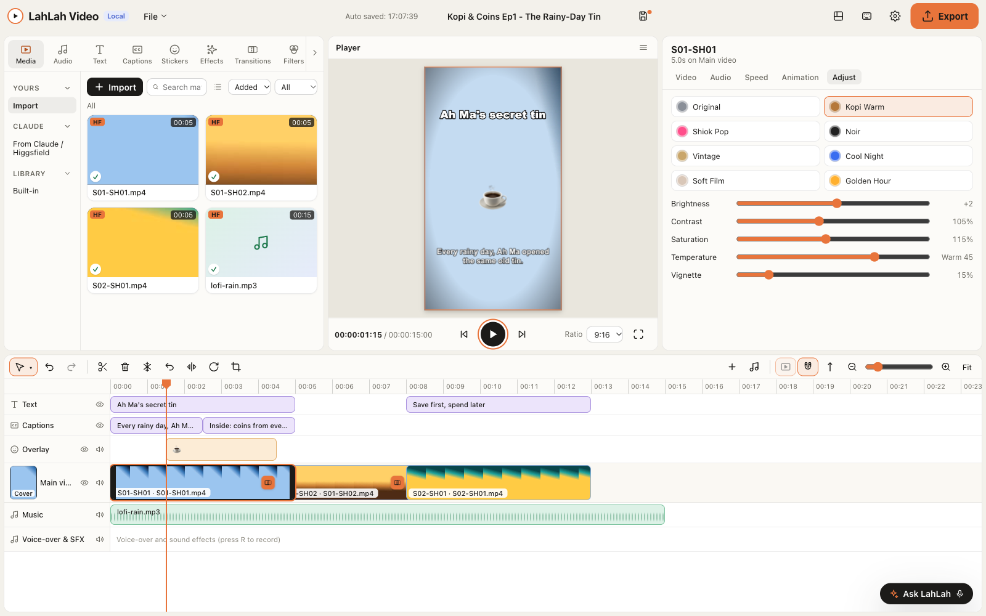
TOPIC 2 · LAHLAH VIDEO
LahLah Video — CapCut-Style Editing, Installed by Claude
A free desktop editor for Mac and Windows that opens Claude's hand-off file and takes voice commands.
Opens the hand-off
lahlah-edit.json lays the clips, trims, transitions and captions on a 9:16 canvas.
The tools you expect
Multi-track timeline, split, speed, transitions, filters, text, captions, music, export presets.
Edit by voice
Click Ask LahLah or press Cmd/Ctrl+K, then say "split at 3 seconds". LahLah Voice (Mac) or Win+H types it for you.
One prompt to install
Ask Claude to install it — or download the .dmg or .exe.
© Tertiary Infotech Academy Pte Ltd
Agentic AI for Video Creation · C436
121
Notes:
LahLah Video is a free desktop editor for Mac and Windows. It opens the lahlah-edit.json file Claude writes, offers the CapCut-style tools an editor expects, and takes plain-English commands that LahLah Voice or Windows voice typing can dictate.

Slide 122
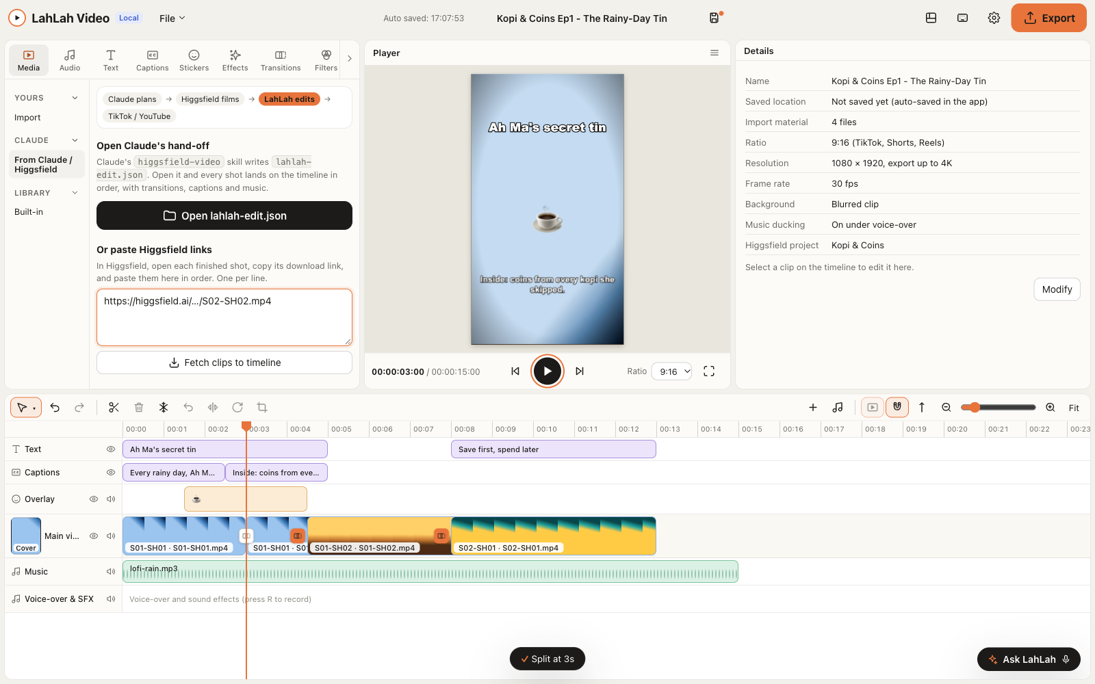
TOPIC 2 · LAHLAH VIDEO + CLAUDE
Claude Cuts the Rough Edit While You Watch
Install the LahLah Video extension and Claude drives the editor directly: open, split, caption, export.
One double-click
lahlah-video.mcpb adds the connector to Claude Desktop. No config file to edit.
Eleven tools
open_handoff, add_clips, run_command, set_captions, export, snapshot and more: Claude edits, you approve.
From Claude / Higgsfield
Open the hand-off or paste Higgsfield download links; each shot lands on the timeline in order.
Your key stays local
Settings › API holds the key. The editor only listens on your own computer.
© Tertiary Infotech Academy Pte Ltd
Agentic AI for Video Creation · C436
122
Notes:
LahLah Video ships a Claude Desktop extension (lahlah-video.mcpb) with eleven tools. Claude opens the hand-off, applies edit commands, sets captions, takes a snapshot frame for you to check and exports for TikTok or YouTube. The editor listens only on 127.0.0.1 and needs the API key from Settings › API; regenerate the key if it is ever shared.

Slide 123
TOPIC 2 · THE EDITOR
LahLah Video or CapCut?
Both cut the episode. Pick by how you like to work.
LahLah Video (course default)
CapCut desktop
Opens lahlah-edit.json: clips, trims and captions in one click.
Auto captions in 30+ languages, templates and effects.
Voice commands from LahLah Voice or Win+H.
Import clips in filename order; Captions > Import file for the .srt.
Free; no watermark; installed by one prompt to Claude.
Cannot read lahlah-edit.json — trim by hand.
Export presets for TikTok, Shorts and YouTube.
4K, 60 fps and Pro-badged assets need CapCut Pro.
© Tertiary Infotech Academy Pte Ltd
Agentic AI for Video Creation · C436
123
Notes:
Both editors cut the episode. LahLah Video reads Claude's hand-off file and takes voice commands; CapCut brings auto captions, templates and effects but needs the clips and captions imported by hand, and some features need CapCut Pro.

Slide 124
TOPIC 2 · TECHNICAL QC
The Technical QC Procedure
Assess edited footage against parameters — the same way every time.
1
Check the export Read resolution, frame rate and duration from the export settings or file info.
2
Play full screen on the target device A phone, sound on, then sound off.
3
Measure the sound Loudness and peaks with a meter; listen for clipping and buried voice.
4
Read every caption Against the script, for timing and position.
5
Compare adjacent shots Faces, props, light, direction.
6
Record and decide Value, target, PASS or FAIL, evidence — then fix and re-check.
TIP A QC report without values is an opinion. Record the number.
© Tertiary Infotech Academy Pte Ltd
Agentic AI for Video Creation · C436
124
Notes:
Technical QC compares the edited footage with measurable targets: resolution, frame rate, duration, loudness, captions and continuity. Record the actual value, the target and PASS or FAIL, so that anyone can repeat the check.

Slide 125
TOPIC 2 · TECHNICAL QC
Measuring the File (Trainer Demo)
Two commands that turn "looks fine" into evidence. FFmpeg is free.
COMMANDS — ffprobe and ffmpeg
# resolution, frame rate and duration
ffprobe -v error -select_streams v:0 \
-show_entries stream=width,height,r_frame_rate:format=duration \
-of default=nw=1 EP01_v1.mp4
# integrated loudness (LUFS) and true peak (dBTP)
ffmpeg -i EP01_v1.mp4 -af loudnorm=print_format=summary -f null -
# expected for TikTok: width=1080 height=1920, 30/1 fps,
# duration about 60, Input Integrated about -14 LUFS,
# Input True Peak no higher than -1 dBTP
© Tertiary Infotech Academy Pte Ltd
Agentic AI for Video Creation · C436
125

Slide 126
LAB 05 · HANDS-ON
Edit, Review and Refine in LahLah Video
LAB 05
DAY 2 · ~80 MIN
THE STORY SO FAR
The shots are in. Priya watches the assembled cut on her phone and says: "Something's off, but I can't say what." Your job: build the cut, review it twice — once for story, once for technical quality — and fix what matters most.
YOU'LL BUILD
EP01_v1.mp4 and EP01_v2.mp4, a story review, a QC report with values, and a fix log
Surface: LahLah Video (or CapCut) + Claude Desktop
Features: Open lahlah-edit.json · voice commands · captions · music · export · story review · technical QC · three fixes · v2
© Tertiary Infotech Academy Pte Ltd
Agentic AI for Video Creation · C436
126
Notes:
Lab 5 (80 min). Assemble the episode, assess it against the story and the technical parameters, and propose and make the changes that improve it. LahLah Video reads the hand-off file Claude wrote: the clips in order, trimmed, with transitions and captions on a 9:16 canvas. CapCut does the same job by hand — import the clips in filename order, then Captions > Import file for the .srt. Voice commands make editing hands-free: press Cmd/Ctrl+K and say "split at 3 seconds", "add crossfade" or "export for TikTok". On a Mac, LahLah Voice types the words for you; on Windows, Win+H does the same. Review twice, separately. The story pass asks what the viewer feels in each scene. The technical pass measures each parameter against its target. Mixing them gives a muddled list. Choose the cheapest fix that works: trim or re-order before re-generating; re-mix the audio before replacing the music; add text in the editor instead of generating it; and when you must re-generate, draft the fix at low res before paying for 1080p. A QC report without values is an opinion. Record the number: 1080x1920, 30 fps, 59.5 s, -14.2 LUFS.

Slide 127
LAB 05 · STEPS
Edit, Review and Refine in LahLah Video
LahLah Video (or CapCut) + Claude Desktop · the full step-by-step, with the reasoning, is in your Learner Guide.
1
Open the edit LahLah Video > Open edit > lahlah-edit.json. No credits left? Open mock-clips/lahlah-edit.json instead.
5
Technical pass Read the export info; Prompt B turns your readings into a QC report with PASS or FAIL.
2
Finish the rough cut Clips speak and music is laid. Sit the music under the voices, add the end card text, check captions.
6
Fix three things One re-made shot in Higgsfield (Prompt C: low-res draft, then 1080p), one audio fix and one caption or text fix in LahLah Video.
3
Export v1 Export for TikTok: 1080x1920, 30 fps, H.264 MP4.
7
Export v2 and re-check Re-run the failed parameters. Record each fix in the fix log.
4
Story pass Watch on your phone. Prompt A: a scene-by-scene story review with Claude.
© Tertiary Infotech Academy Pte Ltd
Agentic AI for Video Creation · C436
127

Slide 128
LAB 05 · THE PROMPT
Edit, Review and Refine in LahLah Video
PROMPT A — story review
I watched EP01_v1 on my phone. Here are my notes per scene:
[YOUR NOTES]
Make a story review table, one row per scene: intended feeling, the feeling it actually creates, and one specific change that would strengthen the story and emotion (pacing, shot order, reaction shot, music, text). Then rank the three changes that matter most.
© Tertiary Infotech Academy Pte Ltd
Agentic AI for Video Creation · C436
128

Slide 129
LAB 05 · THE PROMPT
Edit, Review and Refine in LahLah Video (cont.)
PROMPT B — technical QC report
Here are the readings for EP01_v1:
resolution [W x H], frame rate [FPS], duration [SECONDS], loudness [LUFS] and true peak [dBTP], caption errors [N], continuity notes [NOTES].
Check each against the editing standards in this project. Return a table: parameter, value, target, PASS or FAIL, evidence, fix. Use the cheapest fix that works.
© Tertiary Infotech Academy Pte Ltd
Agentic AI for Video Creation · C436
129

Slide 130
LAB 05 · THE PROMPT
Edit, Review and Refine in LahLah Video (cont.)
PROMPT C — re-make one shot (higgsfield-video skill)
Use the higgsfield-video skill. Re-make [SHOT_ID] only, from the approved reference still, with this change: [CHANGE]. Camera [CAMERA_MOVE]. Draft it low-res first and show me; only after I approve, upgrade it to 1080p on the final model. Show the cost of each step, file both jobs in the Ep1 Higgsfield folder, and update lahlah-edit.json with the new src.
© Tertiary Infotech Academy Pte Ltd
Agentic AI for Video Creation · C436
130

Slide 131
LAB 05 · THE PROMPT
Edit, Review and Refine in LahLah Video (cont.)
COMMANDS — read the file (optional, FFmpeg)
# resolution, frame rate and duration
ffprobe -v error -select_streams v:0 \
-show_entries stream=width,height,r_frame_rate:format=duration \
-of default=nw=1 EP01_v1.mp4
# integrated loudness (LUFS) and true peak (dBTP)
ffmpeg -i EP01_v1.mp4 -af loudnorm=print_format=summary -f null -
© Tertiary Infotech Academy Pte Ltd
Agentic AI for Video Creation · C436
131
Notes:
NOTE: Fix the cut, not the credits. Most problems disappear with a trim, a re-order or a caption — regenerate last.

Slide 132
LAB 05 · VERIFY
Edit, Review and Refine in LahLah Video
Numbers, not feelings: v2 has to beat v1 on every failed line.
CHECK YOUR WORK
✓
EP01_v1.mp4 exported at 1080x1920, 9:16.
✓
The story review covers every scene with intended vs actual feeling and a specific change.
✓
The QC report has at least six parameters with values, targets and PASS or FAIL.
✓
Three fixes made — one in Higgsfield (drafted low-res first), two in the editor — each in the fix log.
✓
EP01_v2.mp4 passes every parameter that failed in v1.
✓
Screenshots of the LahLah Video timeline and the export settings saved as evidence.
© Tertiary Infotech Academy Pte Ltd
Agentic AI for Video Creation · C436
132

Slide 133
TOPIC 2 · RECAP
Episode 1 Is Shot, Cut and Fixed
Episode 1 is made, reviewed and fixed.
Made — Lab 4
Reviewed and fixed — Lab 5
Next — Topic 3
Reference stills, low-res drafts and 1080p finals in one Higgsfield folder, plus a hand-off file.
Make it repeatable and compliant: your own skill, a remedial plan, then your own short film to upload.
A cut in LahLah Video, a story review, a QC report with values, three fixes and v2.
© Tertiary Infotech Academy Pte Ltd
Agentic AI for Video Creation · C436
133

Slide 134
TOPIC 3
Workflow Optimisation, Industry Compliance and Emerging Video Technologies
1
Claude Skills: the studio's know-how as files
2
Industry quality standards and remedial actions
3
Publishing to TikTok and YouTube with the AI label on
4
Emerging video technology and adopting it well
© Tertiary Infotech Academy Pte Ltd
Agentic AI for Video Creation · C436
134

Slide 135
TOPIC 3 · THE STUDIO SYSTEM
One Producer, a Studio's Worth of Know-How
Two episodes a week without hiring: put the studio's way of working where Claude can reuse it.
Skills hold the know-how
Connectors hold the tools
Six SKILL.md folders: storytelling to publishing, plus your compliance review.
Higgsfield over MCP today; any other MCP server tomorrow.
Projects hold the memory
Gates keep people in charge
One project and one Higgsfield folder per episode, filed by stage.
You approve the board, the script, the budget, the cut and the upload.
© Tertiary Infotech Academy Pte Ltd
Agentic AI for Video Creation · C436
135
Notes:
A studio scales when its way of working lives somewhere reusable: skills hold the know-how, connectors hold the tools, projects hold the memory, and approval gates keep people accountable.

Slide 136
TOPIC 3 · SKILLS
Six Skills for a Video Studio
Each skill is one job, written once, loaded when the task matches.
SKILL
THE JOB
HANDS TO
storytelling
Idea to brief, logline, beats and a timed script.
storyboard
storyboard
Shot cards as an HTML artifact; stops for approval.
video-script
video-script
Shots, assets, VO and i2v/t2v prompts with camera presets.
higgsfield-video
higgsfield-video
Budget, references, low-res drafts, 1080p upgrades, folder, hand-off.
LahLah Video or CapCut
kopi-compliance-review
The studio's standards as a repeatable review — your own (Lab 6).
a person who approves
platform-publish
Export, title, hashtags, AI label, private upload plan.
TikTok or YouTube
© Tertiary Infotech Academy Pte Ltd
Agentic AI for Video Creation · C436
136
Notes:
Six skills cover the pipeline: storytelling, storyboard, video-script, higgsfield-video, kopi-compliance-review and platform-publish. Each does one job and hands a named file to the next.

Slide 137
TOPIC 3 · YOUR OWN SKILL
Anatomy of a Skill — SKILL.md
A skill is a folder with SKILL.md. This is the one you install in Lab 6 (shortened).
SKILL.md — inside kopi-compliance-review.zip
---
name: kopi-compliance-review
description: Review a Kopi & Coins episode against the studio's
standards and industry standards; report findings with
evidence, risk and a remedial action. Use before approval.
---
# When to use
Before an episode goes to human approval or upload.
# Procedure
1. Read references/standards.md, the QC report, captions.srt,
the approved script and the upload plan.
2. Check platform specs, loudness, captions and safe areas,
copyright, personal data, money messaging, AI label.
3. One row per finding: standard, evidence, risk, remedy, owner.
4. Mark anything you cannot verify as UNVERIFIED.
# Pitfalls
Never edit the video. Never approve - only a human approves.
© Tertiary Infotech Academy Pte Ltd
Agentic AI for Video Creation · C436
137
Notes:
A skill is a folder whose SKILL.md starts with a name and a description that says when to use it, followed by the procedure and the pitfalls. Claude reads only the description until a task matches, then loads the rest.

Slide 138
TOPIC 3 · SKILLS
Install and Call a Skill in Claude Desktop
Six steps from a folder to a skill Claude uses on every episode.
1
Turn on code execution Settings > Capabilities > Code execution and file creation.
2
Zip one folder The ZIP holds one folder named exactly like the skill, SKILL.md at its root.
3
Upload Customize > Skills > + > Upload a skill.
4
Switch it on Toggle it on; it now shows in every chat.
5
Call it by name "Use the kopi-compliance-review skill on EP01_v2."
6
Improve it Edit SKILL.md, re-zip, re-upload: the next episode is checked for the new rule.
© Tertiary Infotech Academy Pte Ltd
Agentic AI for Video Creation · C436
138
Notes:
Turn on code execution, zip one folder named like the skill, upload it under Customize > Skills, switch it on, call it by name, and improve it by editing SKILL.md and re-uploading.

Slide 139
TOPIC 3 · STANDARDS
Industry Quality Standards: Technical
The published standards a professional video is measured against.
STANDARD
WHAT IT SETS
HOW YOU CHECK
EBU R128 / ATSC A/85
Broadcast loudness: -23 LUFS / -24 LKFS; true peak ≤ -1 dBTP.
Loudness meter on the final mix.
Platform loudness
Streaming normalises near -14 LUFS.
Measure; avoid heavy limiting.
ITU-R BT.709
HD colour space and range.
Scopes; consistent shots.
Platform specifications
Aspect ratio, resolution, codec, duration, safe areas.
Export settings against the help page.
WCAG 2.2 (1.2.2)
Captions for prerecorded audio.
Every spoken line captioned and accurate.
© Tertiary Infotech Academy Pte Ltd
Agentic AI for Video Creation · C436
139
Notes:
Industry quality standards are published, measurable rules — loudness, colour, platform specifications and accessibility. A video that meets them plays correctly and comfortably wherever it is published.

Slide 140
TOPIC 3 · STANDARDS
Industry Quality Standards: Content and Legal
Standards that protect the audience — and the studio.
STANDARD
WHAT IT REQUIRES
KOPI & COINS CHECK
Copyright Act 2021
Permission or licence for music, images and footage.
Licence recorded for every track.
PDPA
No personal data without consent.
Fictional people; no real account screens.
Financial Advisers Act (MAS)
Product recommendations are regulated advice.
General education; disclaimer on end card.
SCAP (ASAS)
Advertising must be legal, decent, honest and truthful.
No promised returns; sponsorship labelled.
TikTok and YouTube AI rules
Label realistic AI-generated media.
AI label on at upload, every episode.
C2PA Content Credentials
Provenance metadata for media.
Keep credentials; TikTok auto-labels them.
© Tertiary Infotech Academy Pte Ltd
Agentic AI for Video Creation · C436
140
Notes:
Content standards protect viewers and the publisher: rights to every asset, personal data protection, fair and lawful money messaging, honest advertising and clear labelling of AI-generated media.

Slide 141
TOPIC 3 · REMEDIAL ACTIONS
From Non-Compliance to Remedy
Every finding needs a corrective action, an owner and a date.
NON-COMPLIANCE
STANDARD
REMEDIAL ACTION
OWNER
Voice says "your savings will grow 8%"
FAA / SCAP
Rewrite to general wording; re-voice the line.
Scriptwriter
Music licence not recorded
Copyright
Replace with licensed track; log the licence.
Editor
Mix at -9 LUFS, clipping
Platform loudness
Re-mix to about -14 LUFS, peak ≤ -1 dBTP.
Editor
Captions under the UI bar
Platform safe area
Move captions up; re-export.
Editor
No AI label in the upload plan
Platform policy
Switch the label on in the upload plan.
Publisher
© Tertiary Infotech Academy Pte Ltd
Agentic AI for Video Creation · C436
141

Slide 142
TOPIC 3 · REMEDIAL ACTIONS
Developing a Remedial Action Plan
A repeatable way to resolve issues that do not comply with industry standards.
1
Identify Find the issue and the evidence: timecode, frame, reading.
2
Reference the standard Name the rule it breaks and why it matters.
3
Assess the risk High: legal or reputational. Medium: viewer experience. Low: polish.
4
Decide the action Correct, replace, re-edit or withdraw — and prevent it recurring.
5
Assign and schedule One owner, one due date, high risks first.
6
Verify and record Re-check after the fix; add a rule to the skill so it does not return.
TIP The last step is what makes a studio better: fix the process, not just the episode.
© Tertiary Infotech Academy Pte Ltd
Agentic AI for Video Creation · C436
142
Notes:
A remedial action plan turns each non-compliance into a corrective action with an owner and a due date, ordered by risk. The final step — updating the standard or the skill — stops the same issue returning in the next episode.

Slide 143
LAB 06 · HANDS-ON
Build a Compliance Skill and Plan Remedial Actions
LAB 06
DAY 2 · ~80 MIN
THE STORY SO FAR
Episode 1 v2 looks good. Before Priya signs it off, the studio needs a review that checks every episode the same way — and a plan for anything that fails.
YOU'LL BUILD
kopi-compliance-review skill installed; a compliance report for EP01_v2; a remedial action plan; EP01_v3
Surface: Claude Desktop — your own skill: kopi-compliance-review
Features: A custom SKILL.md · upload as a skill · compliance review · remedial action plan · fix and re-check · update the skill
© Tertiary Infotech Academy Pte Ltd
Agentic AI for Video Creation · C436
143
Notes:
Lab 6 (80 min). Package the studio's standards as a Claude skill, run it on Episode 1, and turn every finding into a remedial action with an owner and a check. A compliance skill makes review repeatable: the same checks, the same order, the same evidence, every episode. It never edits the video and never approves — only a person approves. Industry standards are the knowledge at work here: loudness (EBU R128 for broadcast, about -14 LUFS for social), platform specifications, WCAG captions, the Copyright Act 2021, the PDPA, the Financial Advisers Act, the ASAS advertising code, and TikTok and YouTube rules for labelling AI content. A remedial action plan is the ability at work here: each finding gets the standard it breaks, a risk level, a corrective action, an owner, a way to verify the fix and a way to stop it recurring. The last step is the one that makes the studio better. When a finding repeats, add a rule to the skill — and the next episode is checked for it automatically.

Slide 144
LAB 06 · STEPS
Build a Compliance Skill and Plan Remedial Actions
Claude Desktop — your own skill: kopi-compliance-review · the full step-by-step, with the reasoning, is in your Learner Guide.
1
Read the skill Open standards.pdf: the rules the skill checks — platform, loudness, captions, rights, PDPA, money messaging, AI labels.
4
Plan the remedies Prompt B: one row per finding — standard, risk, action, owner, check, prevention.
2
Install it Customize > Skills > + > Upload a skill > kopi-compliance-review.zip. Switch it on.
5
Fix the high risks Re-voice or re-caption in LahLah Video; re-make a shot through the higgsfield-video skill if needed (low-res draft first).
3
Run the review Prompt A: Claude calls the skill on EP01_v2 with your QC report and episode-01-v2-notes.pdf.
6
Re-check and improve the skill Run the review on EP01_v3. Prompt C adds one new rule to the skill so the issue cannot return.
© Tertiary Infotech Academy Pte Ltd
Agentic AI for Video Creation · C436
144

Slide 145
LAB 06 · THE PROMPT
Build a Compliance Skill and Plan Remedial Actions
PROMPT A — run the compliance review
Use the kopi-compliance-review skill on Episode 1 v2.
Evidence: my QC report, captions.srt, the approved script, the music licence note and episode-01-v2-notes.pdf (attached).
One row per finding: standard, evidence (timecode, frame or reading), risk (high, medium, low) with a reason, and the remedial action. Mark anything you cannot verify as UNVERIFIED. Do not approve the episode.
© Tertiary Infotech Academy Pte Ltd
Agentic AI for Video Creation · C436
145

Slide 146
LAB 06 · THE PROMPT
Build a Compliance Skill and Plan Remedial Actions (cont.)
PROMPT B — remedial action plan
Turn the findings into a remedial action plan as CSV:
finding, standard, risk, corrective action, owner, due, how we verify the fix, how we prevent it recurring.
Order by risk, high first. Where the fix is a re-make, name the shot ID and the higgsfield-video prompt change, drafted low-res before 1080p.
© Tertiary Infotech Academy Pte Ltd
Agentic AI for Video Creation · C436
146

Slide 147
LAB 06 · THE PROMPT
Build a Compliance Skill and Plan Remedial Actions (cont.)
PROMPT C — improve the skill
The finding "[FINDING]" came from a gap in our process. Draft one new rule for the kopi-compliance-review skill that would catch it next time: the rule, how to check it, the evidence to record. Show the updated SKILL.md section so I can paste it in and re-upload the skill.
NOTE Fix the process, not just the episode. A rule added to the skill today is a finding you never see again.
© Tertiary Infotech Academy Pte Ltd
Agentic AI for Video Creation · C436
147

Slide 148
LAB 06 · VERIFY
Build a Compliance Skill and Plan Remedial Actions
A finding without an owner is a finding that comes back.
CHECK YOUR WORK
✓
kopi-compliance-review shows under Customize > Skills and is on.
✓
The compliance report lists every finding with standard, evidence and risk.
✓
The remedial plan has an owner, a check and a prevention for each finding, high risks first.
✓
High-risk findings are fixed in EP01_v3.
✓
The re-run review shows no high-risk findings.
✓
One new rule drafted for the skill.
© Tertiary Infotech Academy Pte Ltd
Agentic AI for Video Creation · C436
148

Slide 149
TOPIC 3 · PUBLISHING
Publishing: What Each Platform Asks For
The platform-publish skill prepares all of this; you press the button.
PLATFORM
EXPORT
AI LABEL
UPLOAD AS
TikTok
1080x1920, H.264 MP4, 30 fps
More options > AI-generated content
Draft, or private
YouTube Shorts
1080x1920, up to 3 min
Studio > Attributes > AI use
Private, then scheduled
YouTube
1920x1080, H.264, about 8 Mbps
Studio > Attributes > AI use
Private, then scheduled
Instagram Reels
1080x1920; 35% bottom clear
AI label toggle (awaiting verification)
Draft
TIP Higgsfield's connector can post to TikTok; the course skills never do it without your explicit yes.
© Tertiary Infotech Academy Pte Ltd
Agentic AI for Video Creation · C436
149
Notes:
The platform-publish skill prepares export settings, title, description, hashtags and the AI-content label for TikTok, YouTube, Shorts or Reels. Uploads stay private or draft until a person publishes them.

Slide 150
TOPIC 3 · EMERGING TECH
Technologies That Improve Efficiency and Quality
What each technology improves — and the risk to manage.
TECHNOLOGY
IMPROVES
WATCH FOR
Agents with MCP connectors
Claude calls Higgsfield directly; no copy-paste between apps.
Credit spend; tool names change.
Skills
Studio know-how applied the same way every time.
Stale or untrusted skills.
Cinematic presets and models
Film language in one word: Dolly In, Crash Zoom.
Over-styled, show-off shots.
Reference stills and Soul ID
Consistent faces across shots and episodes.
Likeness and consent of real people.
Voice-driven editing
LahLah Voice + LahLah Video: hands-free cuts.
Misheard commands — keep undo close.
Always-on agents and schedules
A weekly cadence (e.g. Hermes Agent with cron).
Publishing work nobody approved.
© Tertiary Infotech Academy Pte Ltd
Agentic AI for Video Creation · C436
150
Notes:
Each new technology improves something specific — agents with connectors remove copy-paste, skills repeat know-how, presets bring film language, references hold faces, voice commands speed editing — and brings a risk to manage. Knowing both is what lets you recommend it responsibly.

Slide 151
TOPIC 3 · ADOPTION
Facilitating the Adoption of New Technology
A new tool is adopted when people use it well — not when it is installed.
01
02
03
04
05
06
Baseline
Pilot
Train
Govern
Measure
Decide
Measure today: time, credits and rework per episode.
Four weeks, one series, a small team, clear success measures.
Hands-on sessions, the skills and Prompt Builder, a champion per team.
Approval gates, credit caps, low-res-first, the compliance skill, AI labels.
Weekly metrics against the baseline.
Scale, adjust or stop — with evidence.
© Tertiary Infotech Academy Pte Ltd
Agentic AI for Video Creation · C436
151
Notes:
Adoption is a change process: measure a baseline, run a small pilot with clear success measures, train people, put governance in place, measure weekly and decide with evidence whether to scale.

Slide 152
TOPIC 3 · ADOPTION
Five Numbers That Decide Whether to Scale
Track these weekly during the pilot. Decide with numbers.
METRIC
MEASURES
PILOT TARGET (EXAMPLE)
Time per episode
Hours from brief to approved cut.
Halve the baseline.
Credits per episode
Generation cost, drafts plus finals.
Within budget; falling week on week.
Draft-to-final ratio
Low-res drafts per approved 1080p shot.
Under 3 — fewer wasted upgrades.
First-pass compliance
Episodes passing review first time.
80% or more.
Audience response
Completion rate, saves and shares.
At or above the baseline.
© Tertiary Infotech Academy Pte Ltd
Agentic AI for Video Creation · C436
152

Slide 153
LAB 07 · HANDS-ON
Mini Capstone: Your Own Short Film, Idea to Upload
LAB 07
DAY 2 · ~70 MIN
THE STORY SO FAR
Priya hands you the studio for an hour: make any short film you like (a micro-drama, an ad, a music clip, a family story) from idea to a private upload, then write the plan that makes this way of working stick. Ah Ma's Love Letter is the worked example.
YOU'LL BUILD
Project "Capstone – [FILM TITLE]"; your film exported as EP02_v1.mp4; a private or draft upload with the AI label on; an adoption plan
Surface: Claude Desktop + Higgsfield + LahLah Video — all skills, platform-publish
Features: Your own idea · a new project · the full skill chain · references as Elements · low-res drafts on a hard budget · LahLah Video · platform-publish · private upload · AI label · adoption plan
© Tertiary Infotech Academy Pte Ltd
Agentic AI for Video Creation · C436
153
Notes:
Lab 7 (70 min). Prove you can run the whole pipeline on a story of your own: approve the board, generate on a budget, cut, check, publish privately with the AI label on, and plan the adoption with your own numbers. This lab is the whole course in one hour on a story you chose: idea, prompt, story, storyboard, script, Higgsfield, edit, review, publish. The skills carry the know-how, so each step is one prompt. Keep it small. Three to five shots of 5 seconds, one location, two characters at most. Ah Ma's Love Letter is four shots, three references and about 14 credits. Export your film as EP02_v1.mp4 and keep the screenshot of the private upload settings with the AI label on. platform-publish prepares everything a platform asks for: export settings, title, description, hashtags, a thumbnail prompt and the AI disclosure. It never posts without your explicit yes. Adopting a new technology means people use it well, not that it is installed. Measure a baseline, run a small pilot, train, govern (credit caps, low-res drafts before 1080p, approval gates, the compliance skill), then decide with numbers.

Slide 154
LAB 07 · STEPS
Mini Capstone: Your Own Short Film, Idea to Upload
Claude Desktop + Higgsfield + LahLah Video — all skills, platform-publish · the full step-by-step, with the reasoning, is in your Learner Guide.
1
Pitch your film Any story you like, 20-45 seconds, 3-5 shots, fictional people only. Fill short-film-brief-template.pdf (see the Ah Ma sample).
4
Cast, then shoot Prompt B: references saved as Elements, low-res drafts with dialogue in quotes, upgrade the keepers, hard budget.
2
New project Create "Capstone – [FILM TITLE]" from project-capstone-setup.pdf; add your brief and your standards.
5
Cut and export Open lahlah-edit.json in LahLah Video; captions, music under the voices, end card, AI label; export EP02_v1.mp4.
3
Idea to approved board Prompt A chains storytelling and storyboard: three loglines, then the brief, asset bible and board. Approve it.
6
Check, publish privately, plan Run kopi-compliance-review, then Prompt C (platform-publish, Private or draft) and Prompt D (adoption plan).
© Tertiary Infotech Academy Pte Ltd
Agentic AI for Video Creation · C436
154

Slide 155
LAB 07 · THE PROMPT
Mini Capstone: Your Own Short Film, Idea to Upload
PROMPT A — your idea to an approved storyboard
Use the storytelling skill, then the storyboard skill.
My short film: [ONE-LINE IDEA]. Genre [GENRE], for [PLATFORM], 9:16, [LENGTH: 20-45] seconds, [3-5] shots, fictional characters only: [WHO].
Give me three loglines and stop. After I pick one, write the brief, the asset bible (characters, location, props) and the storyboard artifact marked DRAFT, then stop for my approval.
© Tertiary Infotech Academy Pte Ltd
Agentic AI for Video Creation · C436
155

Slide 156
LAB 07 · THE PROMPT
Mini Capstone: Your Own Short Film, Idea to Upload (cont.)
PROMPT B — cast, then shoot on a hard budget
Use the video-script skill on the approved storyboard, then the higgsfield-video skill.
1. References first: one 9:16 still per character, location and key prop; save the ones I approve as Elements.
2. Draft every shot at 480p on Seedance 2.0 Mini, sound on; put each spoken line in quotes with the speaker named.
3. Upgrade to 1080p only the drafts I approve.
Hard limit: [BUDGET] credits in total; ask before each batch. Higgsfield project: "Capstone – [FILM TITLE]". Finish with the status table, download links, lahlah-edit.json (fps = the clips' frame rate) and captions.srt.
© Tertiary Infotech Academy Pte Ltd
Agentic AI for Video Creation · C436
156

Slide 157
LAB 07 · THE PROMPT
Mini Capstone: Your Own Short Film, Idea to Upload (cont.)
PROMPT C — publish privately (platform-publish skill)
Use the platform-publish skill for EP02_v1 ("[FILM TITLE]") on [PLATFORM].
Give me: export settings, a title under 60 characters, a description with the AI disclosure, five hashtags, a thumbnail prompt, and the exact clicks to switch on the AI-content label. The upload stays Private (YouTube) or a draft (TikTok). Do not publish anything yourself.
© Tertiary Infotech Academy Pte Ltd
Agentic AI for Video Creation · C436
157

Slide 158
LAB 07 · THE PROMPT
Mini Capstone: Your Own Short Film, Idea to Upload (cont.)
PROMPT D — adoption plan
Write an adoption plan for running Kopi & Coins on Claude, Higgsfield and LahLah Video.
Use my numbers: Episode 1 took [HOURS] hours and [CREDITS] credits; my capstone film took [HOURS] hours and [CREDITS] credits; low-res drafting saved about [SAVED] credits.
Sections: baseline; a 4-week pilot (scope, team); at least four metrics with targets; training and support; governance (credit caps, low-res-first rule, approval gates, the compliance skill, AI labels, who may publish); the decision point to scale, adjust or stop.
NOTE Small and finished beats big and broken. Four good shots and a clean upload are the capstone.
© Tertiary Infotech Academy Pte Ltd
Agentic AI for Video Creation · C436
158

Slide 159
LAB 07 · VERIFY
Mini Capstone: Your Own Short Film, Idea to Upload
Idea to private upload in one session — prove each step.
CHECK YOUR WORK
✓
Your capstone project holds the brief, the approved storyboard and the approved script.
✓
References saved as Elements; every shot drafted low-res and the keepers upgraded within budget.
✓
EP02_v1.mp4 exported: your film, 9:16, captions on, AI label on the end card.
✓
The compliance review shows no high-risk findings.
✓
A screenshot shows the private or draft upload with the AI label switched on.
✓
The adoption plan has a baseline, a pilot, four metrics with targets, governance and a decision point.
© Tertiary Infotech Academy Pte Ltd
Agentic AI for Video Creation · C436
159

Slide 160
TOPIC 3 · ETHICS
AI Video Has a Bill, and Someone Else Pays It
Four numbers behind the ethics of GenAI video. Every clip you generate sits on top of them.
$25M
21%
700×
3
One deepfake video call
Creators' income at risk
Energy of one 5-second clip
Studios suing Midjourney
An Arup worker in Hong Kong sent HK$200M in 15 transfers after a call where the "CFO" and every colleague were deepfakes.
Share of audiovisual creators' revenue at risk from GenAI by 2028. Dubbing and subtitling translators: 56%.
About 3.4 million joules: 700 times a high-quality AI image, or a microwave running for over an hour.
Disney and Universal in June 2025 ("a bottomless pit of plagiarism"), then Warner Bros. Discovery over Superman and Batman.
Hong Kong Police via CNN, Feb 2024
CISAC / PMP Strategy, Dec 2024
MIT Technology Review, May 2025
CNBC, Jun 2025; AP, Sept 2025
TIP Your capstone film already made these choices: whose face, whose style, how many drafts, and whether the label is on.
© Tertiary Infotech Academy Pte Ltd
Agentic AI for Video Creation · C436
160
Notes:
Close Topic 3 with the cost side of GenAI video. In January 2024 a finance worker at Arup in Hong Kong joined a video call with the company's "CFO" and colleagues, all deepfakes built from public footage, and made 15 transfers totalling HK$200 million (about US$25.6 million). CISAC's study with PMP Strategy puts 21% of audiovisual creators' revenue at risk by 2028, and 56% for dubbing and subtitling translators. MIT Technology Review measured about 3.4 million joules for one 5-second AI video, 700 times a high-quality image. In June 2025 Disney and Universal sued Midjourney for copying their characters, and Warner Bros. Discovery followed in September 2025. Which of these did your own capstone touch?

Slide 161
TOPIC 3 · ETHICS
Seven Lines Your Studio Never Crosses
The core ethical issues of GenAI video, each with a real case and the rule you follow in Claude and Higgsfield.
ISSUE
WHAT ALREADY HAPPENED
YOUR RULE
Consent and likeness
SAG-AFTRA's 2023 deal: no digital replica of an actor without consent and pay.
No real face or voice without written consent.
Copyright and creators
Disney, Universal and Warner Bros. Discovery v. Midjourney, 2025.
Never prompt a named film, artist or character.
Deepfakes and misinformation
Arup lost HK$200 million to a deepfake video call.
No realistic fakes of real people or events.
Jobs and income
CISAC: 21% of audiovisual creators' income at risk by 2028.
Credit and pay the humans in your pipeline.
Bias and representation
Bloomberg: 5,100 Stable Diffusion faces made CEOs white men and fast-food workers dark-skinned.
Cast on purpose; check who plays which role.
Environmental cost
One 5-second clip ≈ an hour of a microwave (MIT Technology Review).
Draft at 480p; upgrade only the keepers.
Transparency and labels
Singapore bans deepfakes of election candidates (2024 amendment Act).
AI label on at upload, every time.
© Tertiary Infotech Academy Pte Ltd
Agentic AI for Video Creation · C436
161
Notes:
Seven ethical issues run through every AI video. Consent and likeness: the 2023 SAG-AFTRA contract requires consent and pay before a digital replica of an actor is made or used. Copyright: studios are suing image and video generators over training data and look-alike characters, so never prompt a named film, artist or character. Deepfakes: synthetic video of real people erodes trust in footage and enables fraud. Jobs: creators face real income loss, so credit and pay the people you work with. Bias: Bloomberg's review of 5,100 Stable Diffusion images found it exaggerates race and gender stereotypes, so cast deliberately. Environment: video generation is energy-hungry, which is one more reason to draft at 480p and upgrade only the keepers. Transparency: label AI media at upload; in Singapore, realistic deepfakes of election candidates are banned during elections under the 2024 amendment Act.

Slide 162
TOPIC 3 · RECAP
Kopi & Coins Is Now a Studio, Not a One-Off
Your studio now plans, shoots, checks and publishes. You approve.
Repeatable — Lab 6
Published — Lab 7
Your own compliance skill, a remedial plan and a v3 that passes.
Your capstone short film, from idea to a private upload with the AI label on, in one session.
Adopted
Accountable
An adoption plan with a baseline, a pilot, metrics and governance.
Seven studio rules: consent, copyright, deepfakes, jobs, bias, energy and the AI label.
© Tertiary Infotech Academy Pte Ltd
Agentic AI for Video Creation · C436
162

Slide 163
WRAP UP
Kopi & Coins: Idea to Upload
Two days, one Claude studio, one series.
01
02
03
Plan · LO1
Make · LO2
Scale · LO3
Skills, connector and project set up; brief, script, script review, approved storyboard, standards, work plan.
Higgsfield shots drafted low-res and upgraded; a cut in LahLah Video; story and technical review; v2.
A compliance skill and remedies; your own short film end to end, published privately; an adoption plan.
© Tertiary Infotech Academy Pte Ltd
Agentic AI for Video Creation · C436
163

Slide 164
WRAP UP
What You Can Now Do
Seven abilities you practised, and the lab where you did each one.
1
Review scripts to conceptualize the types of edits required to achieve creative vision of production
Topic 1 · Reviewing a script for edits · Lab 2
2
Develop editing standards and guidelines in accordance to legal requirements and broadcasting standards
Topic 1 · Editing standards and guidelines · Lab 3
3
Develop work plans to outline the processes and timelines needed for the post production processes
Topic 1 · Post-production work plans · Lab 3
4
Review edited footage to propose changes that will enhance the story and emotions in each scene
Topic 2 · Story and emotion review · Lab 5
5
Assess edited footage against technical parameters to ensure alignment to requirements
Topic 2 · Technical QC against parameters · Lab 5
6
Develop remedial actions to resolve issues that do not comply with industry standards
Topic 3 · Remedial action plans · Lab 6
7
Facilitate the adoption of new technologies to improve the efficiency and quality of visual outputs
Topic 3 · Adoption roadmap · Lab 7
© Tertiary Infotech Academy Pte Ltd
Agentic AI for Video Creation · C436
164

Slide 165

BEFORE YOU GO
Course Feedback
Share Your Feedback
Certificate of Completion
Please complete the course feedback form before you leave — it helps us improve this course.
Your trainer shares the link at the end of the course.
Your certificate of completion is emailed to you after the course.
© Tertiary Infotech Academy Pte Ltd
Agentic AI for Video Creation · C436
165

Slide 166
Thank You!
Questions? We're here to help — during and after class.
enquiry@tertiaryinfotech.com | +65 6100 0613

